Slide 1
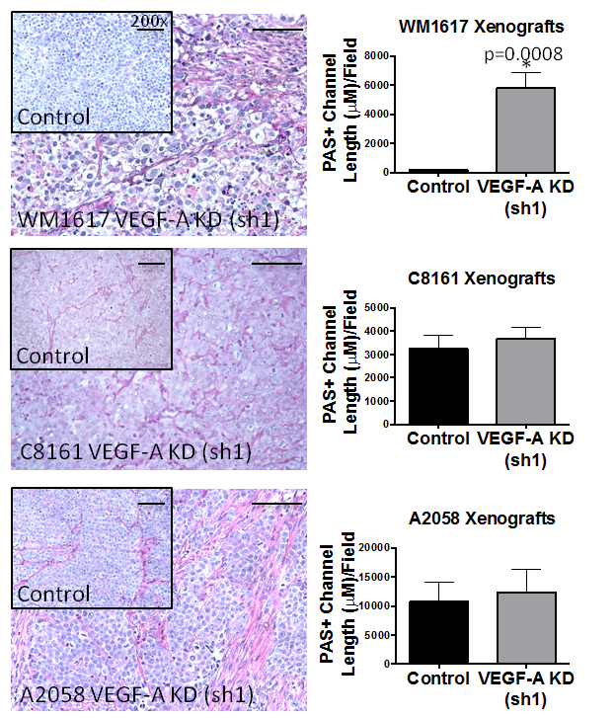
Figure S4. VEGF-A KD modulates VM formation in WM1617 melanoma xenografts.

