Slide 1
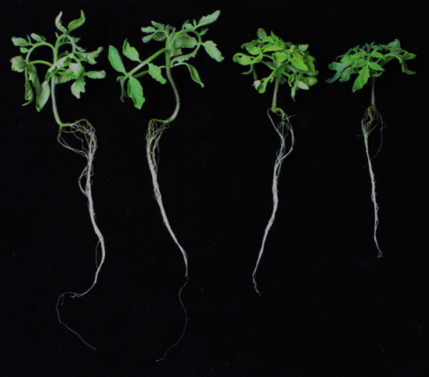
SALT STRESS
young leaf
old leaf
roots
SlIPT1, SlIPT2
SlCKX4, SlCKX5
8 h
8 h
4 h
SlIPT4
2 h
4 h
4 h
SALT STRESS
SlIPT3
SlIPT4
35S::SlIPT3
CKs
(CK-N-glucosides)
8 h
4 h
35S::SlIPT3
WT
SlARR4
1h
+ tZ
SlARR1
SlARR12
SlIPT6, SlARR4
Additional file 8. Hypothetical scheme of SlIPT3 and SlIPT4 response to early salt stress and the feedback regulation by exogenous CK treatment in tomato plants. After salt stress (150 mM NaCl) treatment, immediate downregulation of SlIPT3 and SlIPT4 transcripts with a subsequent upregulation in tomato vegetative organs was determined. Repression of both genes after exogenous application of tZ demostarted the complexity of CK networks, while overabundance of CKs (especially iP7G) in 35S::SlIPT3 may ensure stronger phenotype under salt stress (100 mM NaCl) conditions.

