Slide 1
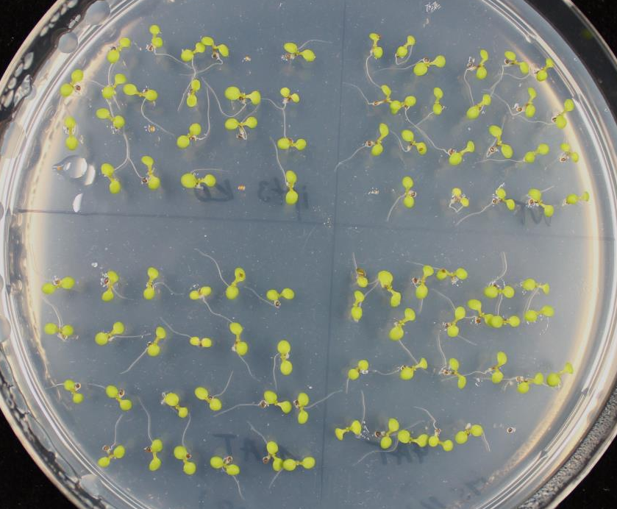
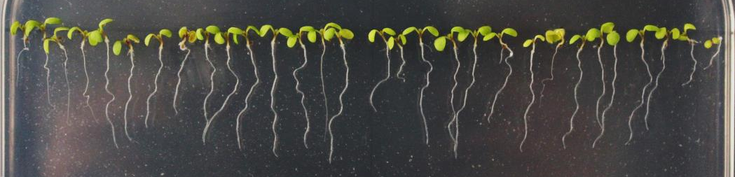
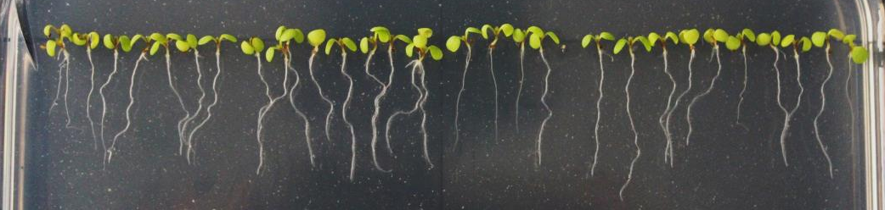
ipt3 KO
WT
ipt3 KO
WT
Comp SlIPT3
Comp SlIPT4
Comp SlIPT3
Comp SlIPT4
Additional 1. Phenotype of 5 DAS Arabidopsis ipt3 KO complemented plants cultivated on control (MS) medium.
Notes:
1

