Slide 1
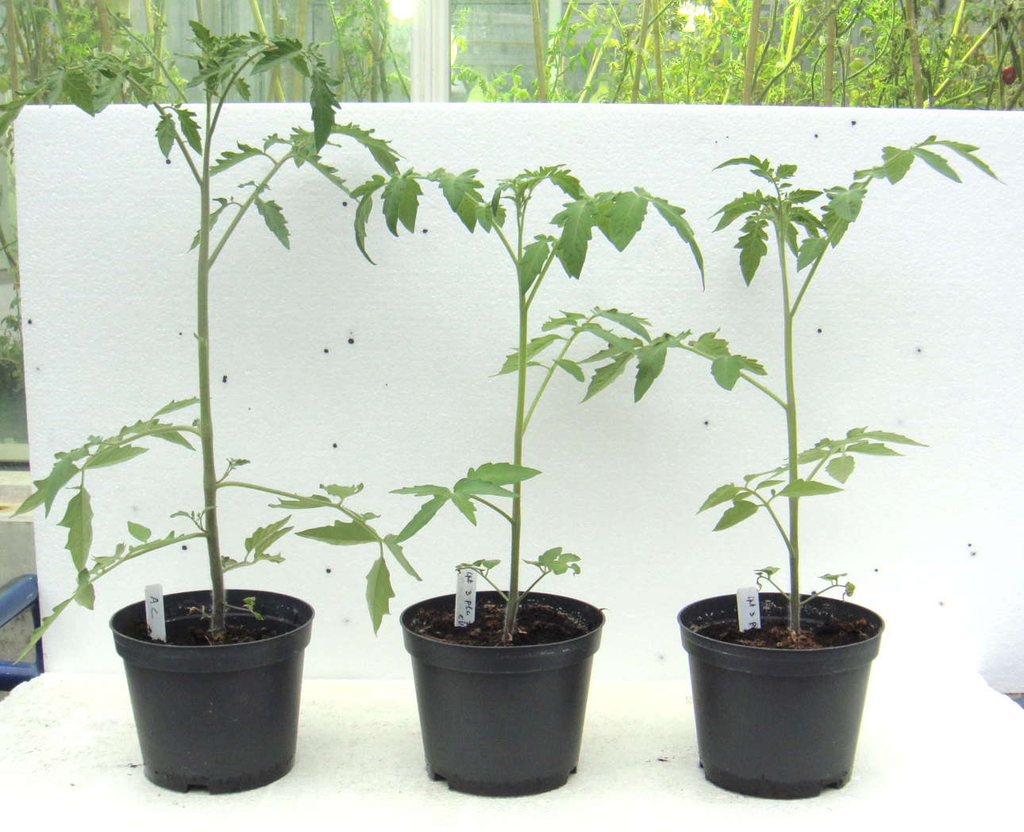
WT
35S::SlIPT3 (L1)
Additional file 4. Phenotype of T1-generation tomato 35S::SlIPT3 (L1) transformants.

