Slide 1
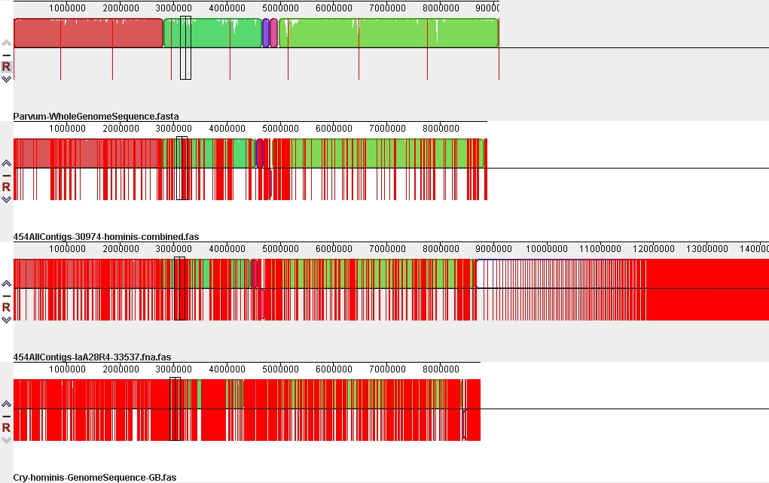
Fig S1
1
2
3
4
5
6
7
8
Published C. parvum Iowa
C. hominis IbA10G2 (30974)
C. hominis IaA28R4 (33537)
Published C. hominis IaA25R3 (TU502)

