Slide 1
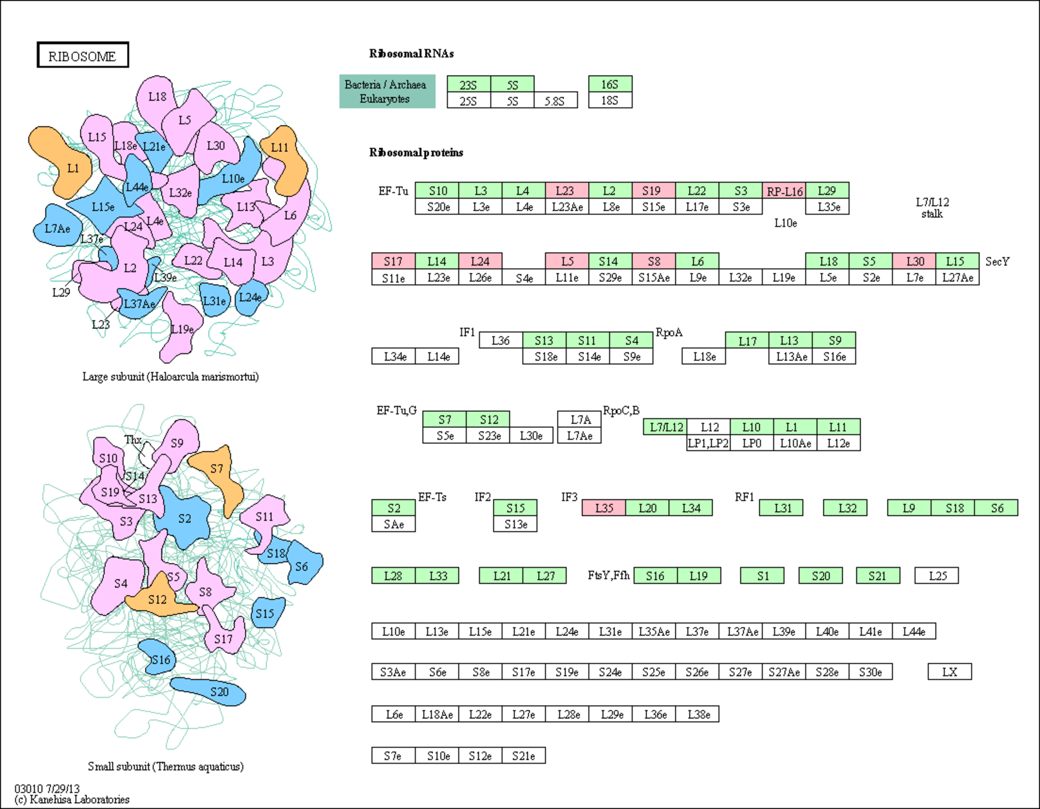
rplW
rpsS
rplP
rpsQ
rplX
rplE
rpsH
rpmD
rpmI

