Slide 1
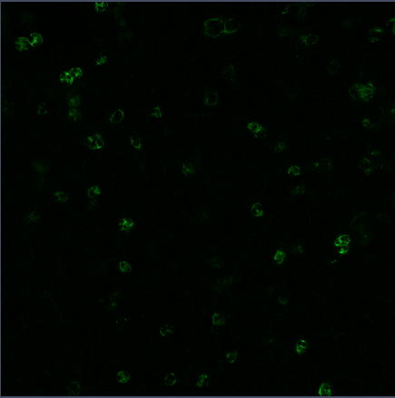
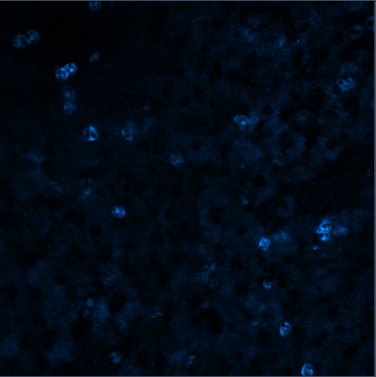
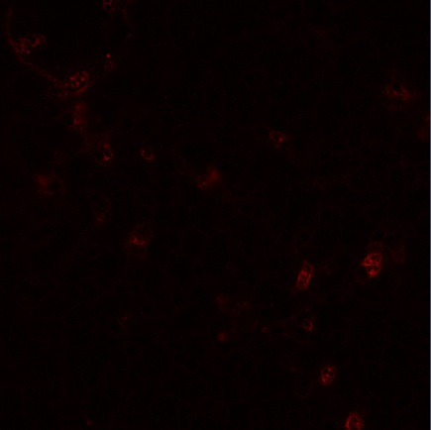
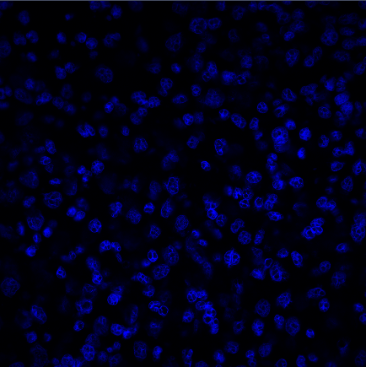
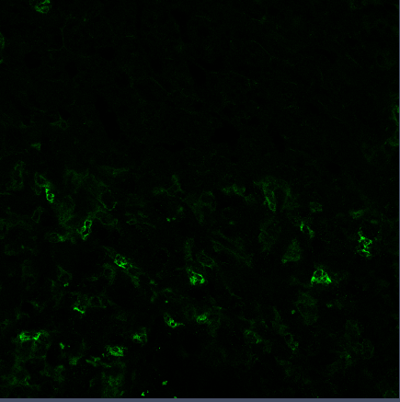
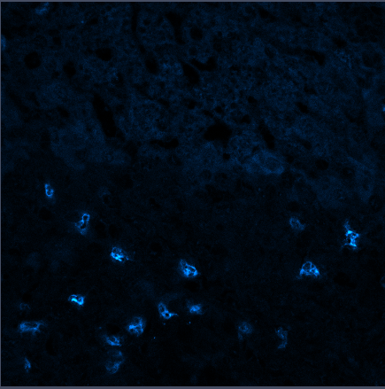
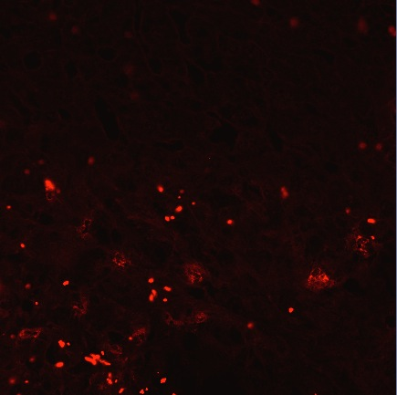
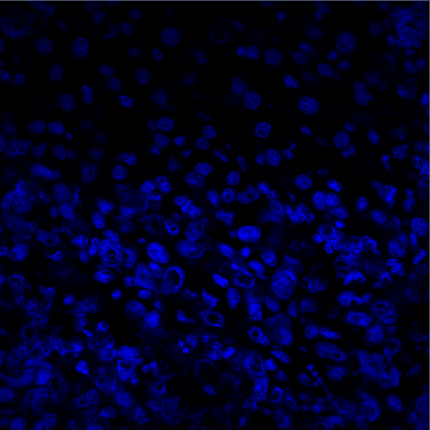
D14
Cd11b
Ly-6G
MMP9
DAPI
Distal Liver Tissue
Distal
Liver Tissue
Invasive Front
Lesion
Tabariès et al., 2015 – Additional File 5
Notes:
Distal: D7-3 distal-2
Invasive front: D7-6 tum1

