Slide 1
Supplemental Figure 1.
Follow-up study of PFKFB2
Whole-genome sequence data of 234 Pima Indians identified 13 tag SNPs in/near PFKFB2 (mAF≥0.01; r²>0.8)
Genotyping of tag SNPs in American Indians from the GRIC with longitudinal data
(13 tags analyzed in full-heritage Pima; 8 tags analyzed in all subjects)
Association analyses in American Indians from the Gila River
Indian Community (GRIC)
Full heritage Pima Indians
Maximum BMI (n=3412; age>15 years)
Maximum BMI z-score (n=2296; age= 5-20 years)
T2D (n=3625)
DN (n= 1610)
Association analyses in urban American Indians being recruited for a cross-sectional study of T2D and DN
T2D (n=3106)
DN (n=864)
Replication of 2 tags
Mixed heritage American Indians
Max BMI (n=3427; age>15 years)
Maximum BMI z-score (n=3054; age= 5-20 years)
T2D (n=4085)
DN (n= 842)
13 tags analyzed in
inpatient American Indians
13 tags analyzed for eQTL
Association analyses with metabolic traits
Body composition (n=555)
Hyperinsulinemic, euglycemic clamp (n=555)
Respiratory chamber (n=423)
Acute insulin response (n=298, full-heritage NGT)
Ad libitum food intake (n=194 including 48 Caucasians)
Association analyses of SNPs with PFKFB2 expression
Adipose tissue biopsies (n=201, all have data on % fat and BMI)
Kidney tissue biopsies (n=61)

Slide 2
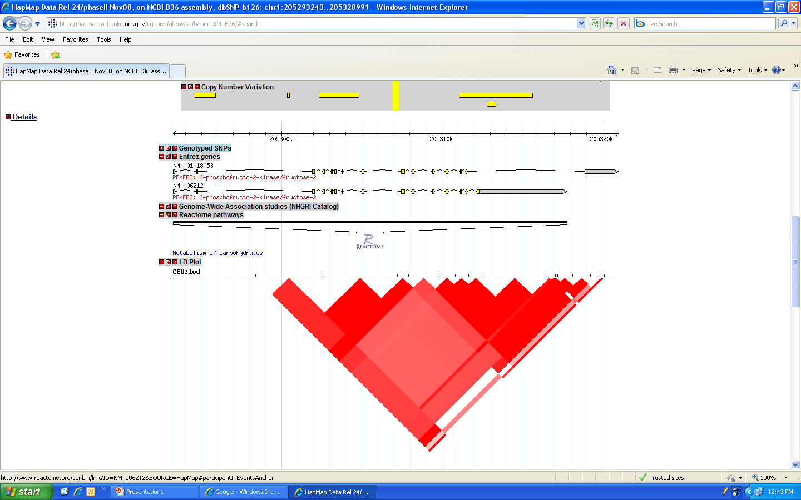
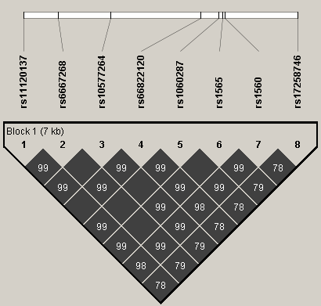
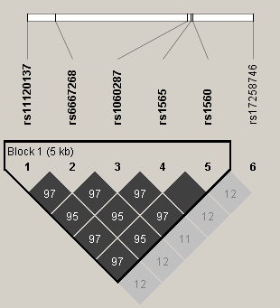
Supplemental Figure 2.
a.
b.
PFKFB2
3’UTR
3’UTR
PFKFB2
3’UTR
3’UTR
*
*
*
*
Pima (r²)
Caucasian (r²)

Slide 3
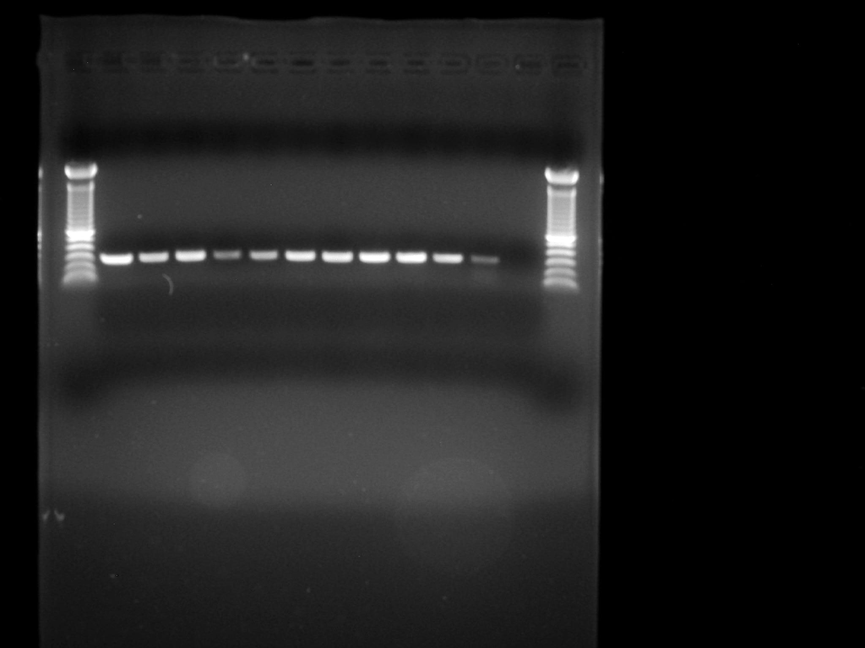
Supplemental Figure 3.
Heart
Brain
Lung
Liver
Muscle
Islet
Adipose
Placenta
Kidney
Negative
Pancreas
Hypothalamus

