Slide 1
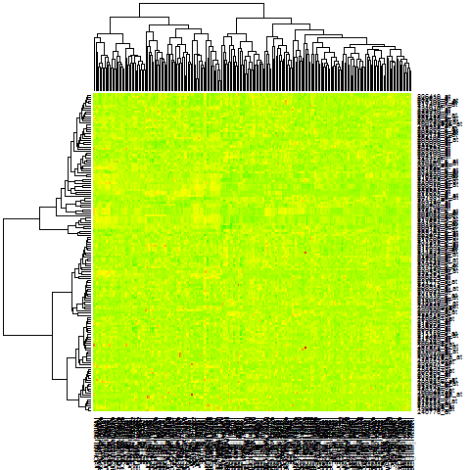
Tumors
4
5
1
2
3
Groups:
NRs
Sup. Fig.1

Slide 2
MDA-MB-453
DOX (ug/ml)
1.25
DMSO
2.5
5
**
TRβ
*
MTT Fold Change
**
**
GAPDH
Sup. Fig.2

Slide 3
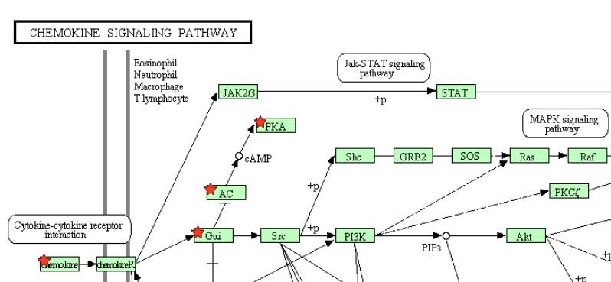
Sup. Fig.3

Slide 4
HCC2185
EV
SH
C H89 D D+H C H89 D D+H
TRβ
pPKA
PKA
Cleaved-Caspase3
Caspase3
GAPDH
Sup. Fig.4

Slide 5
A
HCC202 EV
**
**
**
***
**
**
***
***
*
***
***
NS
Renilla Luciferase / β-Gal
B
HCC202 SH
NS
Renilla Luciferase / β-Gal
Sup. Fig.5

Slide 6
A
HCC202
GC-1 (nM) | - | 0.1 | 1 | 10 | - | - | -
KB-141 (nM) | - | - | - | - | 0.1 | 1 | 10
TRβ
GAPDH
B
***
MTT Fold Change
***
C
MTT Fold Change
*
Sup. Fig.6

