Slide 1

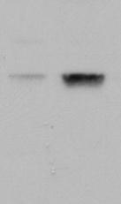



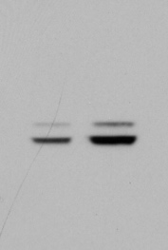
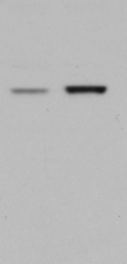
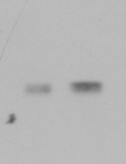
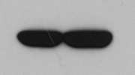

Guarnerio et al. Supplementary Fig. S1
A
B
20% O₂
1% O₂
+doxorubicin
c-myc
kDa
CTR
100
Hsp90
75
75
DAPI γH2AX
DAPI γH2AX
DAPI γH2AX
50
c-myc
37
C
D
IDH2^{R172K}
E
shPten
K-Ras^{G12V}
CTR
CTR
kDa
CTR
kDa
kDa
100
Hsp90
100
Hsp90
100
Hsp90
75
75
75
75
75
75
50
p-ERK1/2
50
IDH2
50
Pten
37
37
37
25
37
25
k-Ras
20
F
shPml
G
15
CTR
shLrf
kDa
kDa
CTR
50
β-actin
100
Hsp90
37
75
75
Lrf
150
50
100
Pml
37
75

Slide 2

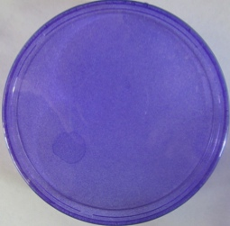
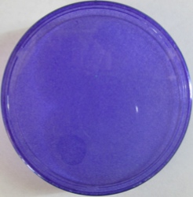

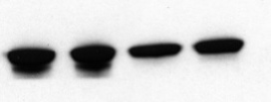
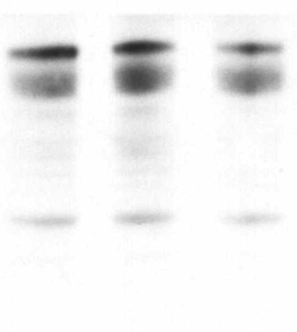
Guarnerio et al. Supplementary Fig. S2
A
BM-MSCs
CD45-Ter119-CD31-
PDGFRα+Sca1+
p53^{KO}Zbtb7a^{F/F}
p53^{KO} Zbtb7a^{F/F}
CRE
CTR
1% oxygen
kDa
+ LV-CTR
p53^{KO} Zbtb7a^{F/F} -CTR
75
Lrf
100
Hsp90
+ LV-CRE
p53^{KO} Zbtb7a^{F/F} -CRE
75
B
C
p53^{KO} Lrf^{+/+}
CTR
CRE
D
p53^{KO}Zbtb7a^{F/F}
E
Before transplant
After transplant
CRE
CRE
CTR
CTR
kDa
75
Lrf
100
Hsp90
75
F
hMSCs
adipocytes differentiation
shSCR(1)
shLRF(1)
kDa
day0
day2
day8
shSCR(2)
shLRF(2)
100
kDa
75
HSP90
100
HSP90
75
75
LRF
75
LRF
50
37

Slide 3
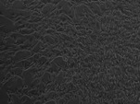
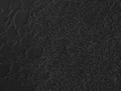


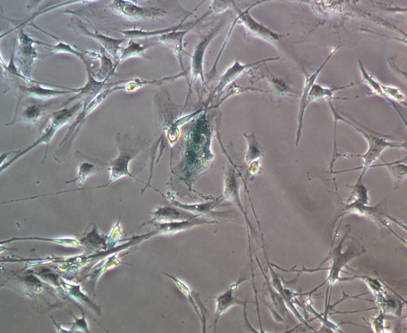
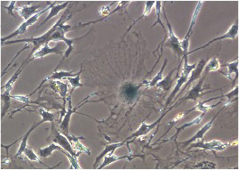
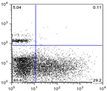
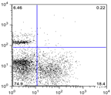
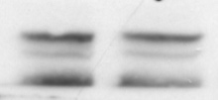

Guarnerio et al. Supplementary Fig. S3
A
Zbtb7a^{F/F}
Transduction with Lentiviral vectors:
LV-CTR and LV-CRE
Osteoblasts (20 days)
ALP staining
kDa
CTR
CRE
BM-MSCs
CD45-Ter119-CD31-
PDGFRα+Sca1+
Chondrocytes (20 days) Tuluidine Blue staining
75
Lrf
CTR-cells
CRE-cells
Adipocytes (7 days) Oil-Red-O staining
100
Hsp90
75
B
CTR-cells
CRE-cells
CFU-F
10x
10x
C
CTR-cells
CRE-cells
D
CTR-cells
CRE-cells
E
CTR
CRE
kDa
0,11%
0,22%
75
Lrf
Annexin-V
100
c-PARP
75
50
β-actin
GFP
37

Slide 4
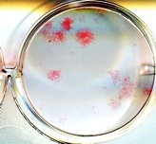
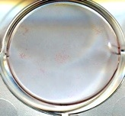
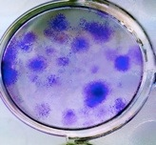
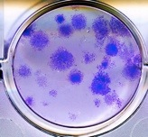
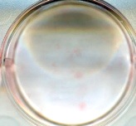
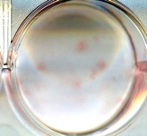
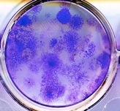
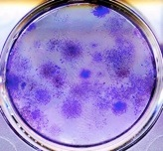
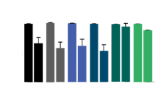
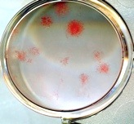
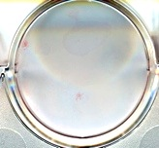
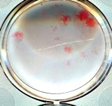
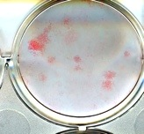
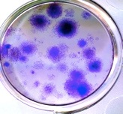
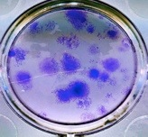
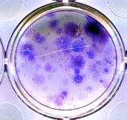
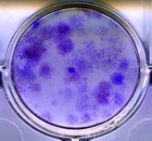
Guarnerio et al. Supplementary Fig. S4
A
B
CTR-
shSCR
CRE-
shSCR
CRE- shSox9
CRE-shSCR
CTR-shSCR
kDa
100
Hsp90
75
75
Sox9
CRE-
shSox9(2)
CRE-
shSox9(3)
C
D
*
*
*
*
Mouse Dlk1
⧫
100
⧫
⧫
⧫
⧫
⧫
-1.5Kb
+1
-3Kb
75
Relative Luciferase activity
⧫
mut1AB
⧫
⧫
⧫
50
mut2
⧫
⧫
⧫
⧫
⧫
mut3
25
⧫
⧫
⧫
⧫
⧫
mut4
0
⧫
⧫
⧫
⧫
⧫
mut5
Lrf
- +
- +
- +
- +
- +
- +
⧫
⧫
⧫
⧫
E
⧫
Dlk-1
WT
mut1AB
mut2
mut3
mut4
mut5
CTR-
shSCR
CRE-
shSCR
CRE-
shDlk1(2)
CRE-
shDlk1(3)
F

Slide 5

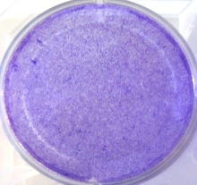
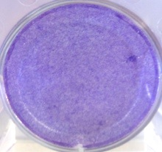
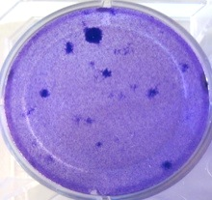
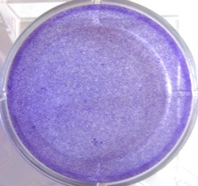
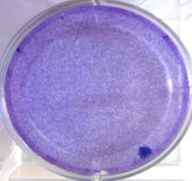
Guarnerio et al. Supplementary Fig. S5
A
p53^{KO}Zbtb7a^{F/F}-cells
B
p53^{KO}Zbtb7a^{F/F}-cells
1st recipient
CTR-shSox9
CRE-shSox9
CTR-shDlk1
CRE-shDlk1
CTR-shSCR
CRE-shSCR
kDa
75
Lrf
75
CTR-shCTR
CRE-shSCR
CRE-shDlk1
CRE-shSOX9
Sox9
100
Hsp90
75
C
CRE-
shDlk1(2)
CRE-
shDlk1(3)
CRE-
shSCR
CRE-
shSox9(2)
CRE-
shSox9(3)

