Slide 1
Figure S1, Additional file 2
Figure 1A | Figure 1B | Figure 1C | Figure 2A | Figure 2B
K562 | Gm12878 HeLa-S3 HepG2 K562 MCF7 | Gm12878 HeLa-S3 HepG2 K562 | K562 MCF7 | H1 hESC K562

Slide 2
Figure S2, Additional file 2

Slide 3
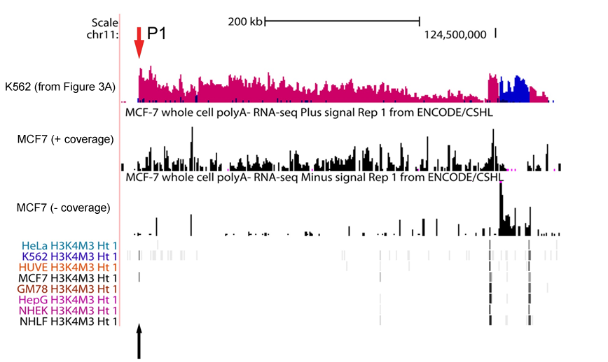
Figure S3, Additional file 2

