Slide 1
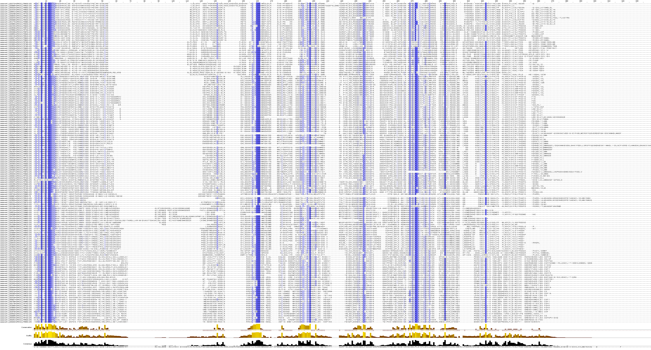
P-loop
Kinase-2
kinase-3
GLPLA
Additional file 5.- NBS multiple alignment and subdomain conservation
A subset of CNL and TNL NBS domains were aligned to show the conserved subdomains; p-loop, kinase-2, kinase-3 and GLPLA. A diagnostic site (red arrow) previously reported (Lopez et. al 2003) presents a W (Tryptophan) for most CNL genes and a D (Aspartic acid) for most TNL. More evident variations like the region before the kinase-2 region were captured by the phylogenetic trees to separate the two groups.
CNL
TNL

