Slide 1
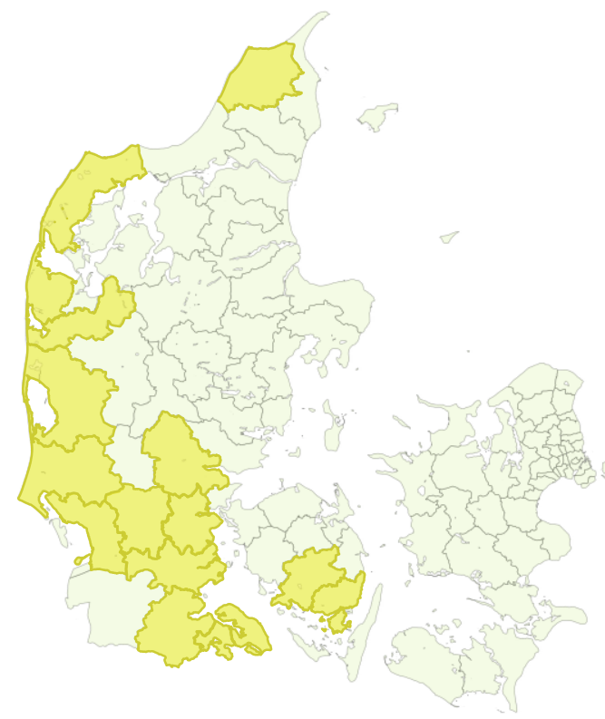
Supplemental Figure. Map of Denmark (excluding the island of Bornholm) displaying areas of tick sampling by municipality indicated by the numbers 1—15.
For cross-reference, please see the Supplementary Table.
1
2
3
4
5
6
9
7
8
10
11
14
15
12
13

