Slide 1
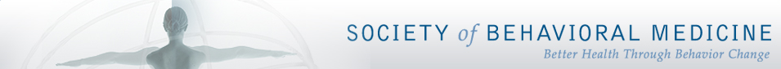
The RELEVANCE, IMPACT, AND REACH OF BEHAVIORAL MEDICINE
Dawn K. Wilson, Ph.D.
President of the Society of Behavioral Medicine
Professor of Psychology
University of South Carolina
Notes:
HI

Slide 2


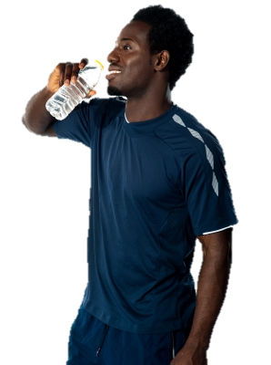

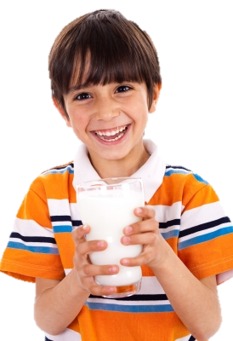
BEHAVIOR MATTERS

Slide 3

“THE PART CAN NEVER BE WELL UNLESS THE WHOLE IS WELL.”
PLATO

Slide 4
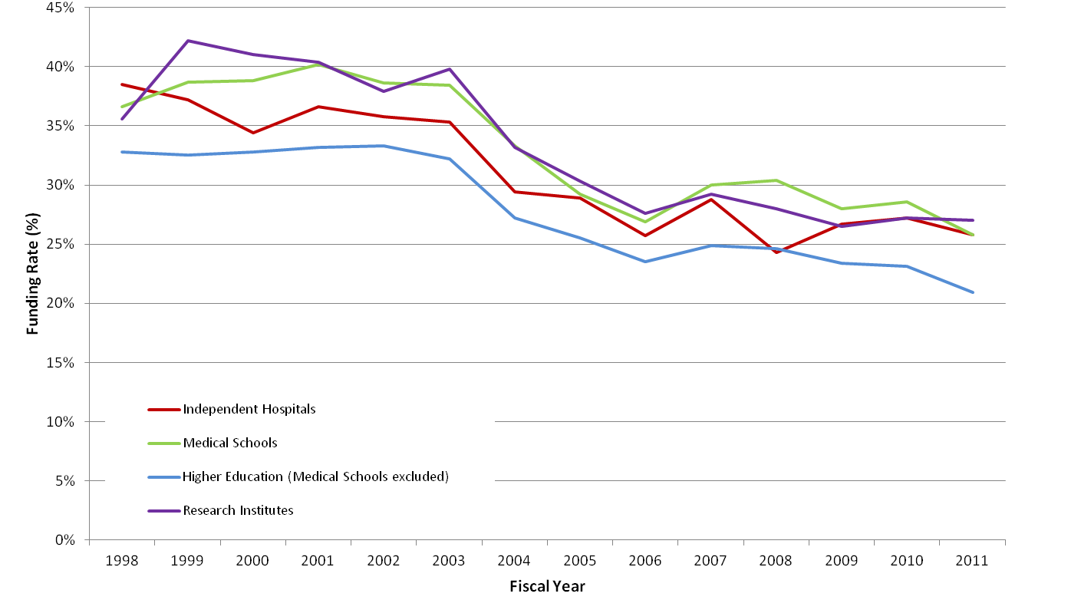
FUNDING CLIMATE
NIH Funding by Type of Organization for Principal Investigators with PhD Degree
*
*Percentage of applicants awarded per fiscal year

Slide 5
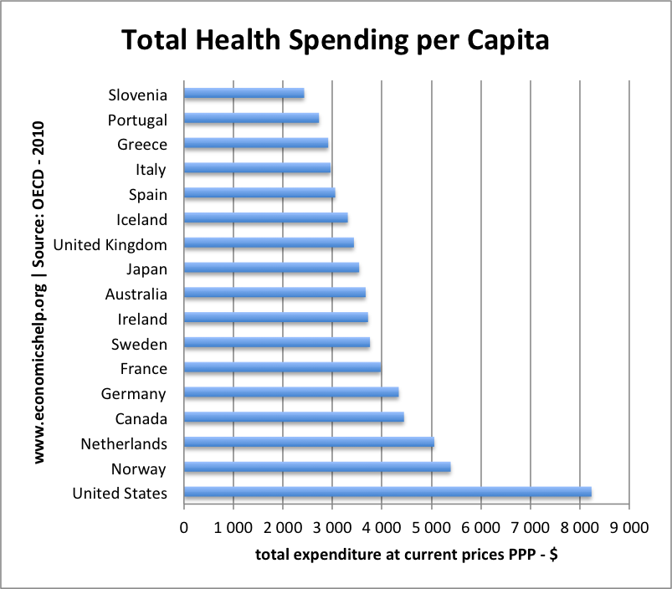
HealthCare Spending per capita
Source: Organization for Economic Cooperation and Development, Paris, France; PPP = Per Capita Expenditure
Notes:
This graph shows total health care expenditure (including both public and private spending). The biggest spender by a long way is the US, which spends over $8,000 per capita. This compares to less than $3,000 per capita for Italy, Greece and Portugal.

Slide 6
Mortality, Weight Status, and Lifestyle
Matheson et al. (2012). Journal of the American Board of Family Medicine

Slide 7
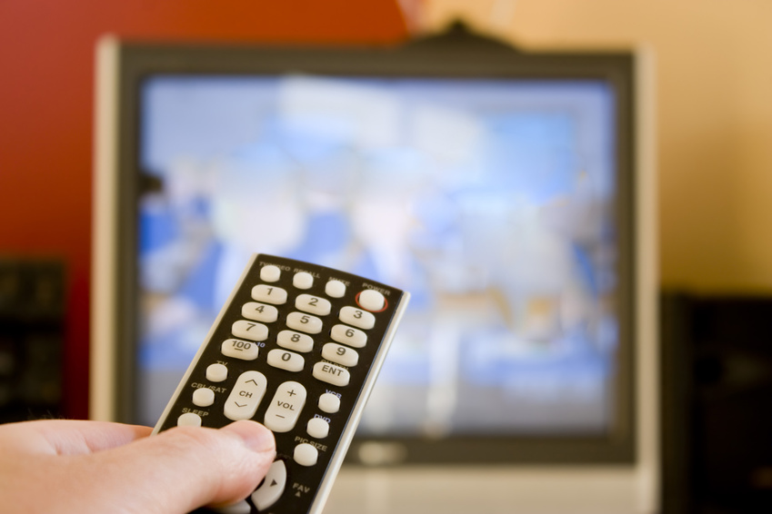
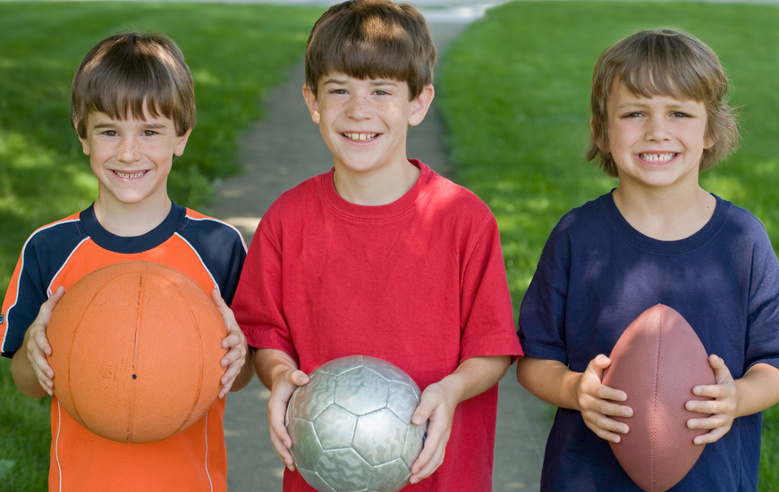
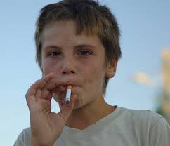
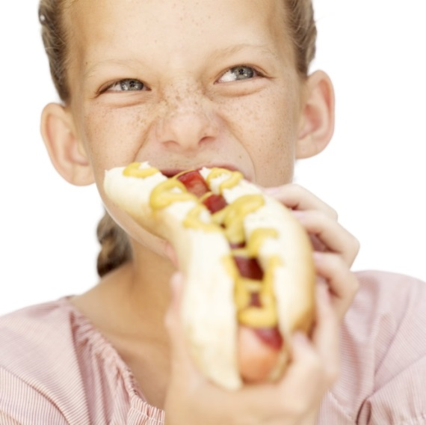
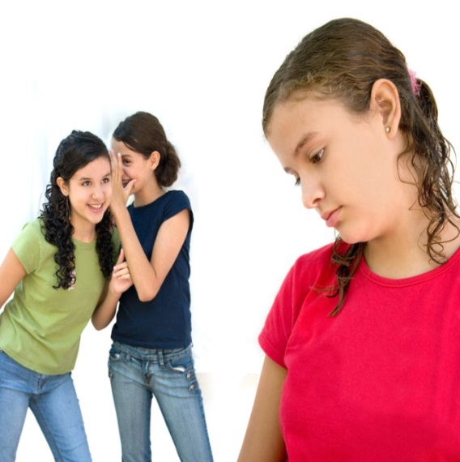
Health behavior Clustering in Youth
PHYSICAL
ACTIVITY
SEDENTARY
BEHAVIOR
RISKY BEHAVIORS
HEALTH
BEHAVIORS
MENTAL HEALTH
DIET
Giannakopoulos et al. (2008). Child: Care Health and Development; Leech et al. (2014). IJBNPA; Mistry et al. (2009). Preventive Medicine;
Paxton et al. (2007). American Journal of Health Behaviors

Slide 8

HEALTH BEHAVIORS AND LIFE SATISFACTION
LIFE SATISFACTION
Limiting fat intake
17,246 Students (17–30 yrs)
21 Countries
Not smoking
Eating fruit
Using sun
protection
Physical activity
Grant et al. (2009). International Journal of Behavioral Medicine

Slide 9
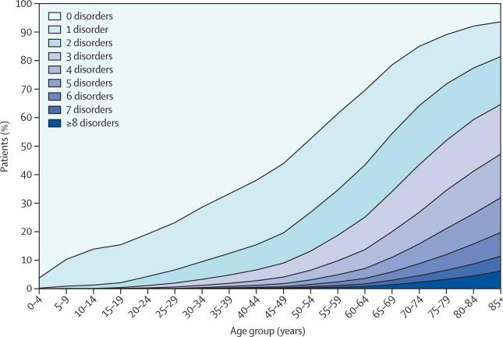
MULTIMORBIDITY BY AGE
Barnett et al. (2012). The Lancet

Slide 10
FRAMEWORK FOR POSITIVE BEHAVIORAL AND PSYCHOLOGICAL DEVELOPMENT
Minimize toxic conditions
Teach, promote, and richly reinforce prosociality
Positive Development
Promote mindful psychological flexibility
Monitor and limit opportunities for problem behavior
Biglan et al. (2012). American Psychologist

Slide 11



SYSTEMS APPROACH
Educational System
Recreational
Facilities
Media
Healthcare Clinics
Community Centers
Social
Support
Parenting
Individual
Genetics
Efficacy
Motivation
Optimism
Skills
Policy
Schools
Family
Peers
Role Models
Teachers
Healthcare Providers
Churches
Neighborhood
Workplace
Built Environment
Culture
Government Agencies
Bronfenbrenner (1979, 2006)

Slide 12
Mechanisms for nurturing environments
Autonomy Supportive vs.
Controlling Health Care Climate
Mental Health
Less Depression
Less Somatization
Less Anxiety
Quality of Life
Needs Satisfaction of
Autonomy
Competence
Relatedness
Personality Differences in Autonomy
Physical Health
Not Smoking
Exercising
Weight Loss
Glycemic Control
Healthier Diet
Dental Hygiene
Intrinsic vs.
Extrinsic Life Aspirations
Ng et al. (2012). Perspectives on Psychological Science

Slide 13
behavior change Wheel
Sources of behavior
Intervention functions
Policy Categories
Environmental/
Social planning
Guidelines
Restrictions
Education
Persuasion
Environment
CAPABILITY
OPPORTUNITY
Communication/
Marketing
Physical
Social
Fiscal measures
Psychological
Physical
Incentivization
Automatic
Reflective
Modeling
MOTIVATION
Legislation
Enablement
Coercion
Regulation
Training
Service provision
Michie et al. (2011). Implementation Science

Slide 14


Slide 15



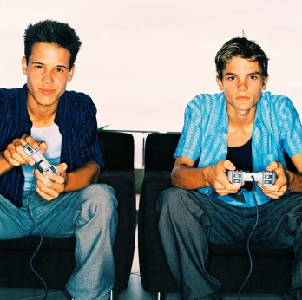
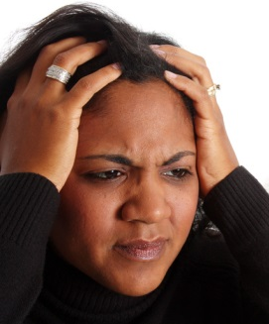
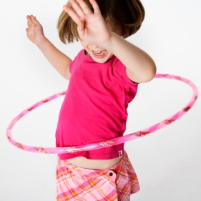

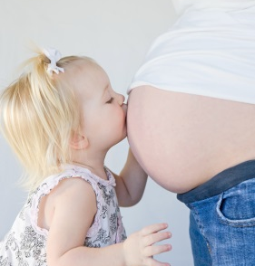
Behavior Matters Across the Lifespan
Dawn K. Wilson, Ph.D., President, Society of Behavioral Medicine (2014)

Slide 16


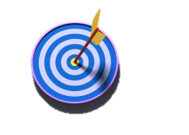
Changing Behavior in the early years
Behavioral skills
Family engagement
↓SEDENTARY BEHAVIOR
Energy intake
Meals in front of the TV
BMI, triceps skinfold, waist circumference, & waist-to-hip ratio
Epstein et al. (2008). Arch Pediatric Adolescent Medicine; Robinson (2001). JAMA

Slide 17
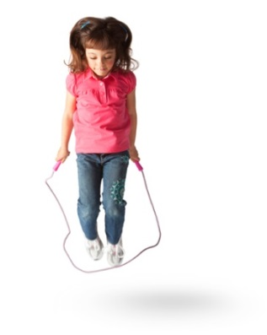
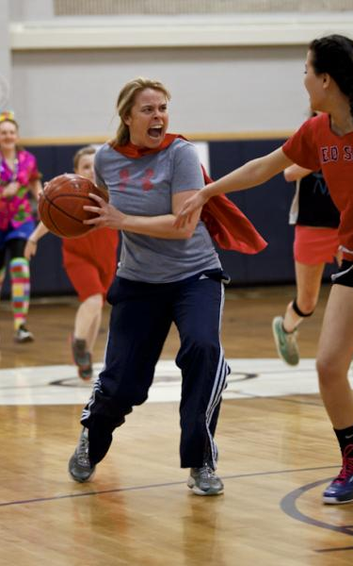
PHYSICAL ACTIVITY AND ACADEMIC OUTCOMES
Laboratory Settings
↑ PHYSICAL ACTIVITY
Academic performance
Memory, attention
Planning, decision making
Behavioral skills
Reinforcement
School-Based Interventions
↑ PHYSICAL
ACTIVITY
Academic performance
BMI
Behavioral skills
Teacher Support
*p < 0.01
*
Davis et al. (2011). Health Psychology; Donnelly et al. (2009). Preventive Medicine; Hillman et al. (2009). Neuroscience

Slide 18
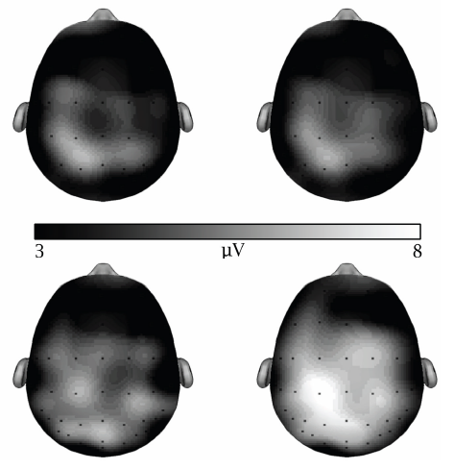
PHYSICAL ACTIVITY AND COGNITIVE FUNCTIONING
CONGRUENT
INCONGRUENT
REST
EXERCISE
Hillman et al. (2009). Neuroscience

Slide 19

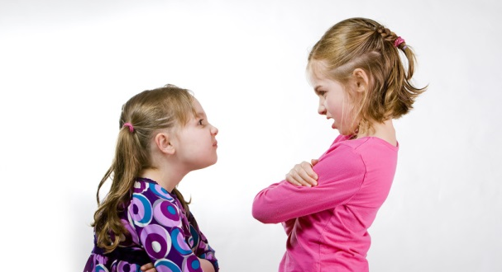
DRUG AND VIOLENCE PREVENTION
DRUG PREVENTION
VIOLENCE PREVENTION
Social/ personal competence skills
Anger management skills
Social resistance skills
Violence and the media
Conflict resolution skills
↓ SMOKING, ALCOHOL
INTAKE, ILLICIT DRUG USE
      Social norms
      Attitudes
      Self-esteem
↓ VERBAL AND PHYSICAL AGRESSION
Delinquency
Botvin et al. (2003). Journal of Child & Adolescent Substance Abuse; Botvin & Griffin (2004). Journal of Primary Prevention;
Botvin et al. (2006). Prevention Science

Slide 20

RIPPLE EFFECTS OF DRUG PREVENTION
IndividualEffects
School Effects
**p < 0.01, *p < 0.05
Botvin et al. (2003). Journal of Child & Adolescent Substance Abuse

Slide 21

ARKANSAS SCHOOL POLICY
POLICIES
Lifetime physical activity
Certification of PE teachers
Prohibited junk foods
**p < 0.01, *p < 0.05
http://publichealth.uams.edu/research/publications-and-reports

Slide 22
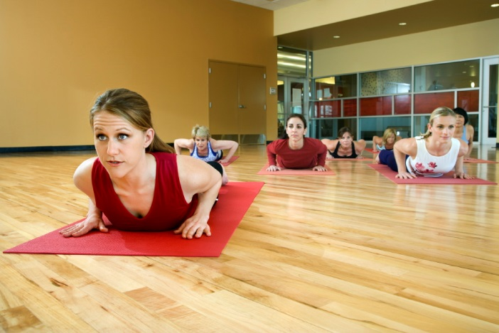
INTENTIONAL RIPPLE EFFECTS
Intervention
Self-Efficacy Healthy Eating
Fruit & Veg Intake
Self Efficacy Stress Mgmt
Relaxation Activities
Image-based behavioral counseling
B_{Mediated} =.07 (95% CI: .01-.18)
↓ ALCOHOL
↑ FRUIT & VEGETABLE INTAKE
↑ RELAXATION
ACTIVITIES
Fitness goal/ Health behavior contract
B_{Mediated} =.09 (95% CI: .03-.20)
Werch et al. (2007). Journal of Adolescent Health; Werch et al. (2010). Preventive Medicine.

Slide 23


MOTIVATIONAL INTERVENTION
Weight loss RCT
(n=239 women)
INTRINSIC MOTIVATION
PHYSICAL ACTIVITY
WEIGHT LOSS
Outcome | R²
Eating self-efficacy | .27
Eating restraint | .17
Eating disinhibition | .16
External eating | .15
Emotional eating | .12
Eating self-regulation
Mata et al. (2009). Health Psychology

Slide 24
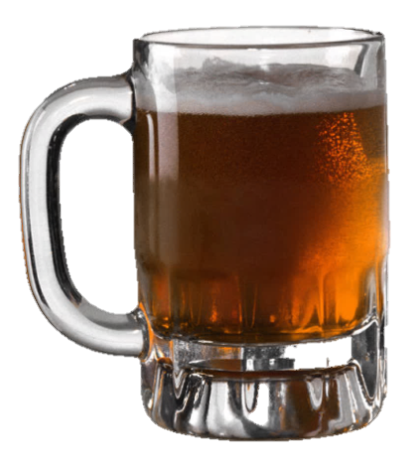


SMOKING AND ALCOHOL EFFECTS
Motivation
Behavioral
skills
↓SMOKING
Reduced Binge Drinking
Smoking Cessation RCT
African American light smokers (n=755)
Stahre et al. (2013). Journal of Addictive Diseases

Slide 25


RIPPLE EFFECTS ON UNTREATED SPOUSES
Untreated in the Women’s Health Trial (n=304)
↓ ENERGY & FAT INTAKE (p < 0.01) Wives’ attitudes & fat intake → husbands’ fat intake
*p < 0.05
Gorin et al. (2010). International Journal of Obesity; Shattuck, White, & Kristal (1992). American Journal of Public Health

Slide 26


PHYSICAL ACTIVITY AND MENTAL HEALTH
Behavioral intervention (n=401 overweight women)
PHYSICAL
ACTIVITY
DIET
Tailored on motivation
Support from health counselors
Kerr et al. (2008). Depression and Anxiety

Slide 27
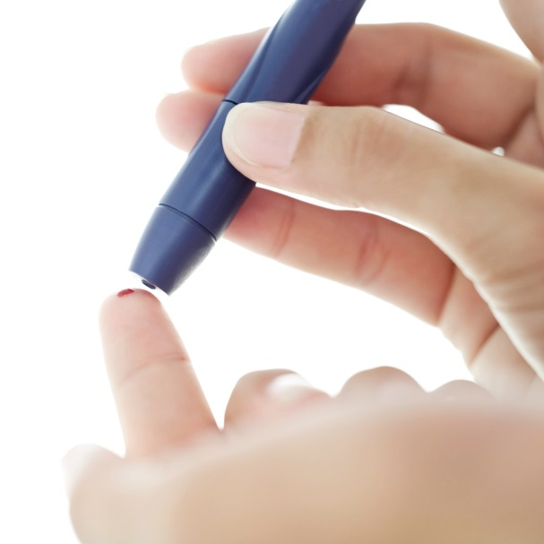
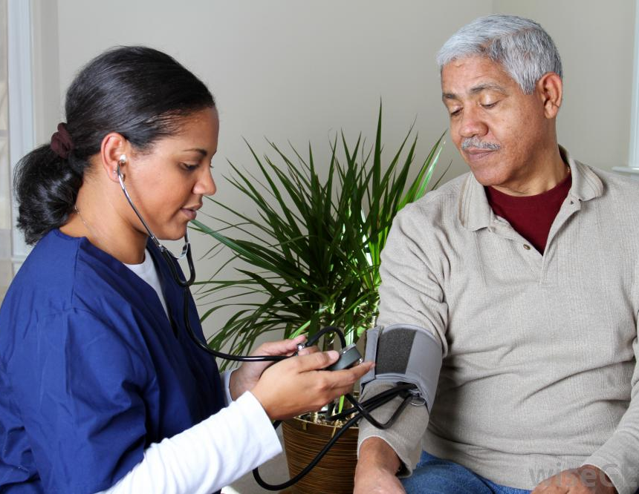

SELF-REGULATION AND CHRONIC
DISEASE OUTCOMES
46%
reduction in HbA1c over 2 years
RCT for improved HYPERTENSION
VA patients (n=216)
Nurse-delivered by phone for 24 months
Diet
Exercise
Smoking
Alcohol Use
MODULES:
Powers et al. (2009). American Journal of Medicine
Notes:
Check next to 46%

Slide 28

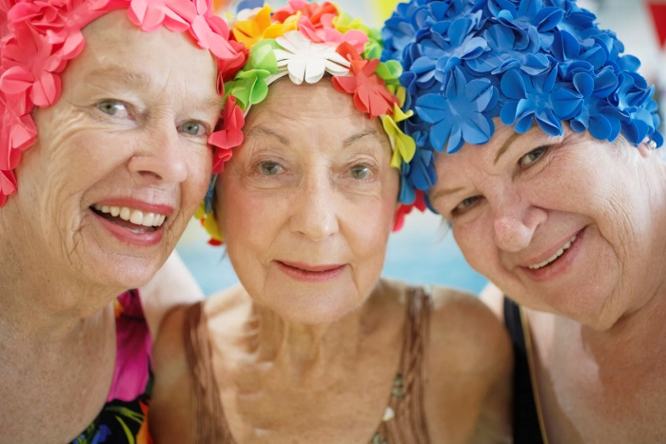
RIPPLE EFFECTS OF CHRONIC DISEASE
SELF-MANAGEMENT
Chronic Disease Self-Management Program
HEALTH STATUS
PHYSICAL ACTIVITY
STRETCHING EXERCISES
RELAXATION
COMMUNICATION WITH PHYSICIANS
SELF-EFFICACY
  Adults with chronic diseases (n=958)
Peer-led intervention
Physical health
Mental health
Behavioral skills
Skill mastery
Reinterpret symptoms
Modeling
Group persuasion
Healthcare
Utilization
Lorig et al. (2006). Medical Care; Lorig et al. (2012). Health Education and Behavior.

Slide 29


MECHANISMS FOR RIPPLE EFFECTS
COGNITIVE
SOCIAL

Slide 30

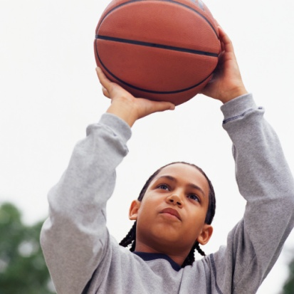



COGNITIVE MECHANISMS
Physical Health
Cognitive-Behavioral Skills
Domain-specific Cognitive Constructs
Global
Cognitive Constructs
Mental
Health
Annesi (2011). Psychological Reports; McPhie & Rawana (2012) Mental Health and Physical Activity;
Minnix et al. (2011) Nicotine and Tobacco Research; Surkan et al. (2012) Maternal and Child Health Journal

Slide 31
COGNITIVE MEDIATORS OF
Exercise-Depression Relationship
Authors | Design | Sample | Mediators
Dishman et al. (2006) | Cross-sectional | 1,250 adolescents | Physical Self-Concept Self-Esteem
Ryan (2008) | Cross-sectional | 376 undergraduates | PA Self-Efficacy Physical Self-Esteem Global Self-Esteem
Pickett et al. (2012) | Cross-sectional | 164 adults | PA Self-Efficacy
McPhie et al. (2012) | Prospective | 4204 adolescents | Self-Esteem
Petty et al. (2009) | Dose-Response, RCT | 207 adolescents | Physical Self-Worth Global Self-Worth
Notes:
Make this more spify

Slide 32
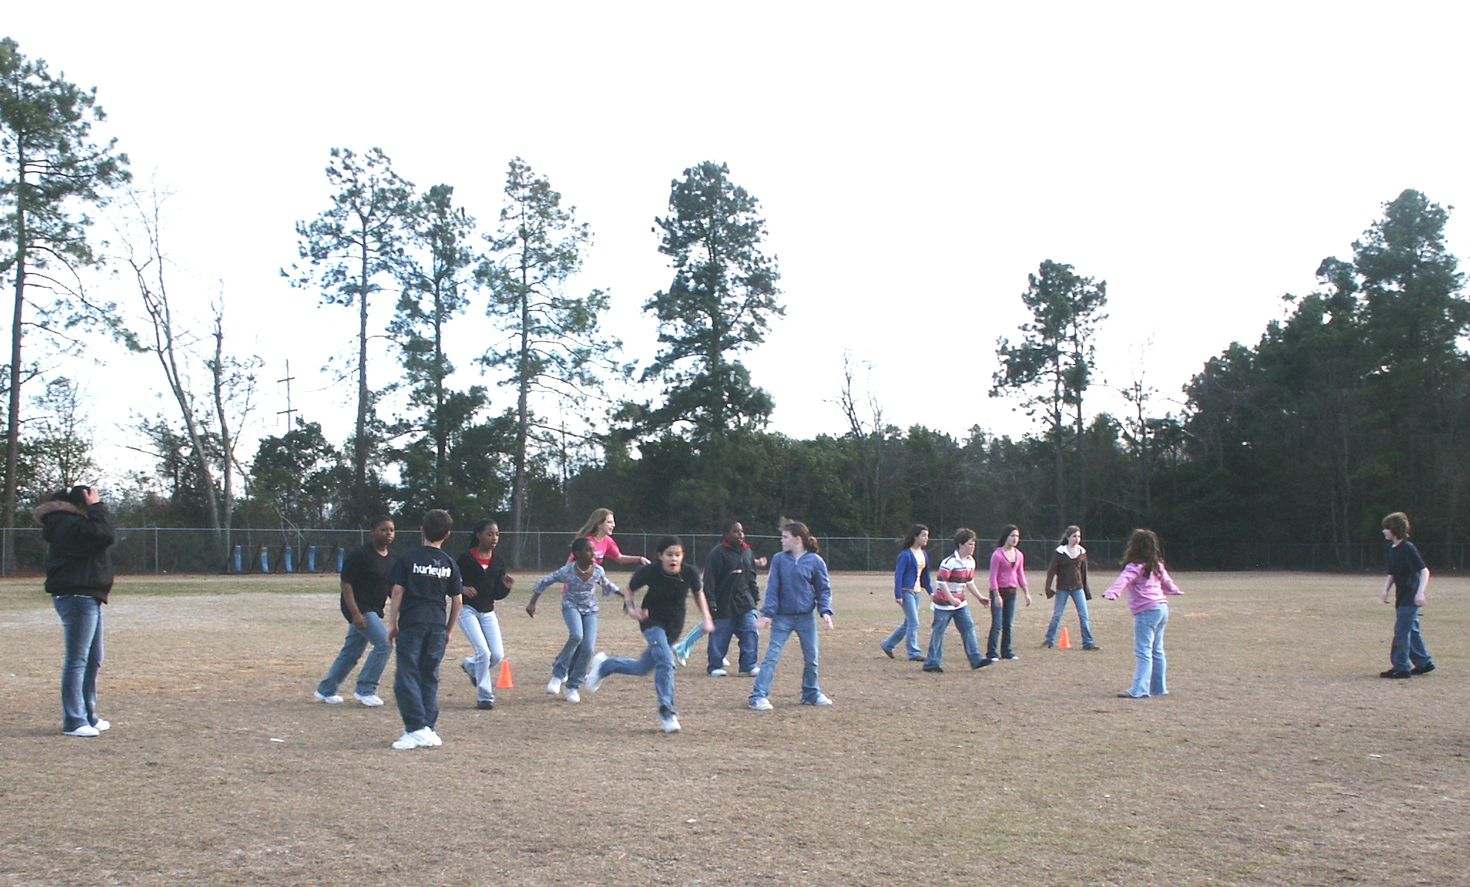
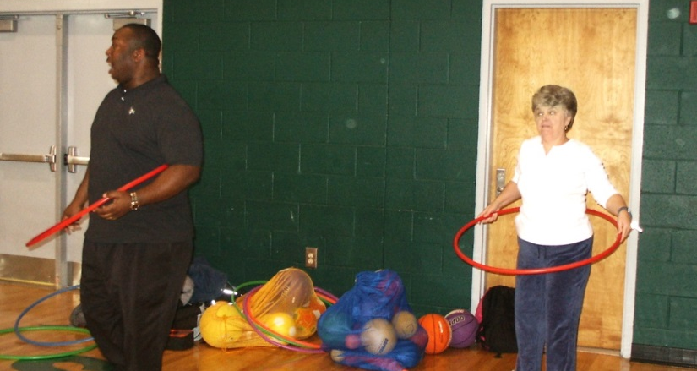
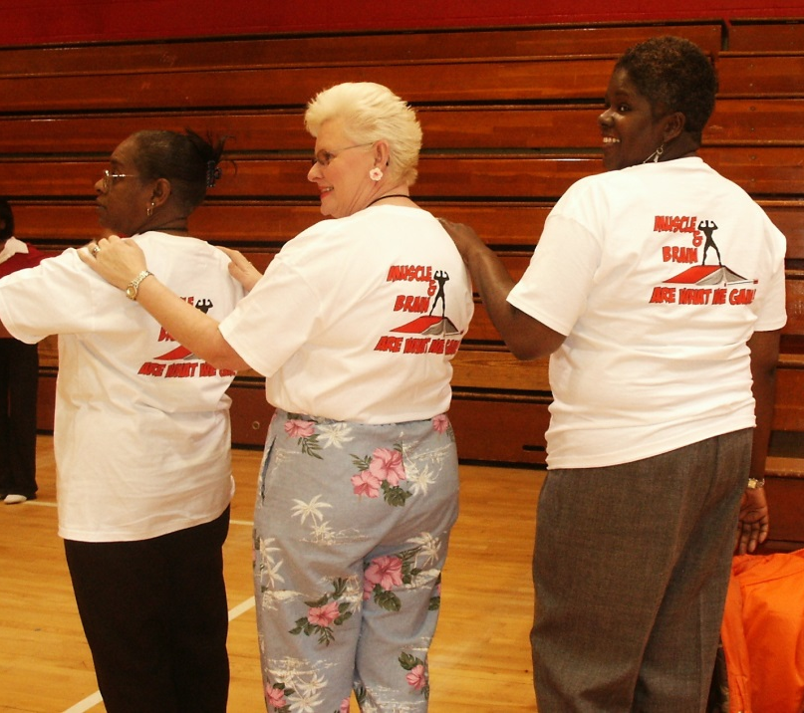
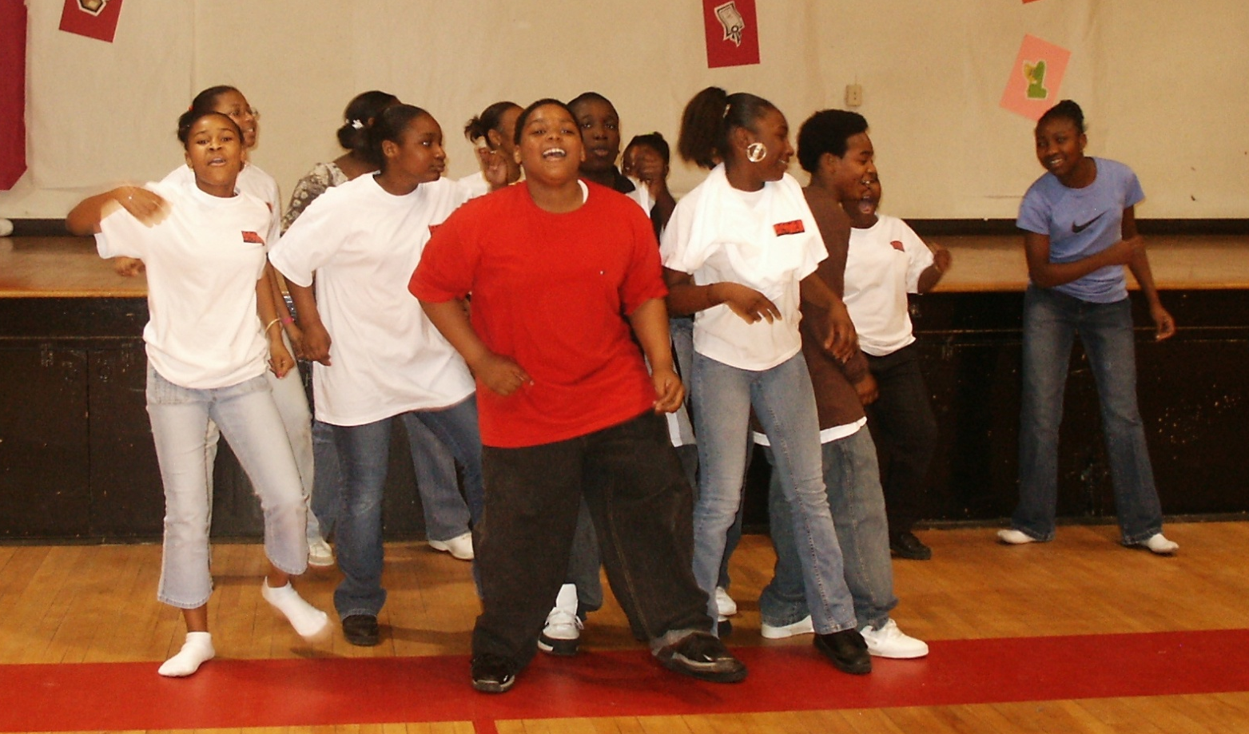
ACTIVE BY CHOICE TODAY (ACT)
Wilson et al. (2011). Health Psychology; Zarrett et al. (2012). Evaluation and Program Planning

Slide 33
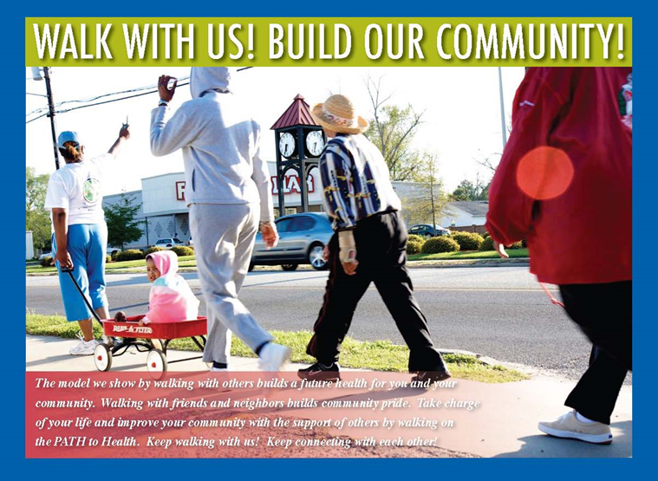
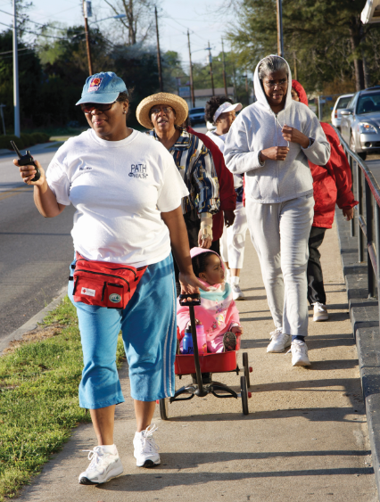


POSITIVE ACTION FOR TODAY’S HEALTH (PATH)
Wilson et al. (2013) Spatial and Spatio-temporal Epidemiology; Coulon et al. (2012). American Journal of Public Health;
Wilson et al. Annals of Behavioral Medicine (revised)

Slide 34


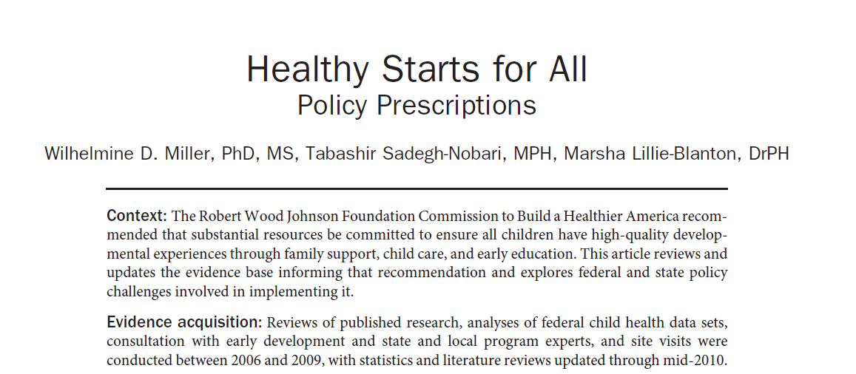

POLICY
Miller et al. (2011). American Journal of Preventive Medicine

Slide 35

NIH INSTITUTES
NCI
NEI
NHLBI
NHGRI
NIA
NIAAA
NIAID
NIAMS
NIBIB
NICHD
NIDCD
NIDCR
NIDDK
NIDA
NIEHS
NIGMS
NIMH
NIMHD
NINDS
NINR
NLM

Slide 36
IMPACT OF BEHAVIORAL INTERVENTIONS
COST SAVING
Intervention | NCPP | NBGH | Russell
Lifestyle Modification
Alcohol screening- counseling | Cost-saving | Cost-saving | Not included
Tobacco screening- prevention | Cost-saving | Cost-saving | Cost-effective
Counsel parents- motor vehicle safety | Cost-effective | Cost-saving | Not included
Goodell et al. (2009). Robert Wood Johnson Foundation Policy Brief

Slide 37

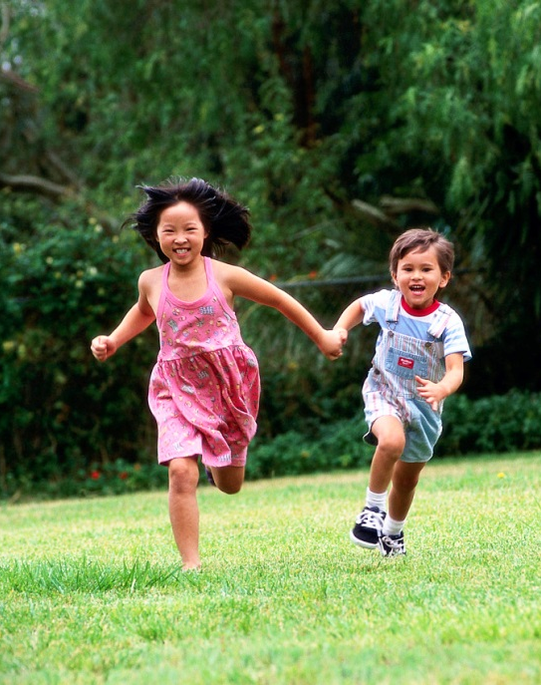
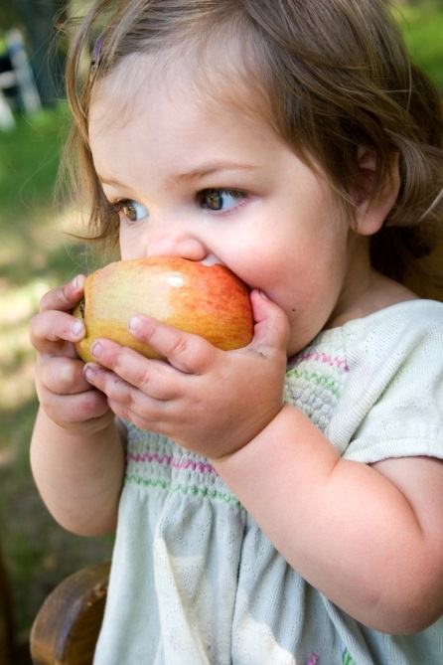


BEHAVIOR MATTERS

Slide 38
