Slide 1
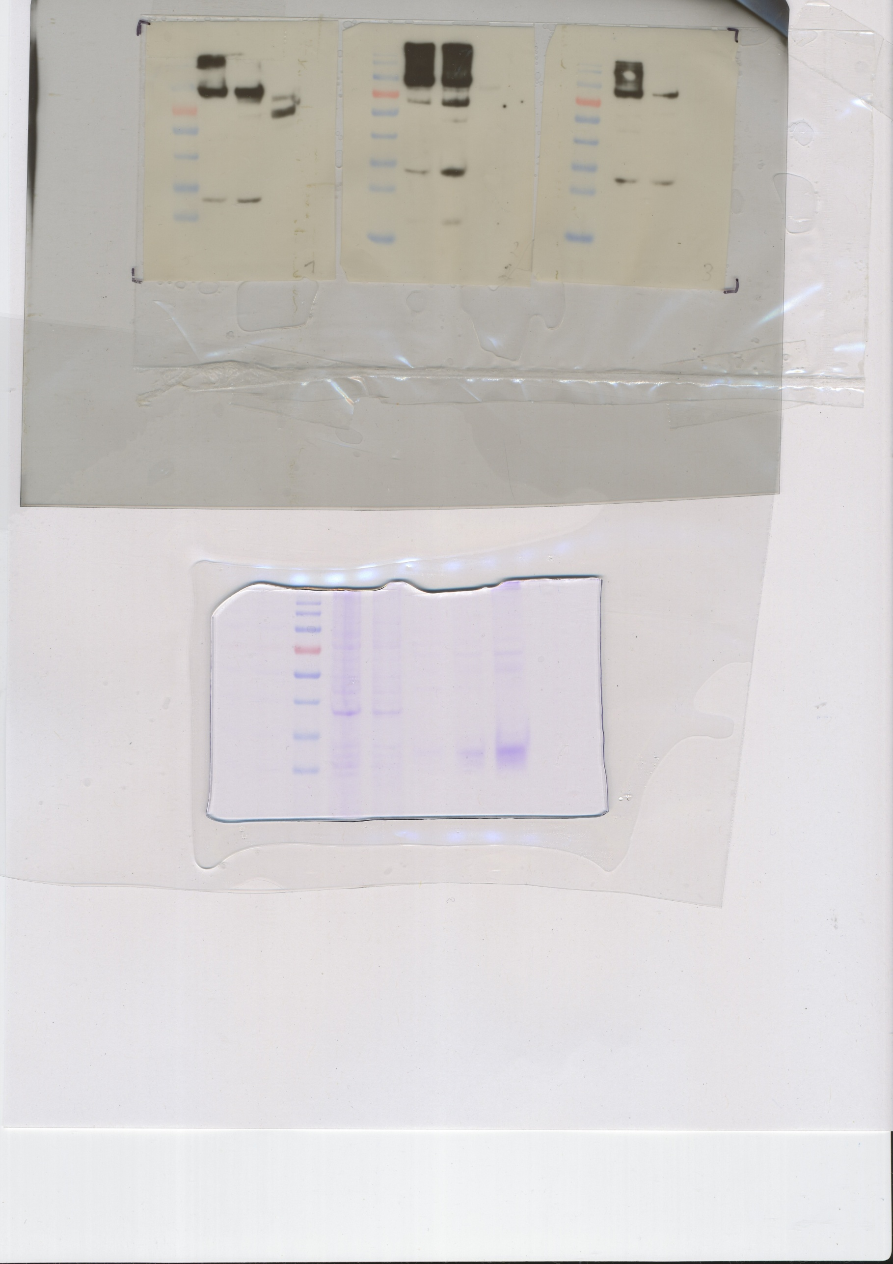
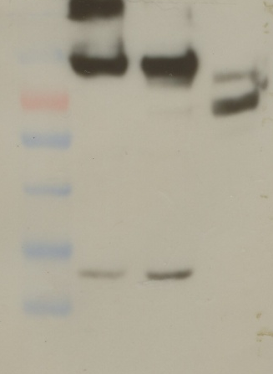
Westernblot rCof a 1/pooled coffee workers‘ sera
M B- B+ E M B- B+ E
M Marker
B- bacteria before induction
B+ bacteria after induction
E eluate
70 KD -
55 KD -
40 KD -
35 KD -
25 KD -
protocol:
Membrane blocked for 1h (TBS with 0,05% Tween and 3% milkpowder)
Antibody 1 over night (200µl sera 4,9,18) in 10 ml TBS with 0,05% Tween and 3% milkpowder
2 washing steps (TBS and 0,05% Tween) a 15‘
Antibody 2 (anti human IgE Progen Cat. 11001 1: 500) in 10 ml TBS with 0,05% Tween and 3%milkpowder for 1 h
2 washing steps (TBS and 0,05% Twee) a 15‘
Antibody 3 (HRP conjugat anti 1: 2000 mouse IgG Pierce Cat. 1858413) with 0,05% Tween and 3%milkpowder, 1h
3 washing steps (TBS and 0,05% Tween) a 10‘
Detection

