Slide 1
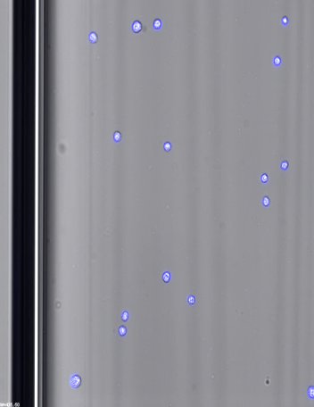
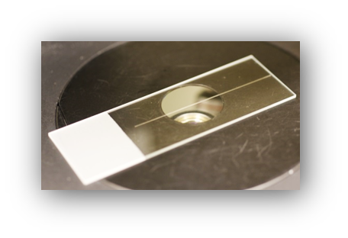
A
Hoechst 33342-stained cell
VitroTube
B

