Slide 1
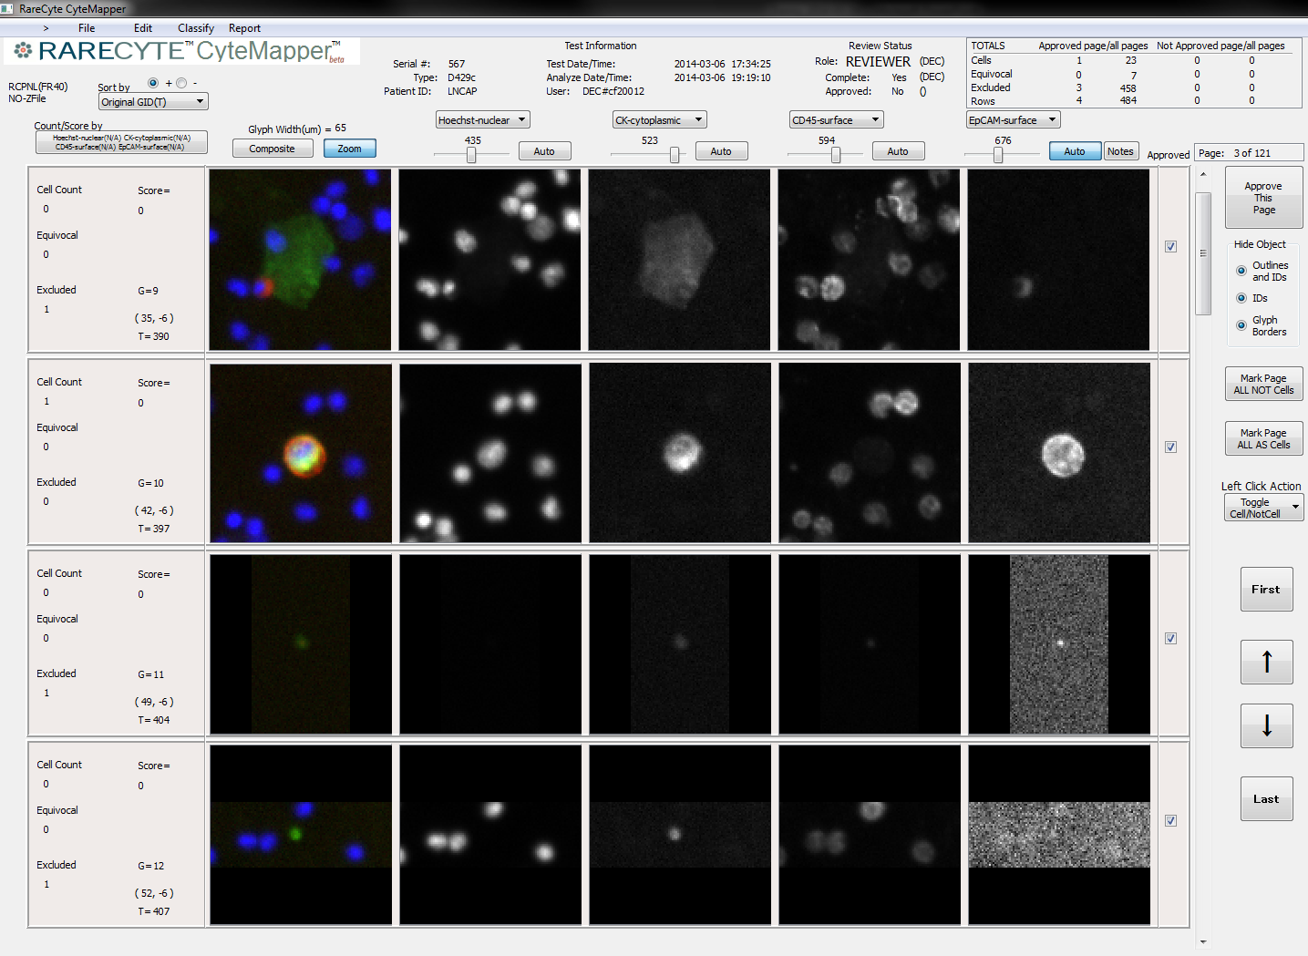
Composite
DAPI
Cytokeratin
CD45
EpCAM

