Slide 1
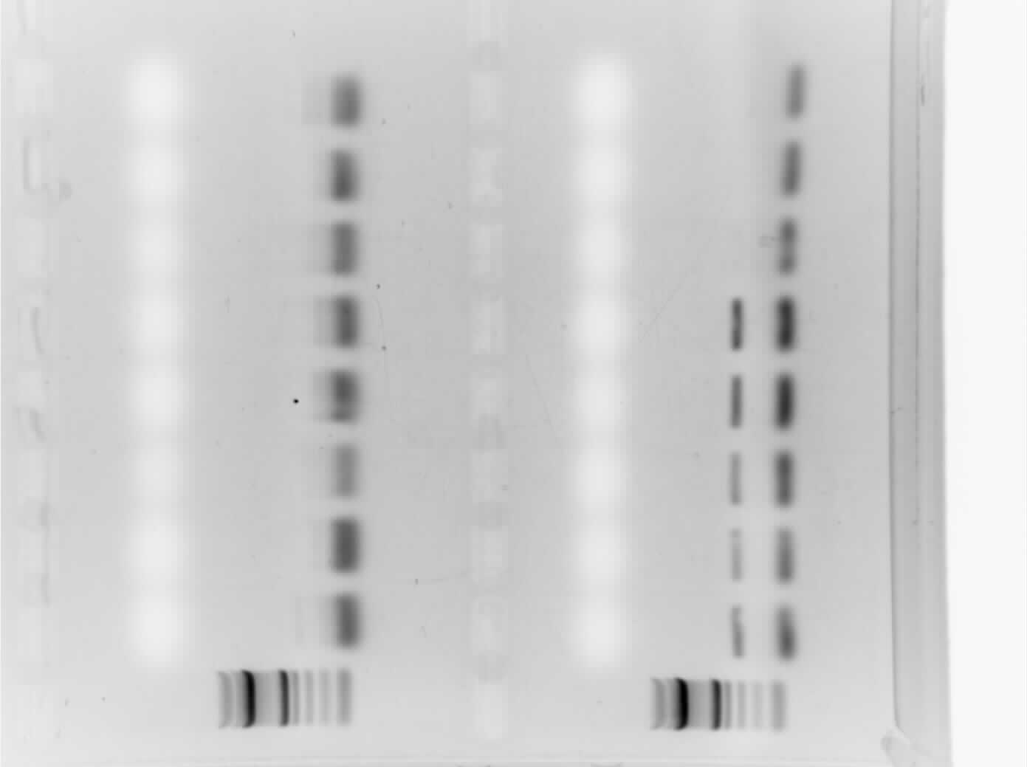
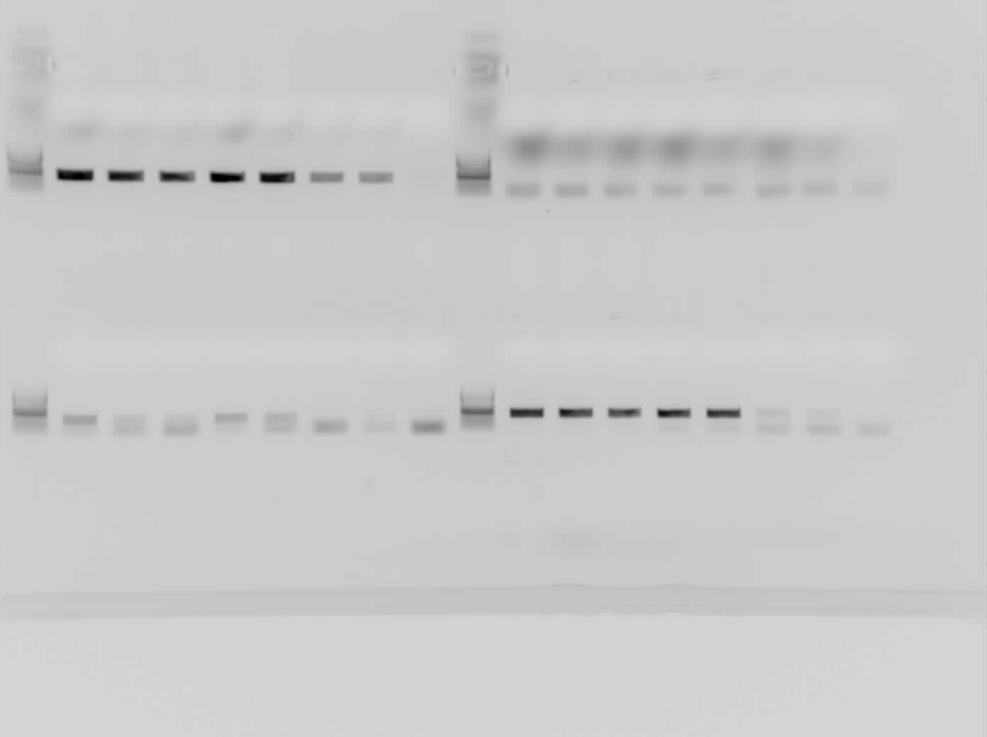
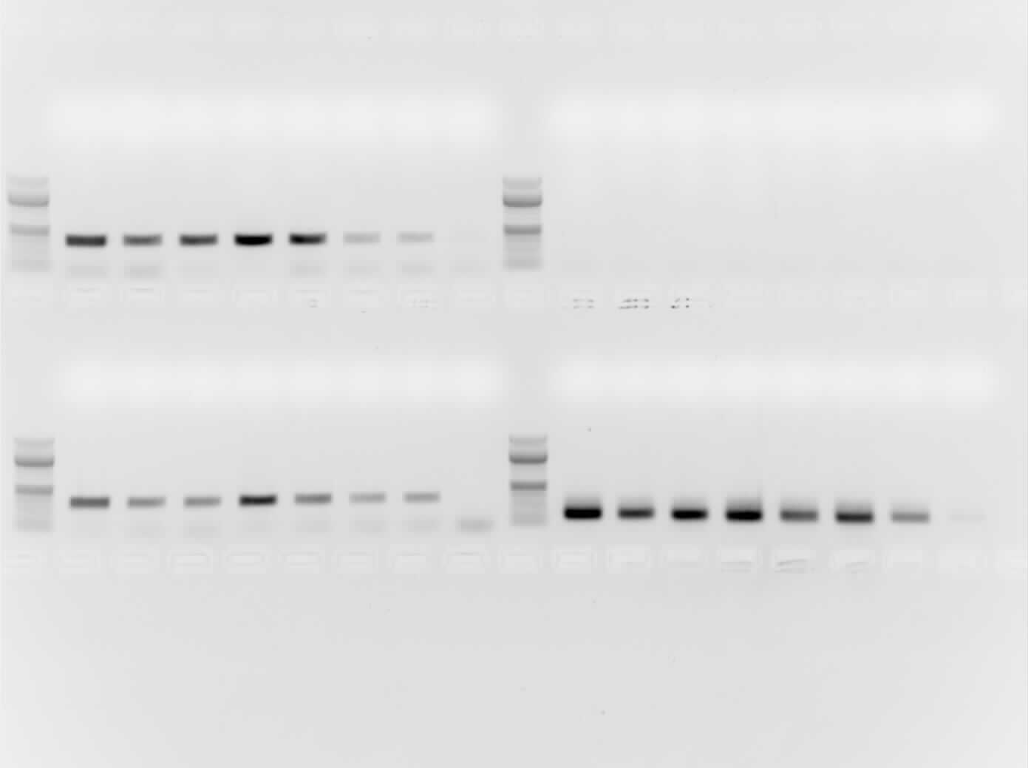


TRACK WT
SLC16A3
NDUFAL2
EGLN3
GLUT1
CA9
IDH1
36B4

