Slide 1
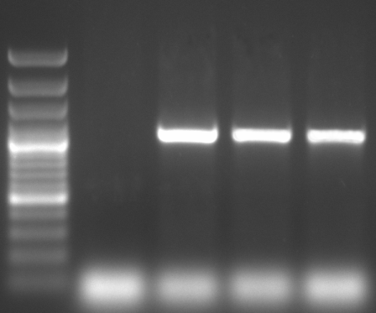
SPM
PM
P
M Col 1.1 1.2 1.3
M Col 2.1 2.2 2.3
M Col 3.1 3.2 3.3
bp
1131
1059
351
Figure S2

