Slide 1
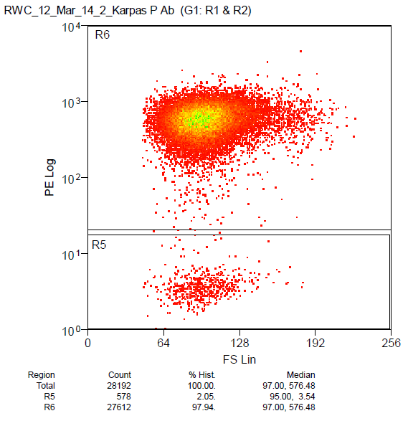
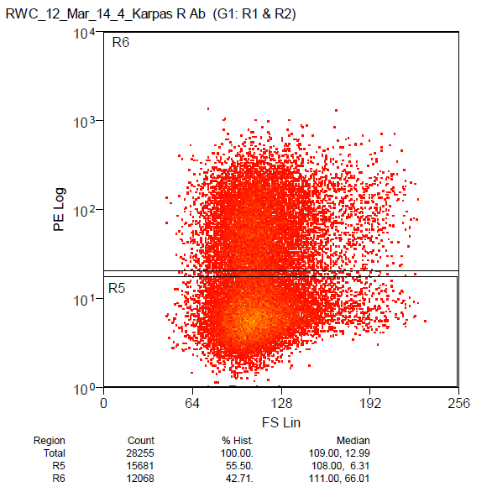
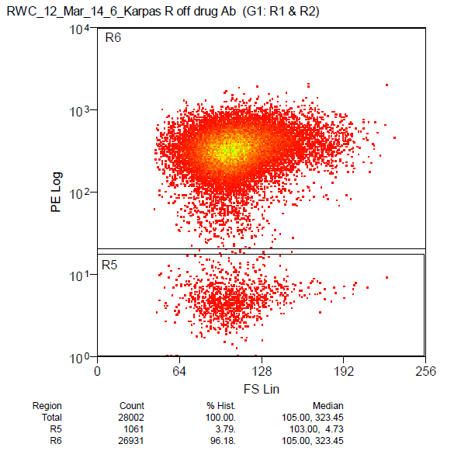
Supplemental Figure 1
A
Karpas-P
B
Karpas-R
B
Karpas-R Off BV
CD30
Forward Scatter
Supplemental Figure 1. Karpas-R cultured in the absence of BV regains CD30-positivity.
Karpas-R cells were placed in brentuximab vedotin (BV)-free media for 26 weeks. Flow cytometry showed increased surface CD30 expression after 26 weeks when BV selection pressure is removed.

