Slide 1
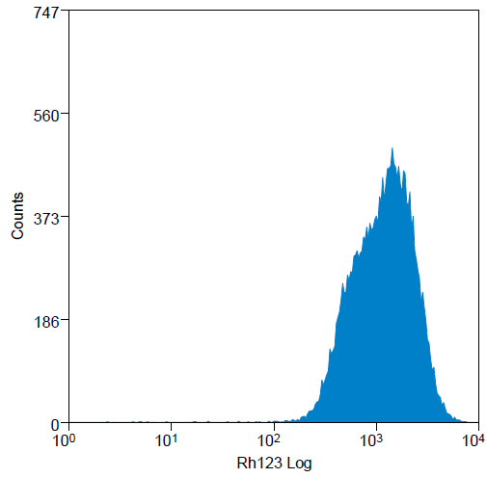
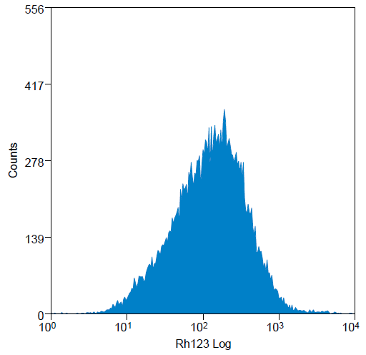
Supplemental Figure 3. Rhodamine Efflux Assay. L428 P and L428 R were labeled with rhodamine-123 dye for 2 hours at 37º for 2 hours. Rhodamine efflux activity was quantified by flow cytometry.
Supplemental Figure 3
L428 P
L428 R

