Slide 1
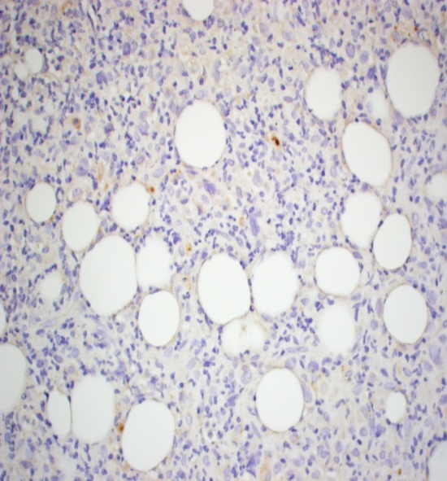
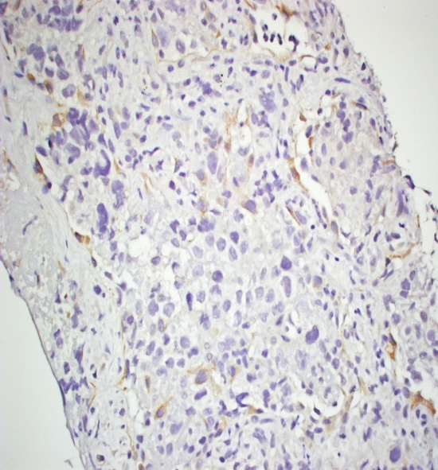
Supplemental Figure 4
PgP Expression Acquired by HL Patient at BV Resistance
A
B
Before BV
After BV
Supplemental Figure 4. Immunohistochemistry for PgP on HL patient biopsy.
Panel A shows P-glycoprotein (PgP) staining performed on a patient with Hodgkin lymphoma (HL) prior to brentuximab vedotin (BV) treatment. At that time, the patient was sensitive to BV and had 0% PgP staining as judged by the pathologist. Panel B shows PgP staining performed on the same HL patient who developed relapsed disease after treatment with BV. At that time, this patient did not respond to subsequent BV treatment and had 25% PgP staining as judged by the pathologist.

