Slide 1
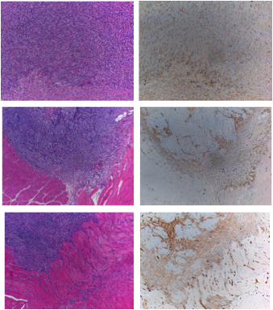
Supplemental
Figure 3
H & E
β3
HCT-116 #1
HCT-116 #2
HCT-116 #3
Supplemental Figure 3: HCT-116 tumor xenografts have β3 integrin expression. HCT-116 in the hindlimbs of nude mice. β3 integrin expression by IHC in non-irradiated HCT-116 tumors

