Slide 1
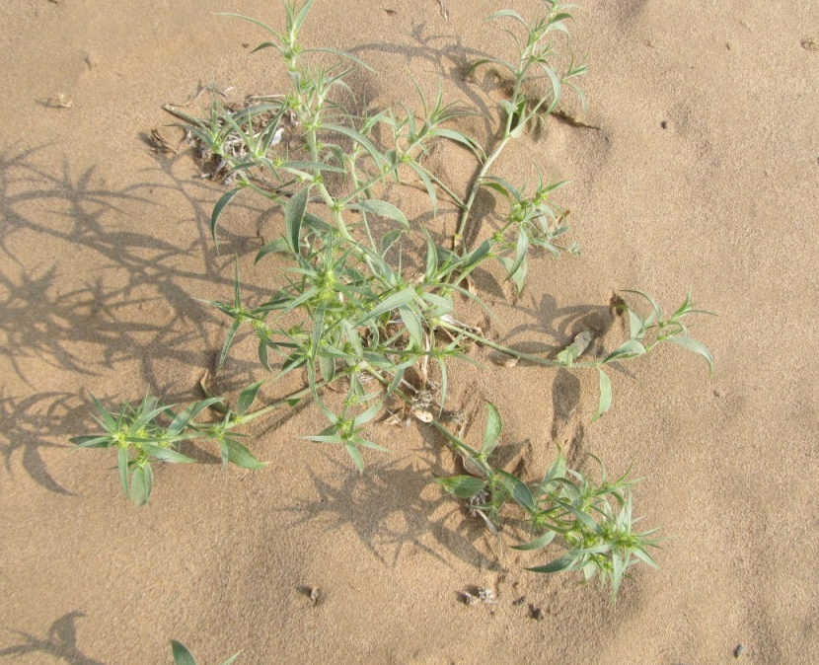
Notes:
Additional file 2. The morphology of the sand rice adult plant.

