Slide 1
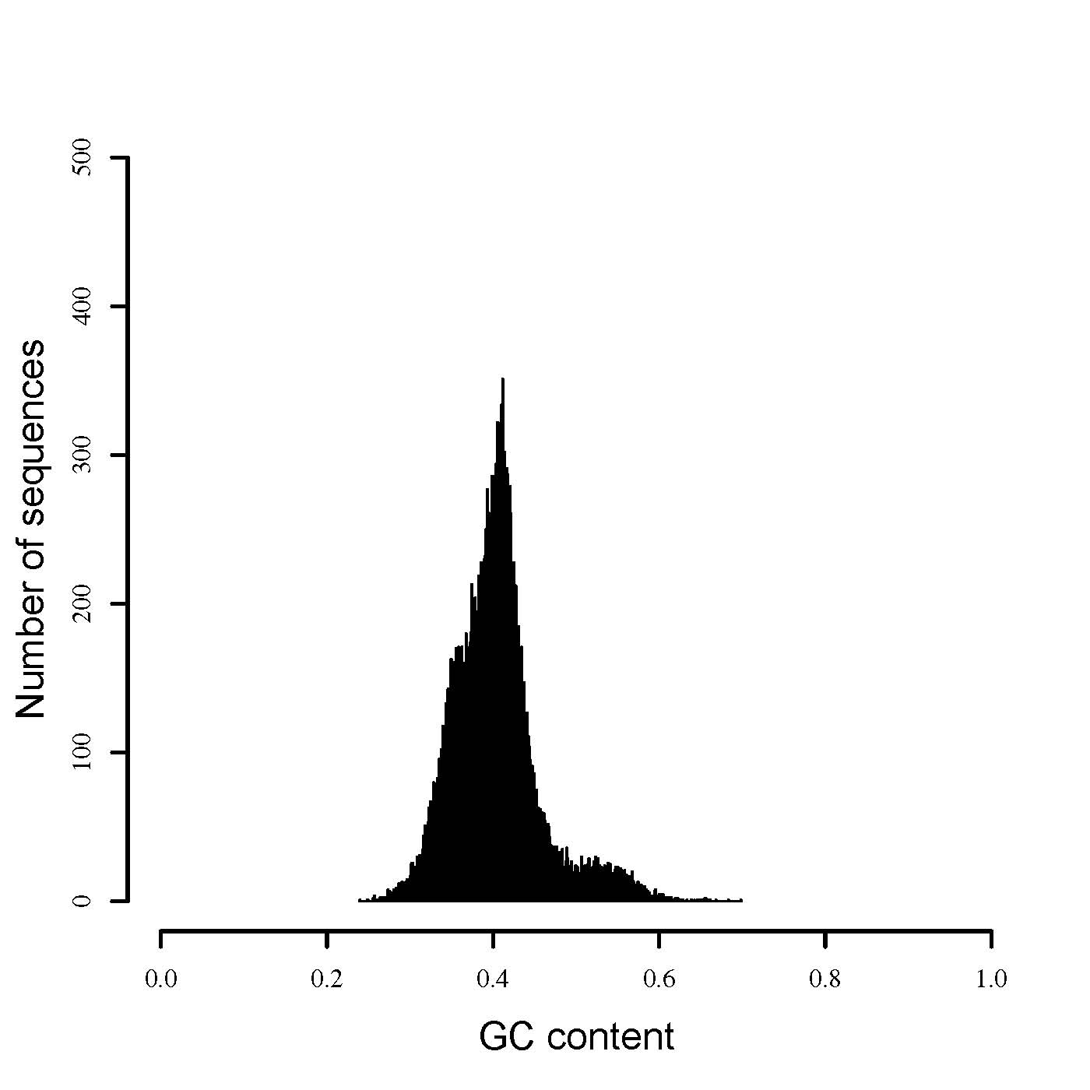
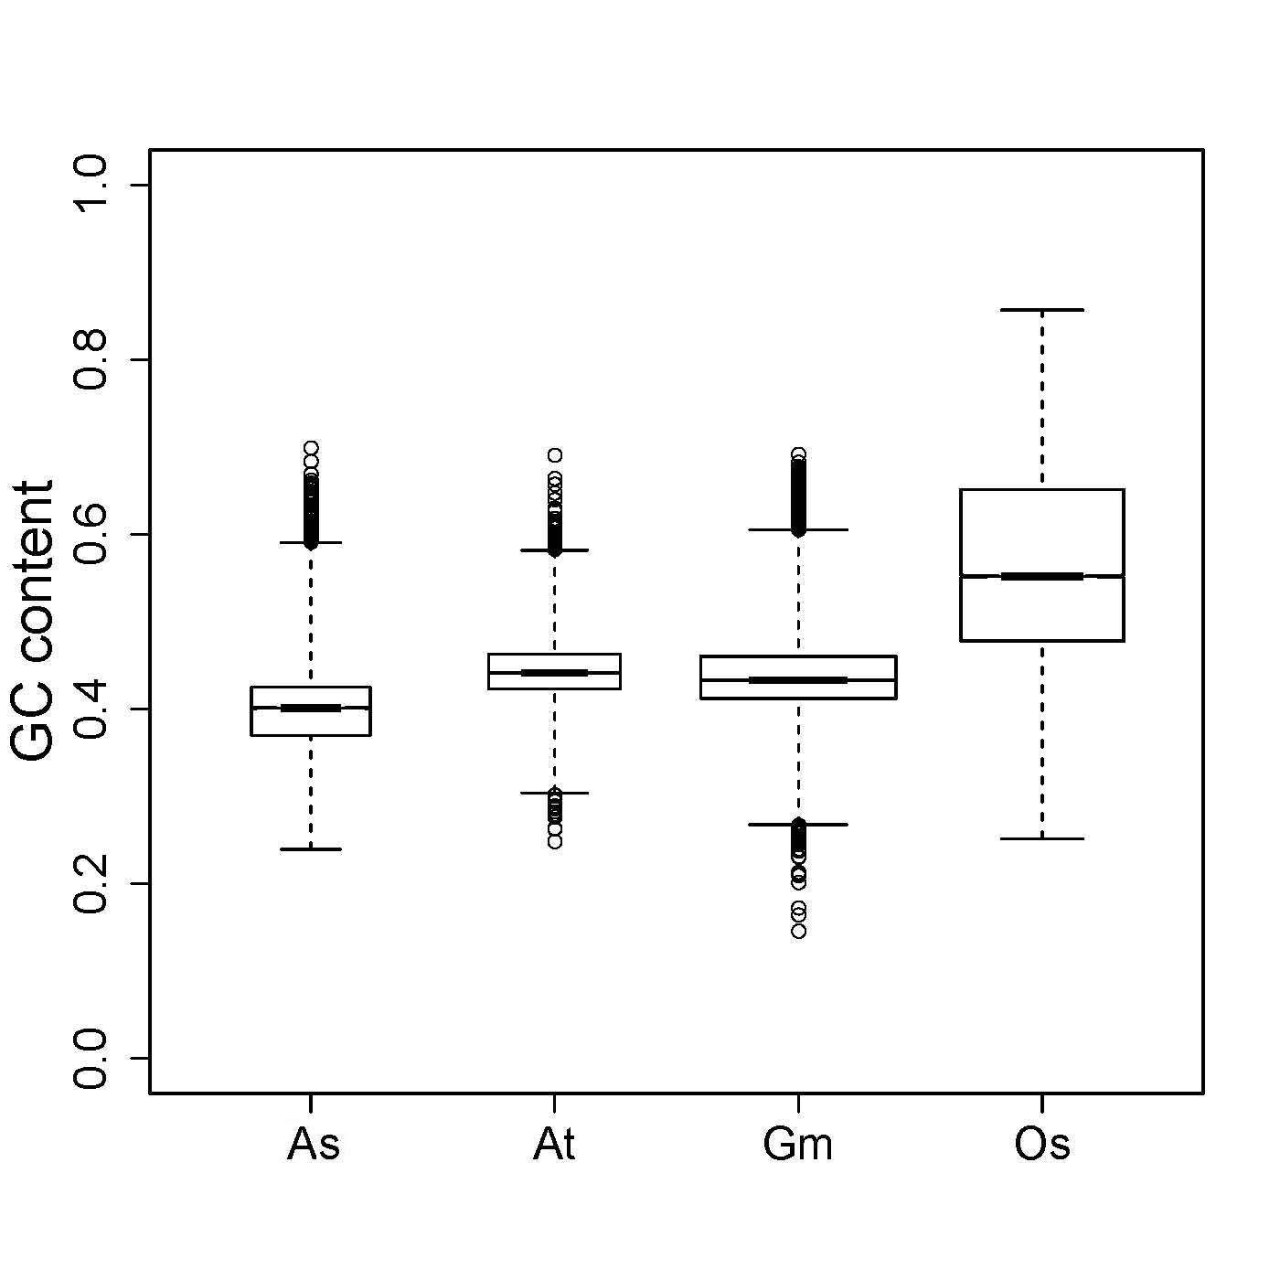
A B
Notes:
Additional file 7. GC content analysis of sand rice unigenes. (A) Frequency of GC content of sand rice unigenes. (B) Distribution of GC content of unigenes for sand rice (As) and transcripts for Arabidopsis (At), Soybean (Gm), and rice (Os).

