Slide 1
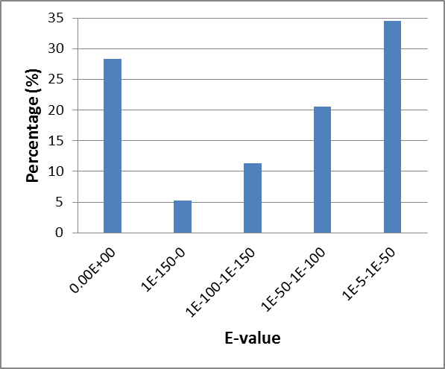
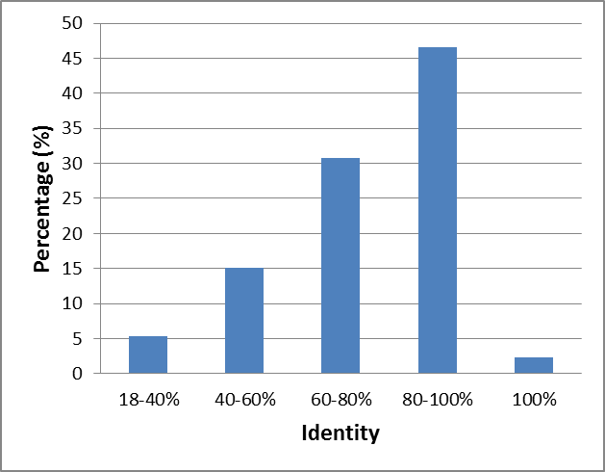
A B
Notes:
Additional file 9. Characteristics of Sand rice unigenes hitted deposited sequences in Nr database and newly sequenced sugar beet peptide sequences. (A) Nr annotation results distributed by the E-value. (B) Nr annotation results based on sequence identities.

