Slide 1

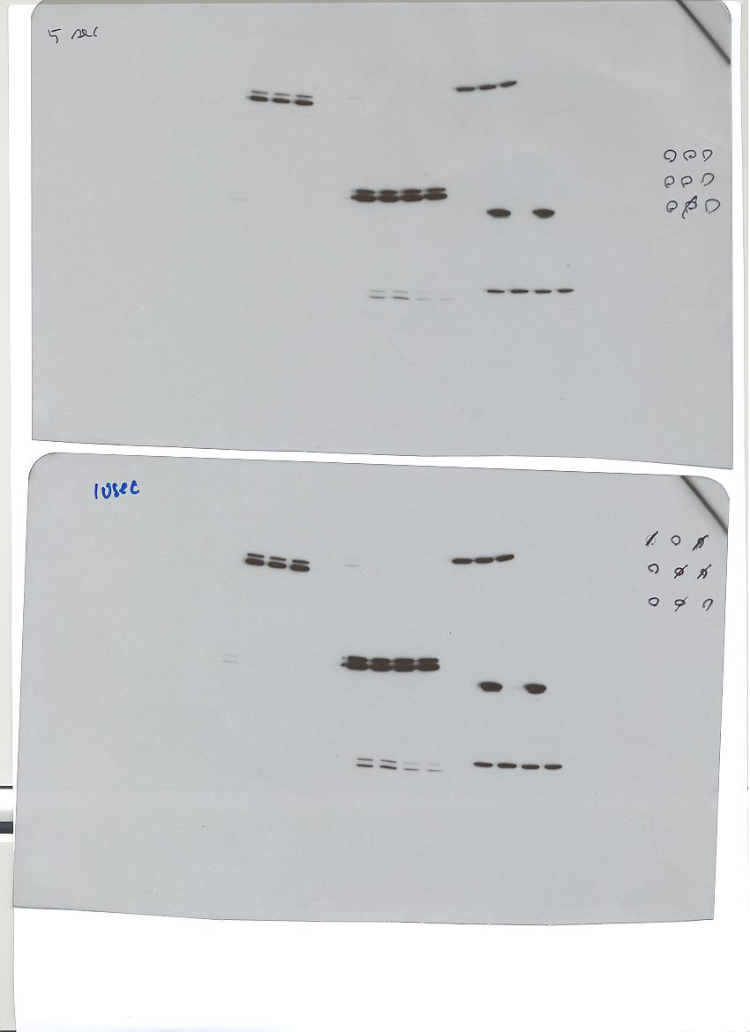
HLA class I
KYSE30
(A)
(B)
OE19
**
**
p-Erk
Erk
Actin
**
**
**
MFI
**
**
12 h
24 h
48 h
72 h
**
**
**
**
**
0 0.5 2 10 μM
UO126 concentration
(C)
0 0.1 0.5 1.0 ng /mL
IFN-γ concentration
KYSE30
HLA class I
IFN-γ concentration (ng/mL)
**
0
0.1
0.5
**
*
Supplemental Figure S1.
Optimal conditions of MAPK inhibitors
and IFN-γ.
(A), OE19 was treated with the MAPK inhibitor, UO126, at the indicated doses and subjected to Western blot. Western blot data show one out of three independent experiments with comparable results.
(B)(C), KYSE30 was treated with IFN-γ and/or the MAPK inhibitor, PD98059, at different doses and exposure intervals, and the expression of HLA class I (W6/32) was analyzed by flow cytometry.
** p < 0.01, * p < 0.05 between the treated and non-treated cells.
*
MFI
**
**
*
24 48 72 h
24 48 72 h
DMSO
PD98059 50 μM

