Slide 1
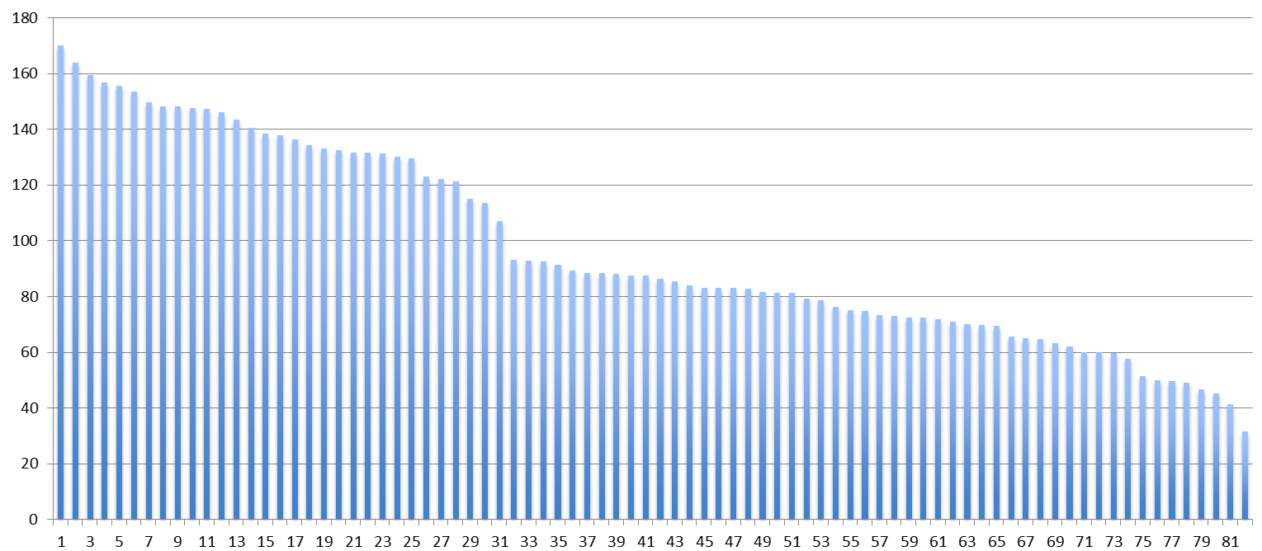
Supplementary Figure S2. Mean of Target Coverage in 38 SCLC Cases
Mean: 97.3
Median: 86.8
Range: 31.4-170.1
Mean of target coverage
Sample

