Slide 1
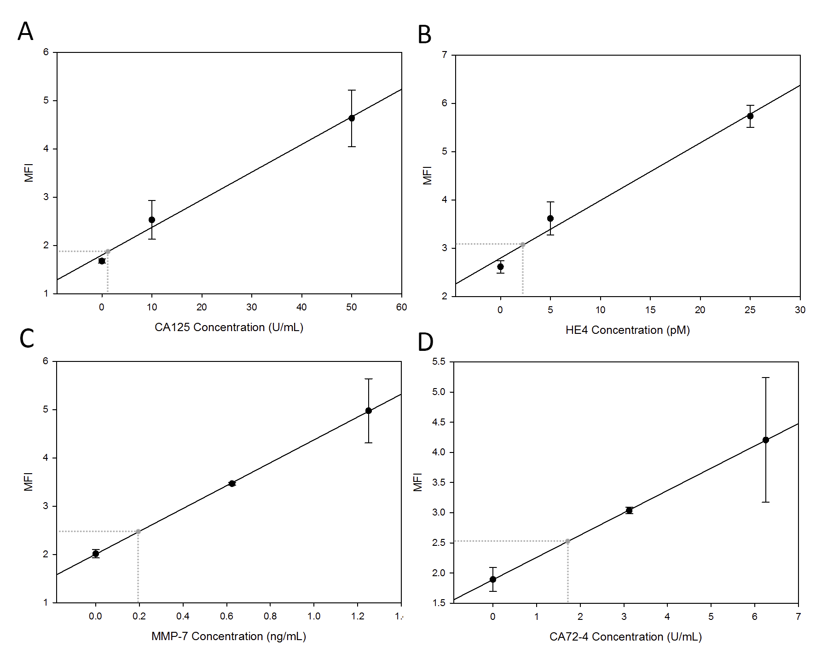
Figure 1: Isolation of lower portion of [A] CA125, [B] HE4, [C] MMP-7, and [D] CA72-4 dose response curves with a linear fit to demonstrate the region of the limit of detection for each biomarker on the p-BNC.

