Slide 1
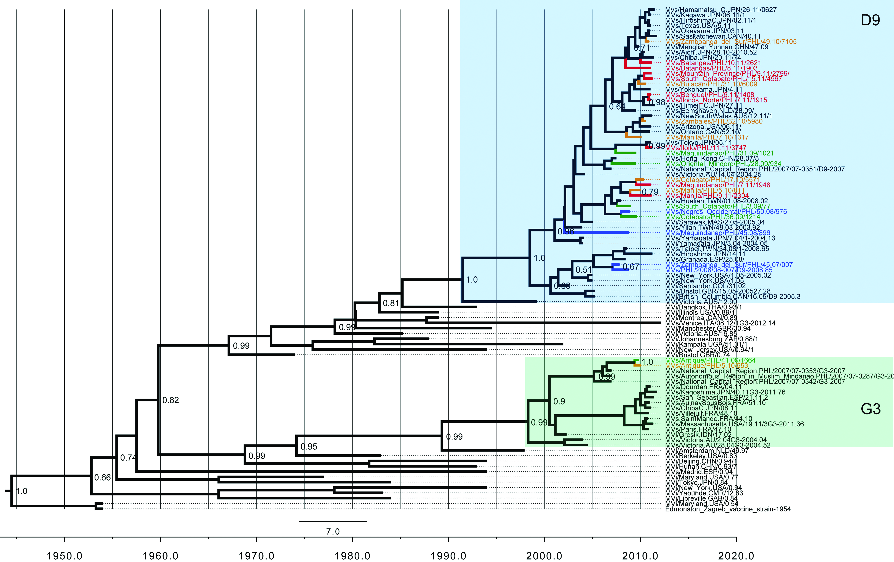
Supplementary Fig. S1
4
3
2
1

