Slide 1
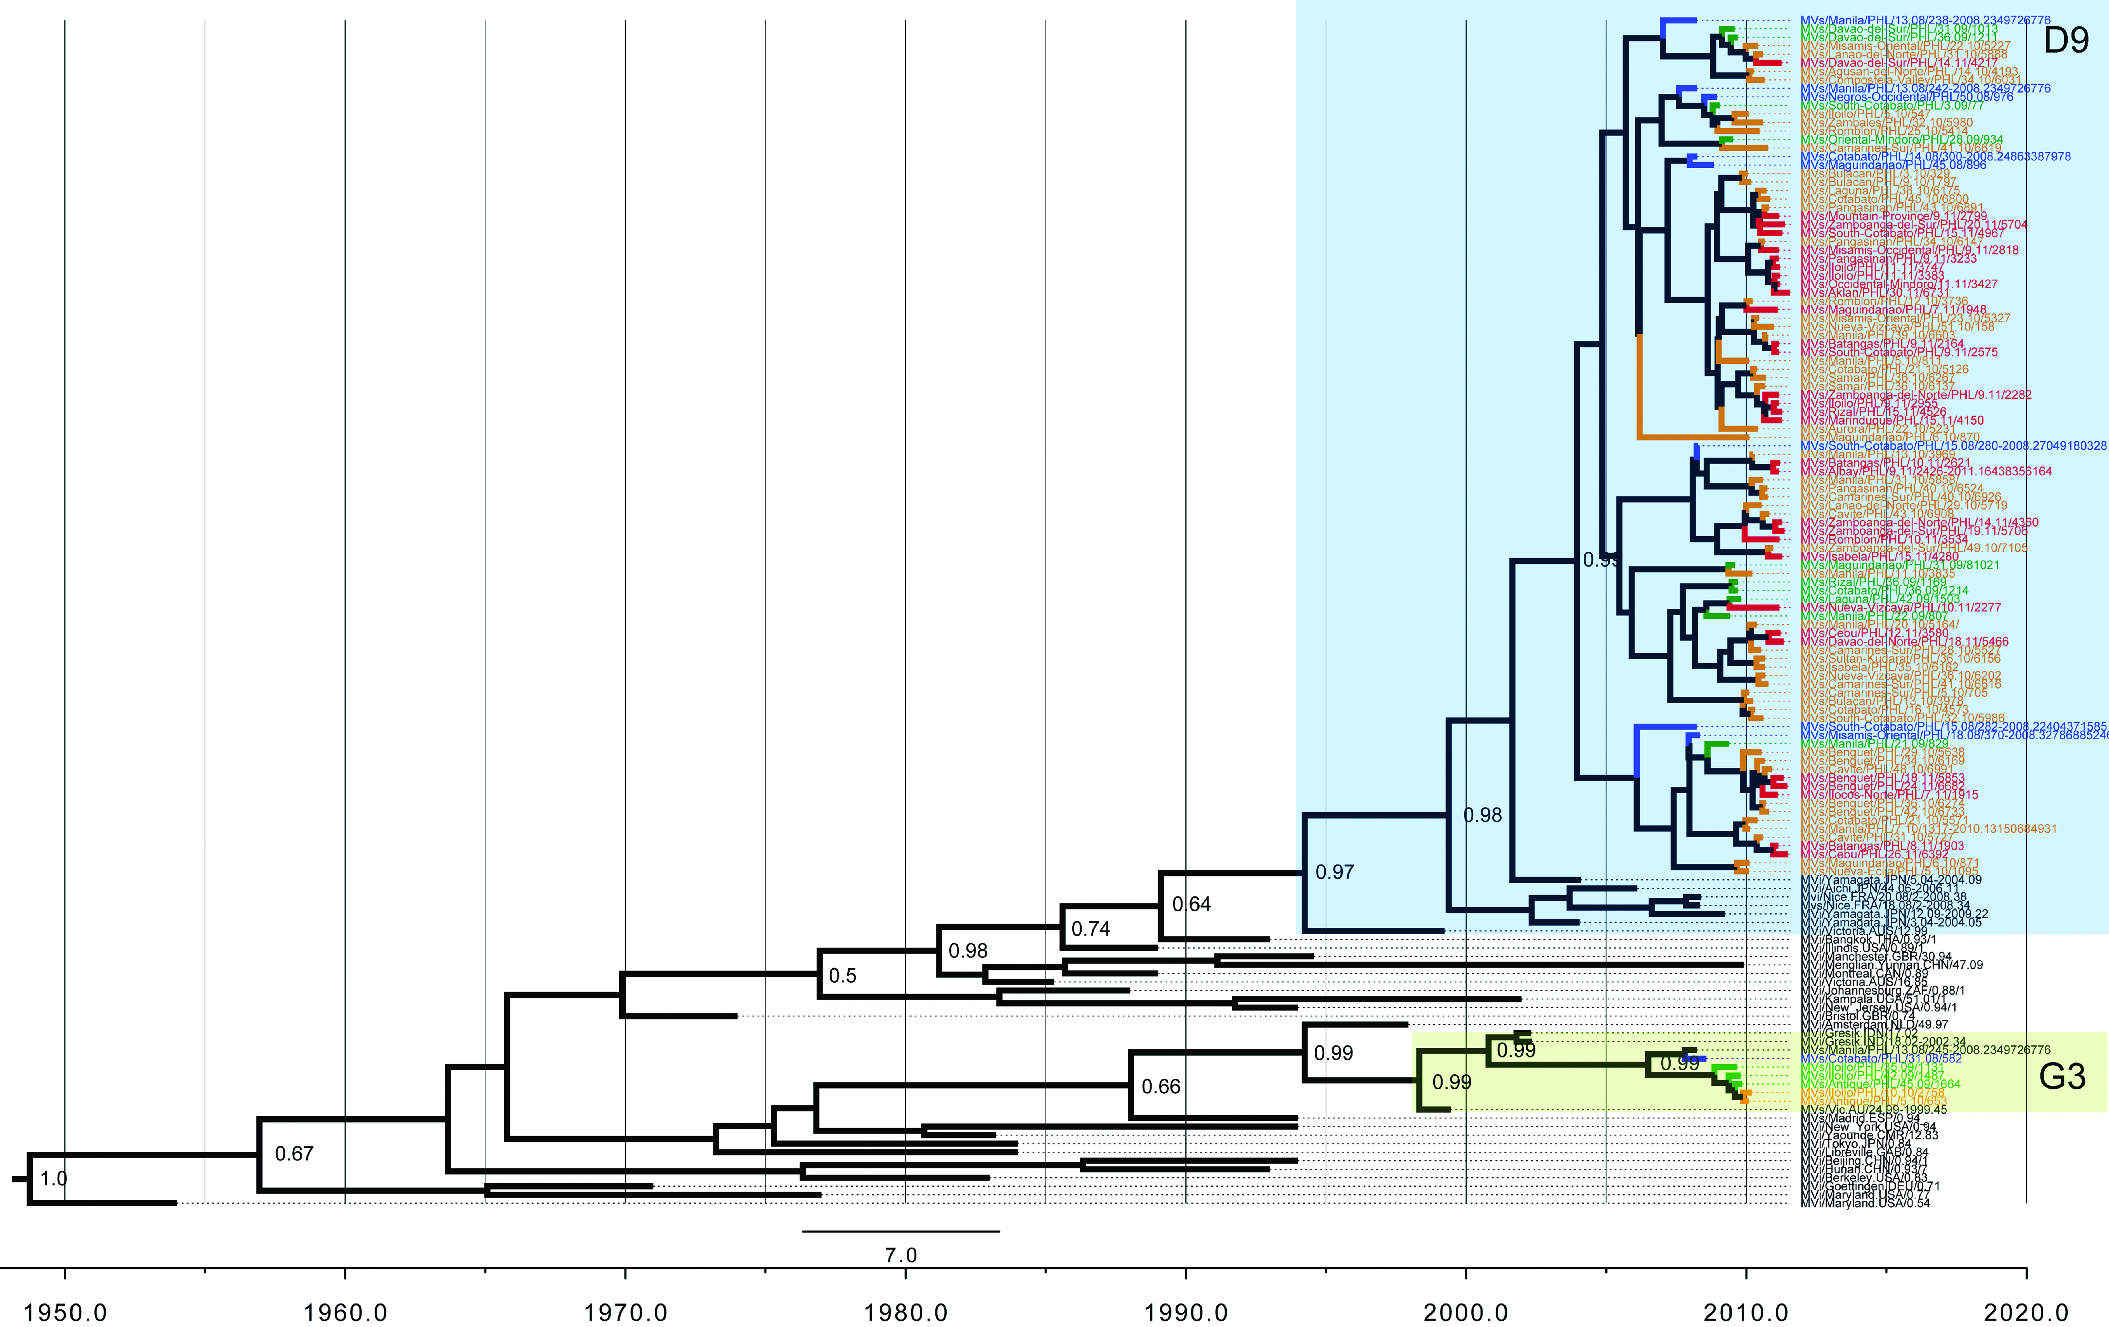
Supplementary Fig. S2

