Slide 1
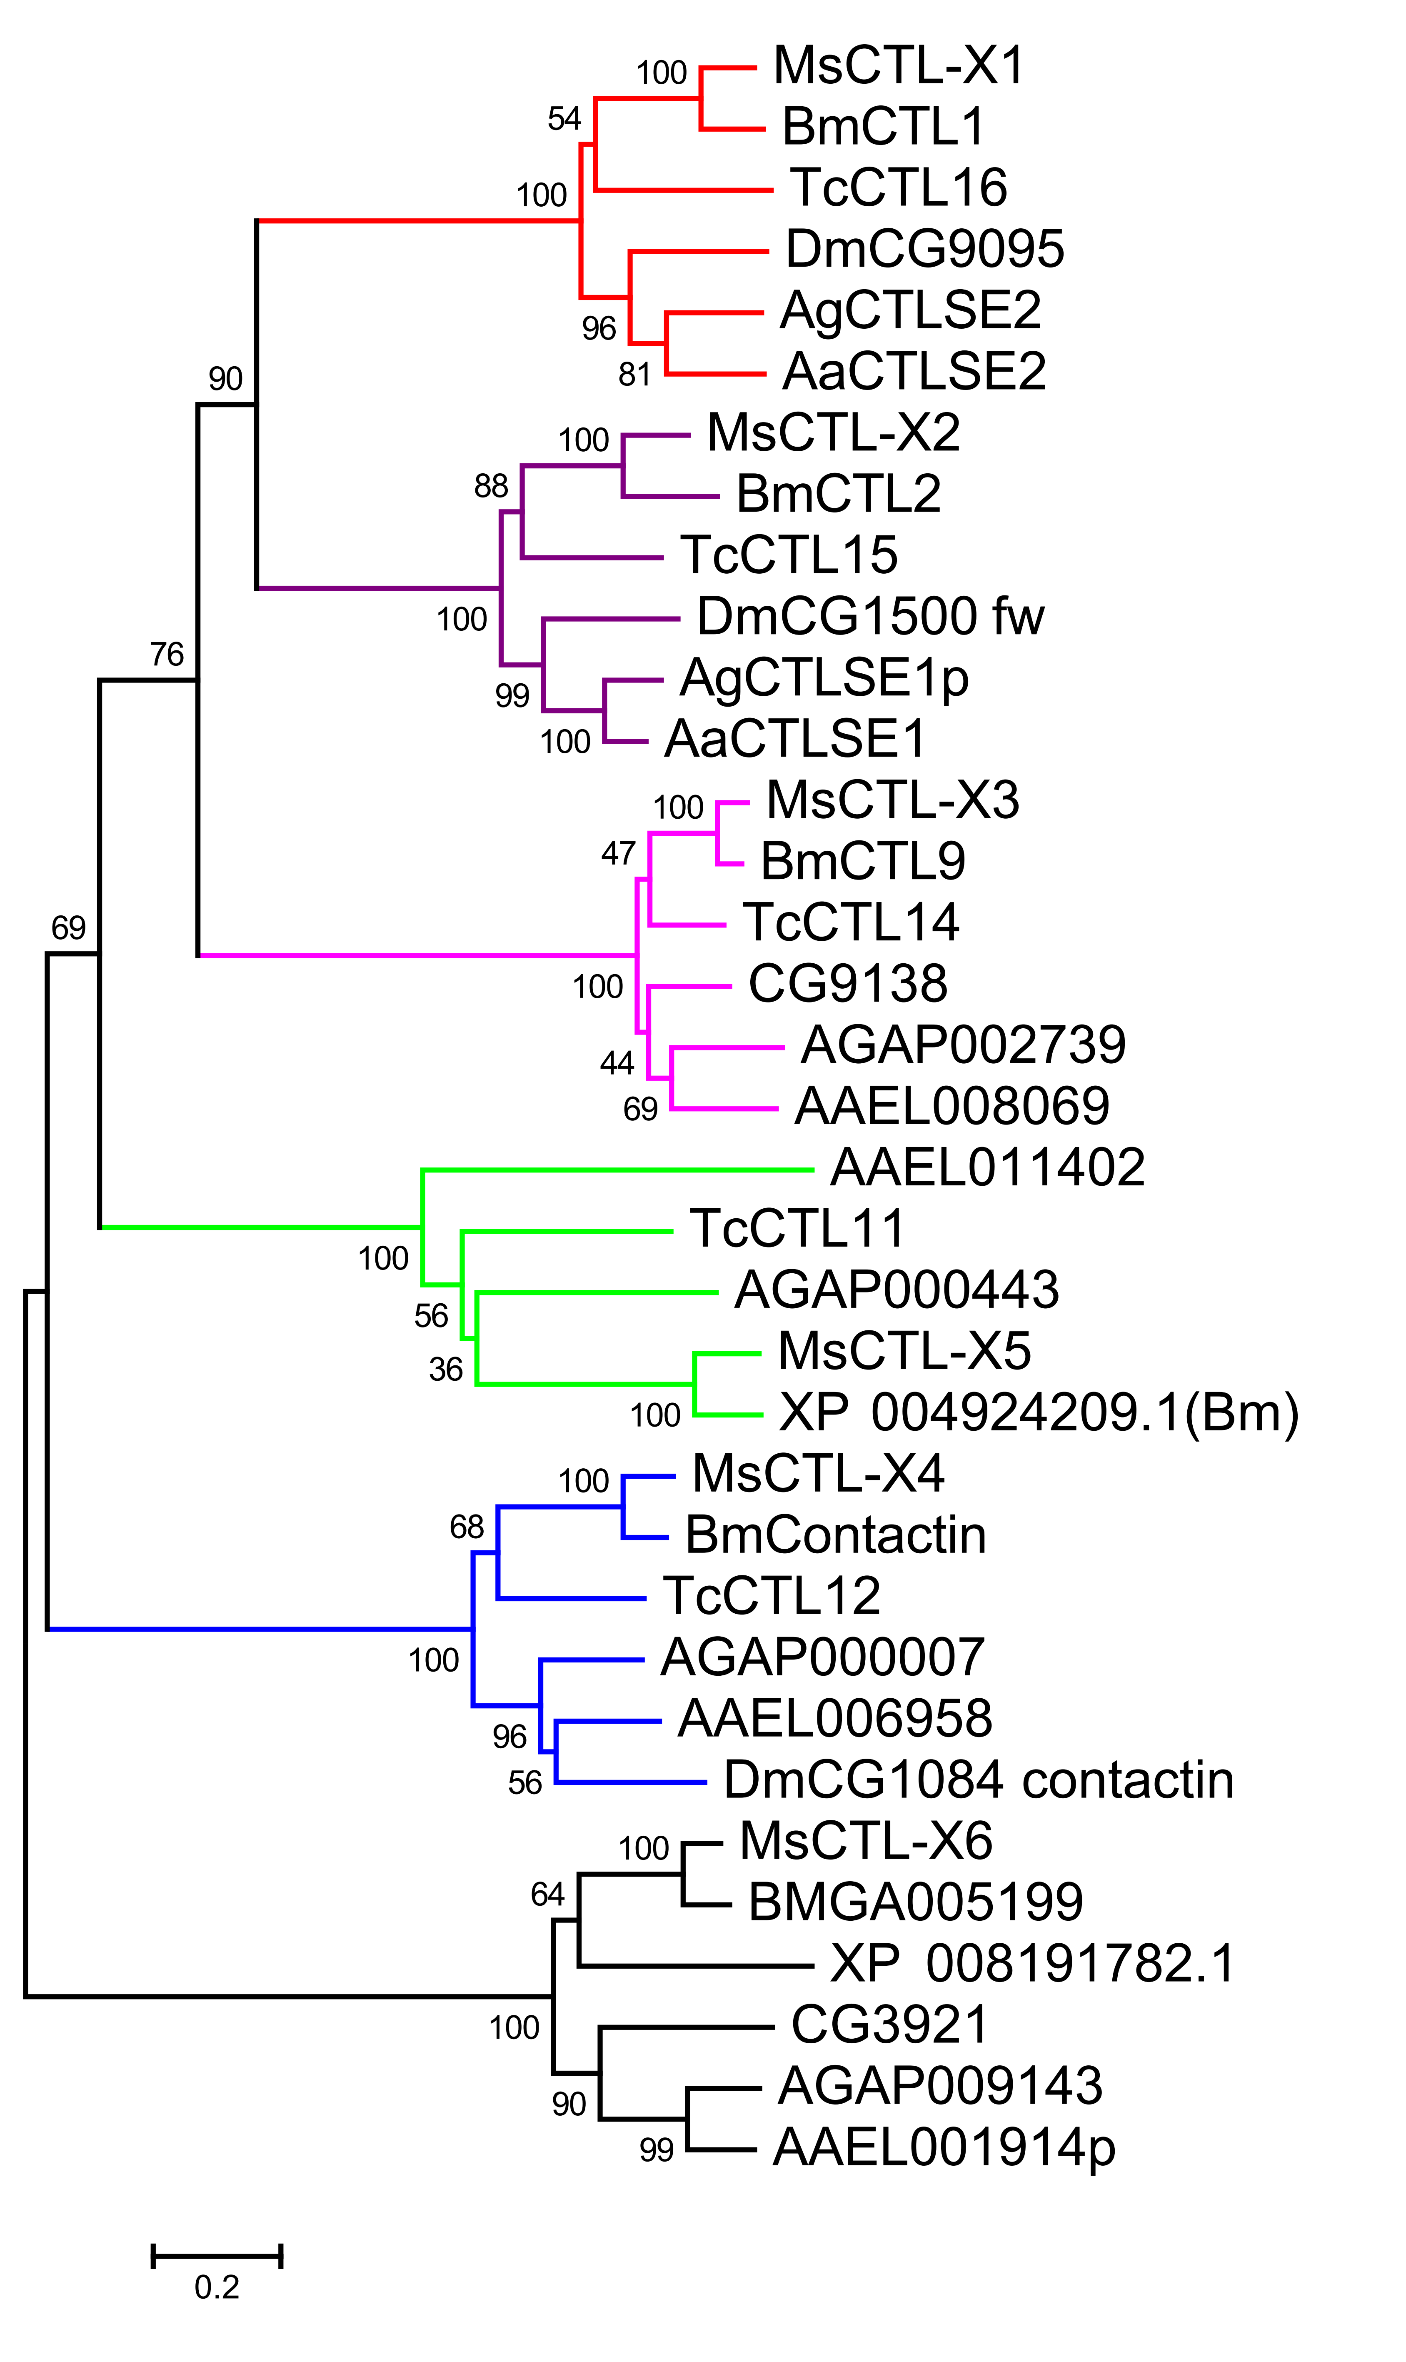
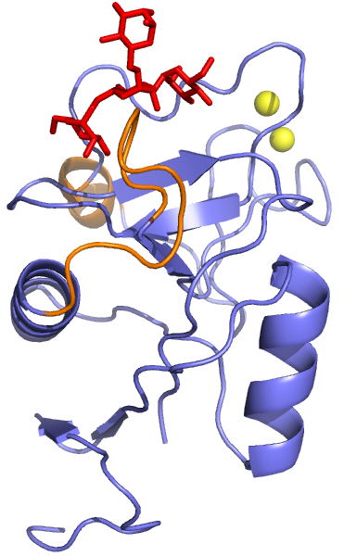
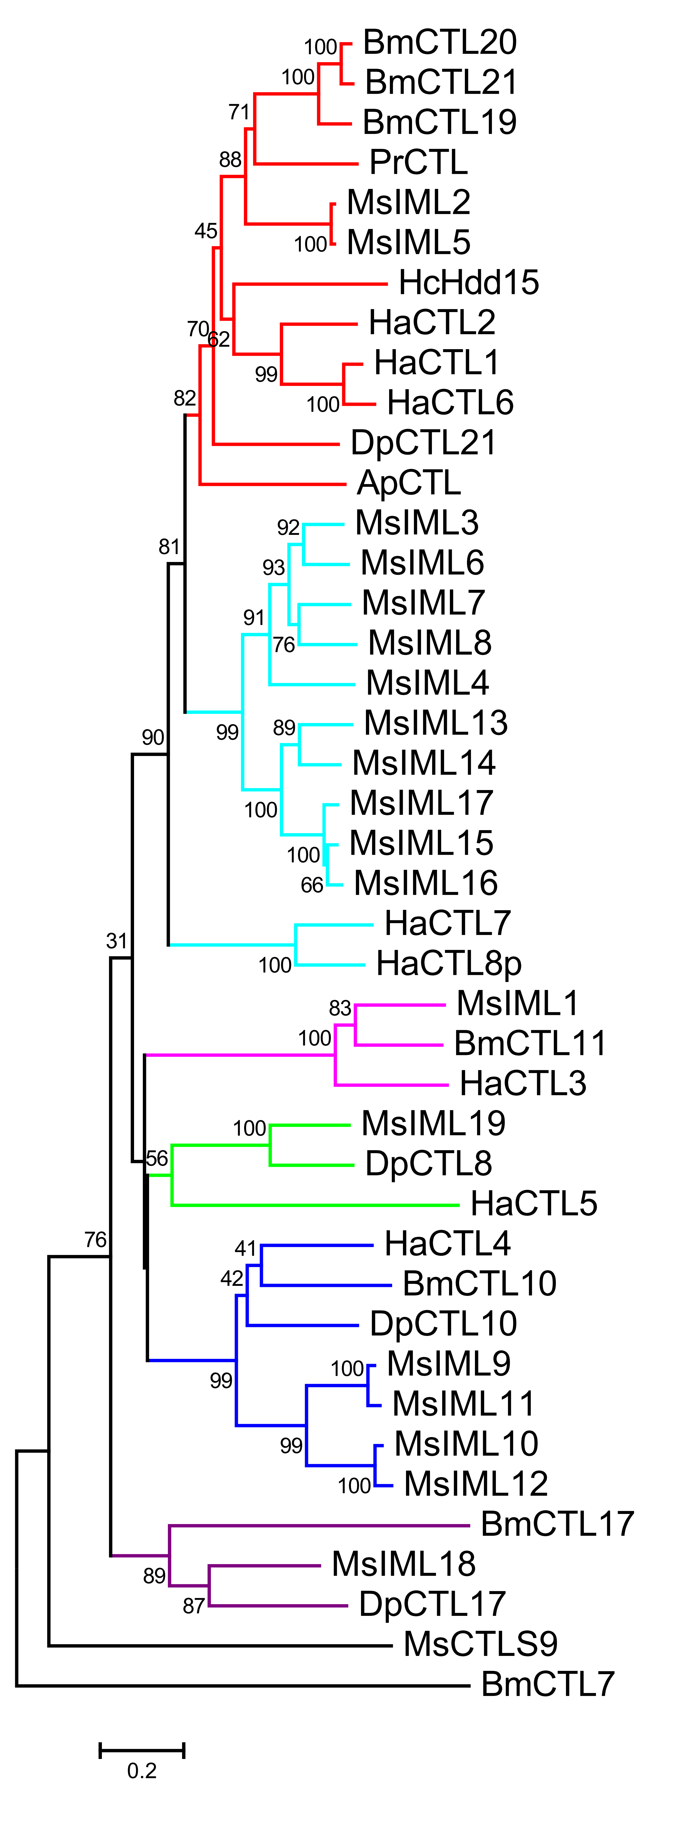
Graphic abstract
CTL-S1:
IML-1:
CTL-X1:
Fig. 1
CTL-S1~8:
CTLD
163~808
CTL-S9:
CTLD
CTLD
CTLD
501
IML-1~8, 10~18:
CTLD
CTLD
264~344
IML-9, 19:
CTLD
CTLD
329
CTL-X1:
CCP
FTP
CTLD
3CCP
TM
831
CTL-X2:
CCP
FTP
CTLD
10CCP
TM
1112
CTL-X3:
CTLD
LDLa
4CCP
FA58C
4CCP
2HYR
GCC
LamG
EGF
3573
CTL-X4:
3CUB
EGF
EGF
FA58C
CCP
14EGF
HYR
GCC
TM
CTLD
IG
IG
IG
IG
IG
FN3
FN3
FN3
FN3
TM
1310
CTL-X5:
CTLD
CUB
CTLD
2CUB
EGF
2719
CTL-X6:
SR
PbH1
SR
SR
CTLD
TM
2995

Slide 2
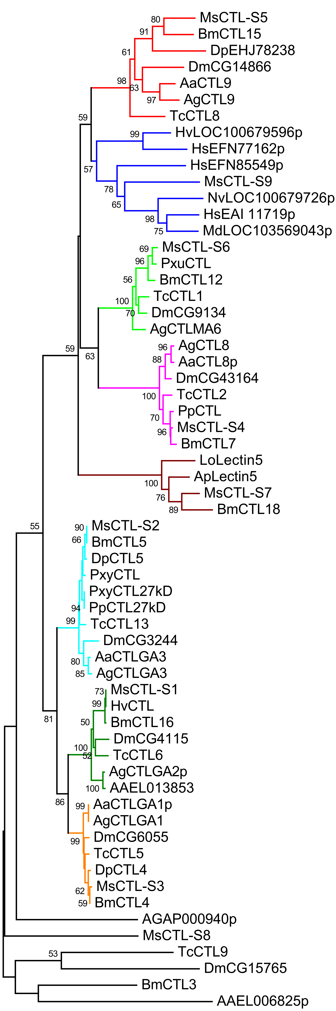
Fig. 2
A
B
0.2
0.2
C
0.2
(Dm)
(Ag)
(Aa)
(Aa)
(Ag)
(Ag)
(Aa)
(Bm)
(Tc)
(Dm)
(Ag)
(Aa)

Slide 3
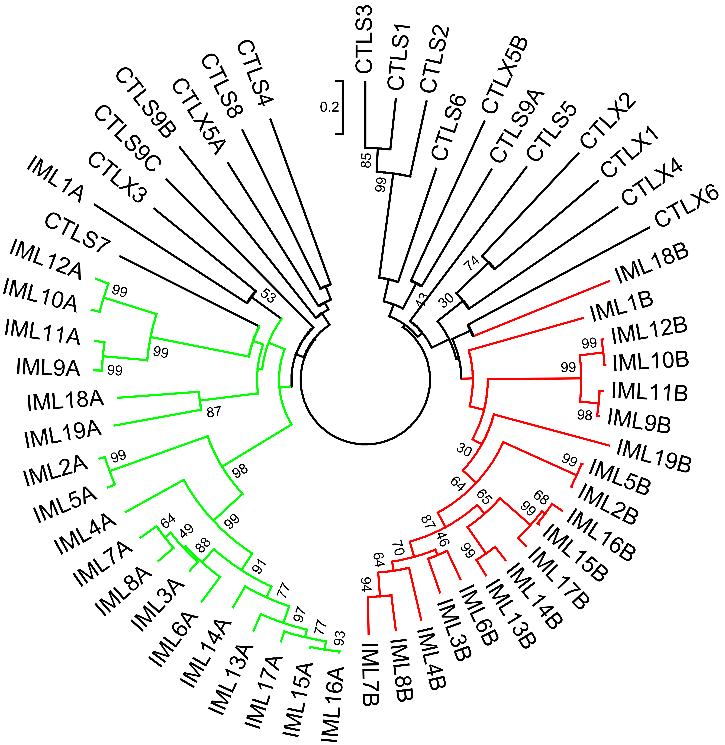
Fig. 3
Scaffold:
00014
IML-13
IML-14
IML-15
IML-16
IML-17
00017
IML-9
IML-10
IML-11
IML-12
00030
IML-8
IML-4
IML-7
IML-3
IML-6
Fig. 4

Slide 4
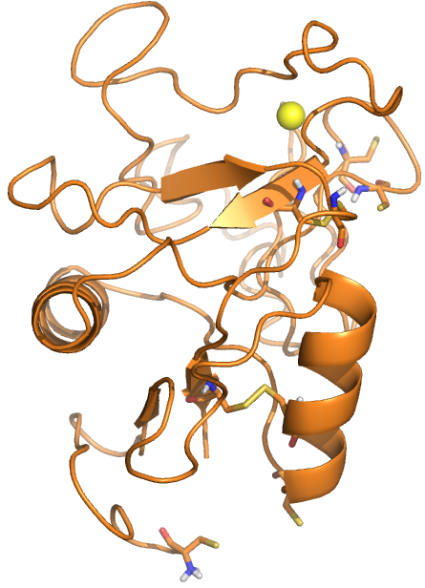
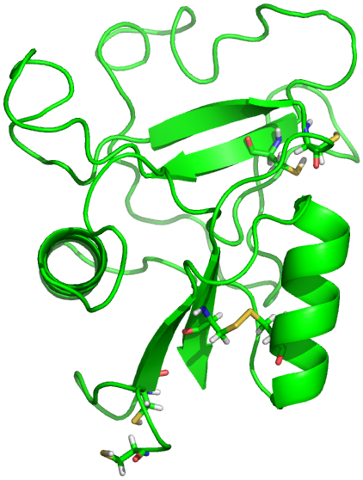
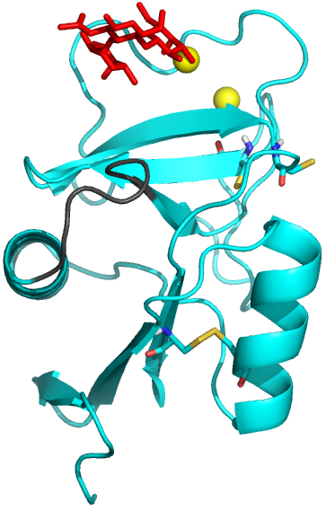
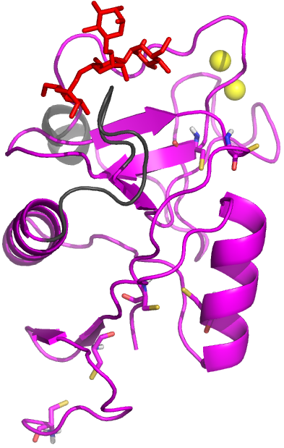
Fig. 6
A CTL-S2
B CTL-X5A
C IML-1A~Gal-NAG-Fuc
D IML-1B~(Man)₄

