Slide 1
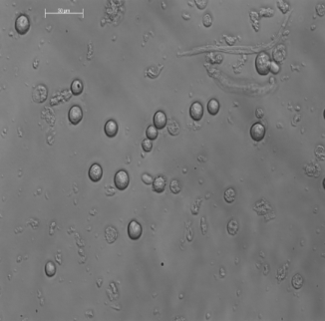
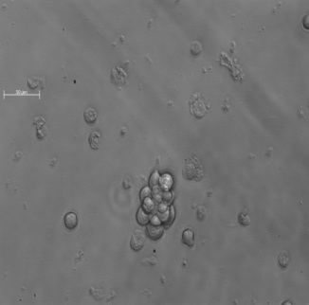
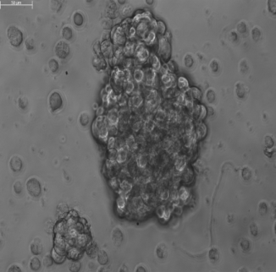
A
B
CD24⁻ (CD24⁻ tumor)
CD24⁻ (CD24⁺ tumor)
CD24⁺ (CD24⁺ tumor)

