Slide 1
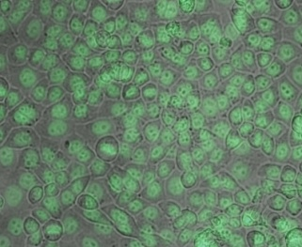
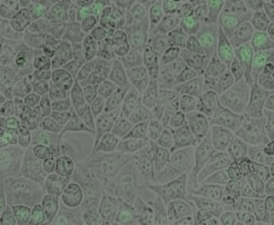
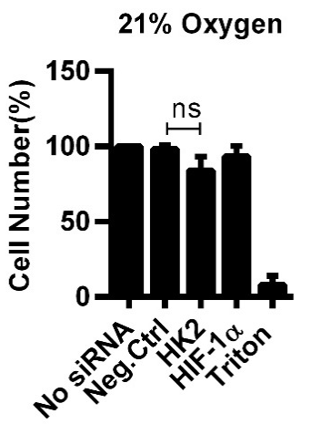
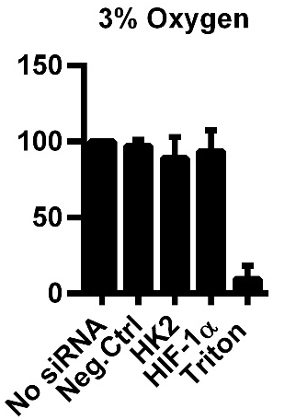
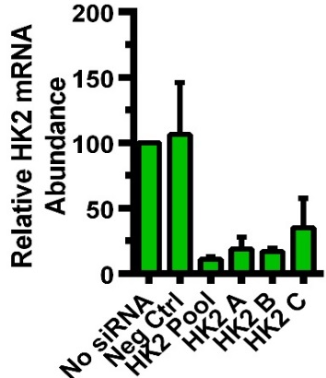
A
D
GAPDH siRNA
GFP siRNA
2
1.5
1
0.5
# Parasites in mock transfected cells
0
B
# Parasites in siRNA transfected cells
120
-0.5
100
-1
80
-1.5
Relative GAPDH Transcript
Abundance(%)
-2
60
Mock
Neg
% GAPDH Transcript Remaining
Casp 2
Casp 3
Casp 4
Casp 7
Casp 9
Casp 1
Casp 6
Casp 8
40
GAPDH
Casp 10
20
Log₂
0
Neg Ctr
48 hr
GAPDH
24 hr
GAPDH
48 hr
GAPDH
72 hr
GAPDH
96 hr
C
E
F
Relative Transcript
Abundance(%)
Figure S1

