Slide 1
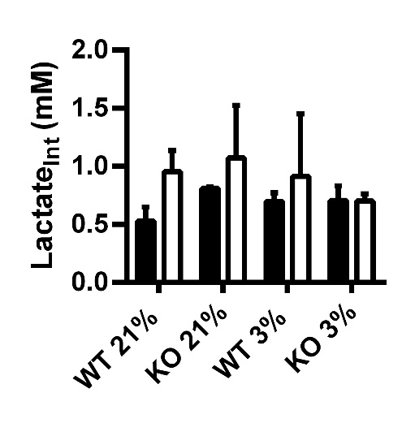
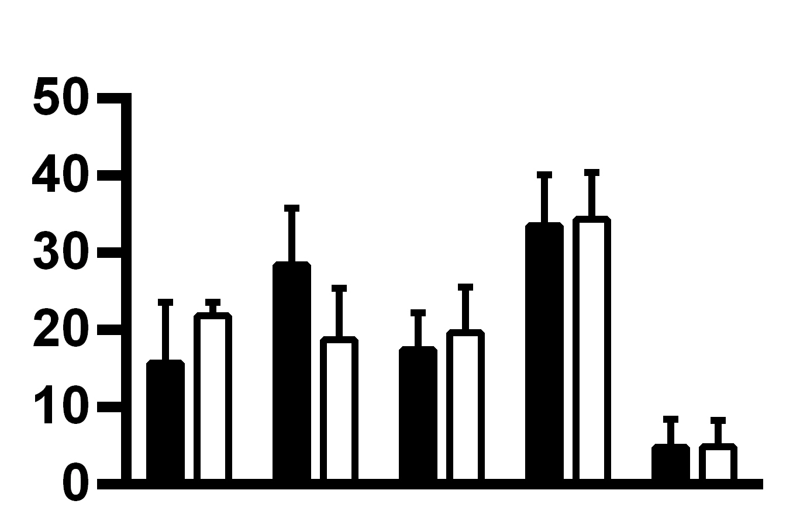
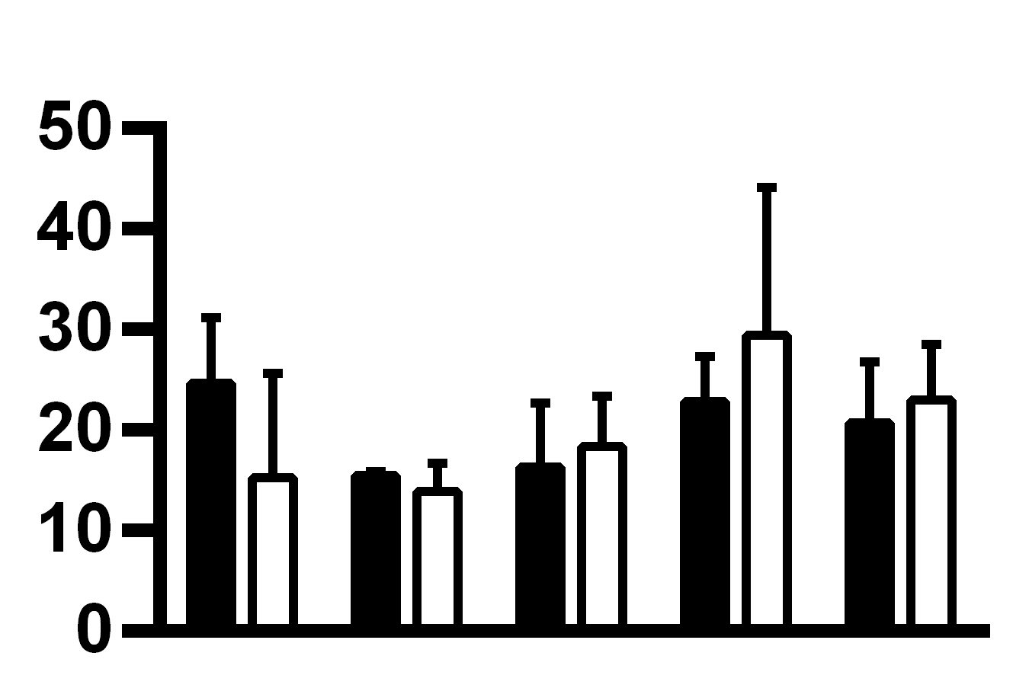
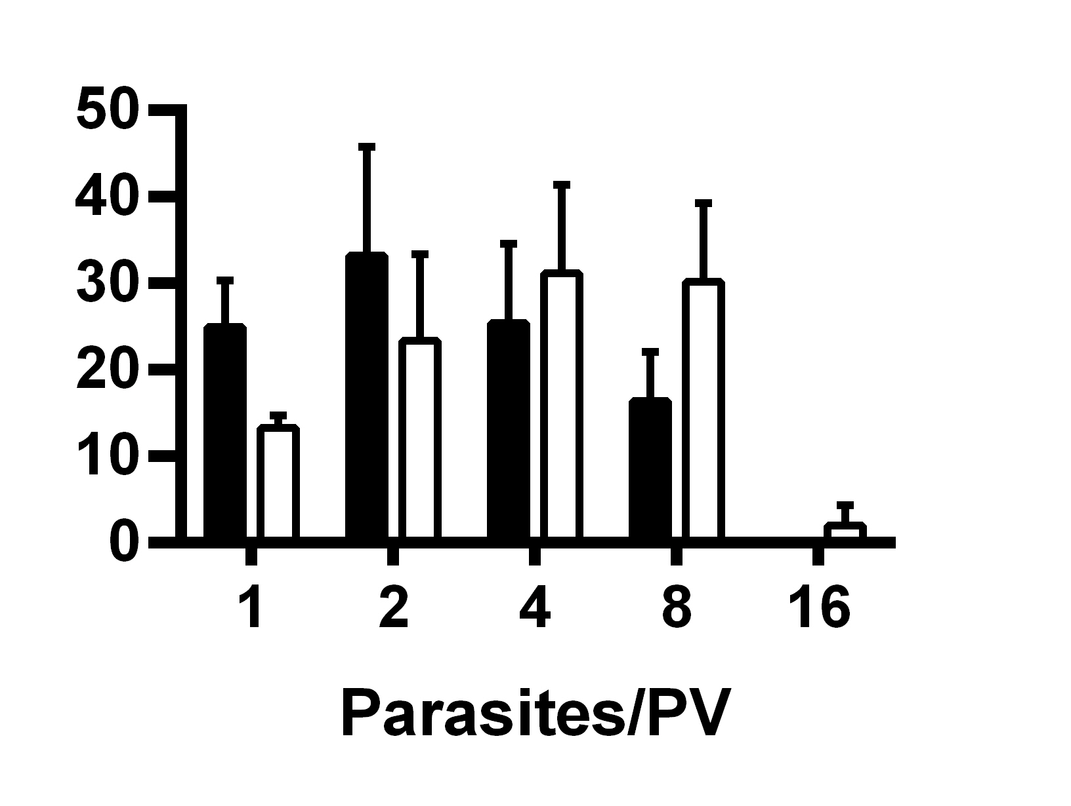
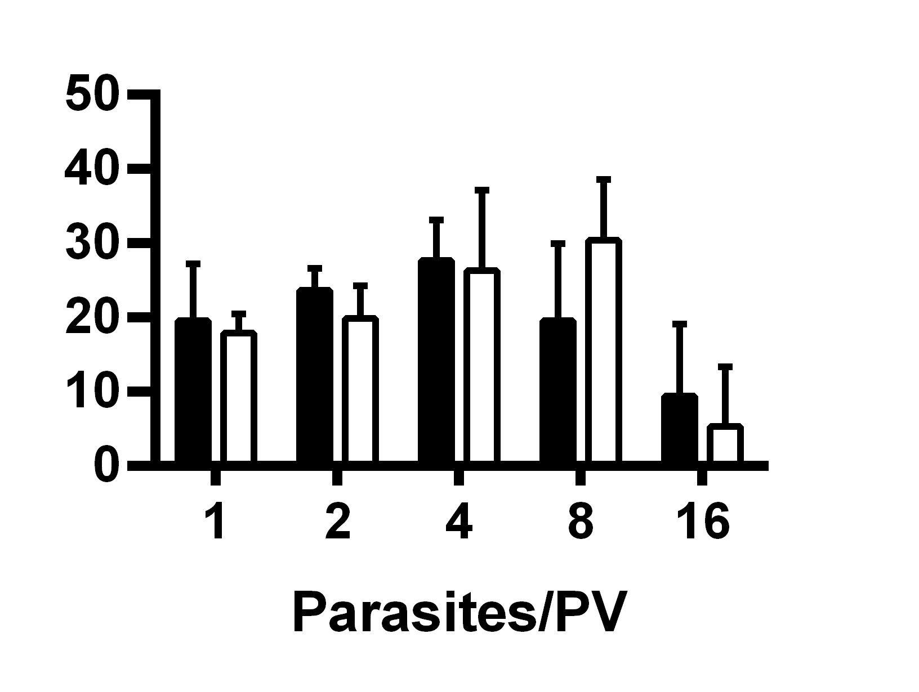
Figure S4
A
Mock
Toxo
B
HIF-1α WT
C
Neg. Ctrl.
21% O₂
HIF-1α KO
21% O₂
HK2 siRNA
% of Total Vacuoles Counted
% of Total Vacuoles Counted
3% O₂
3% O₂

