Slide 1
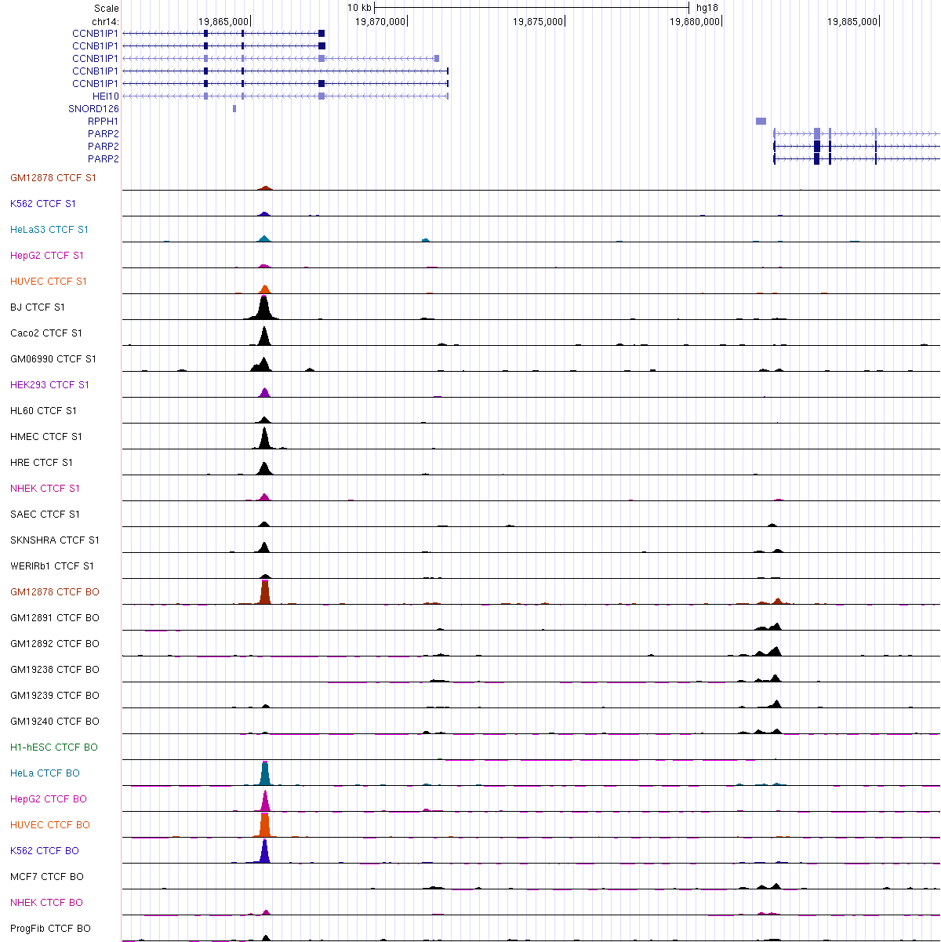
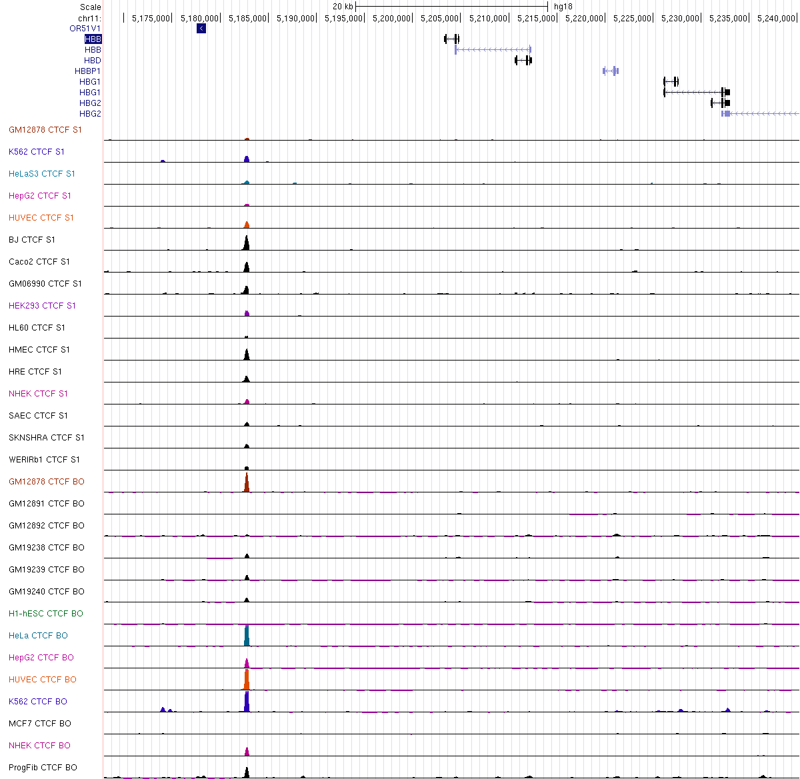
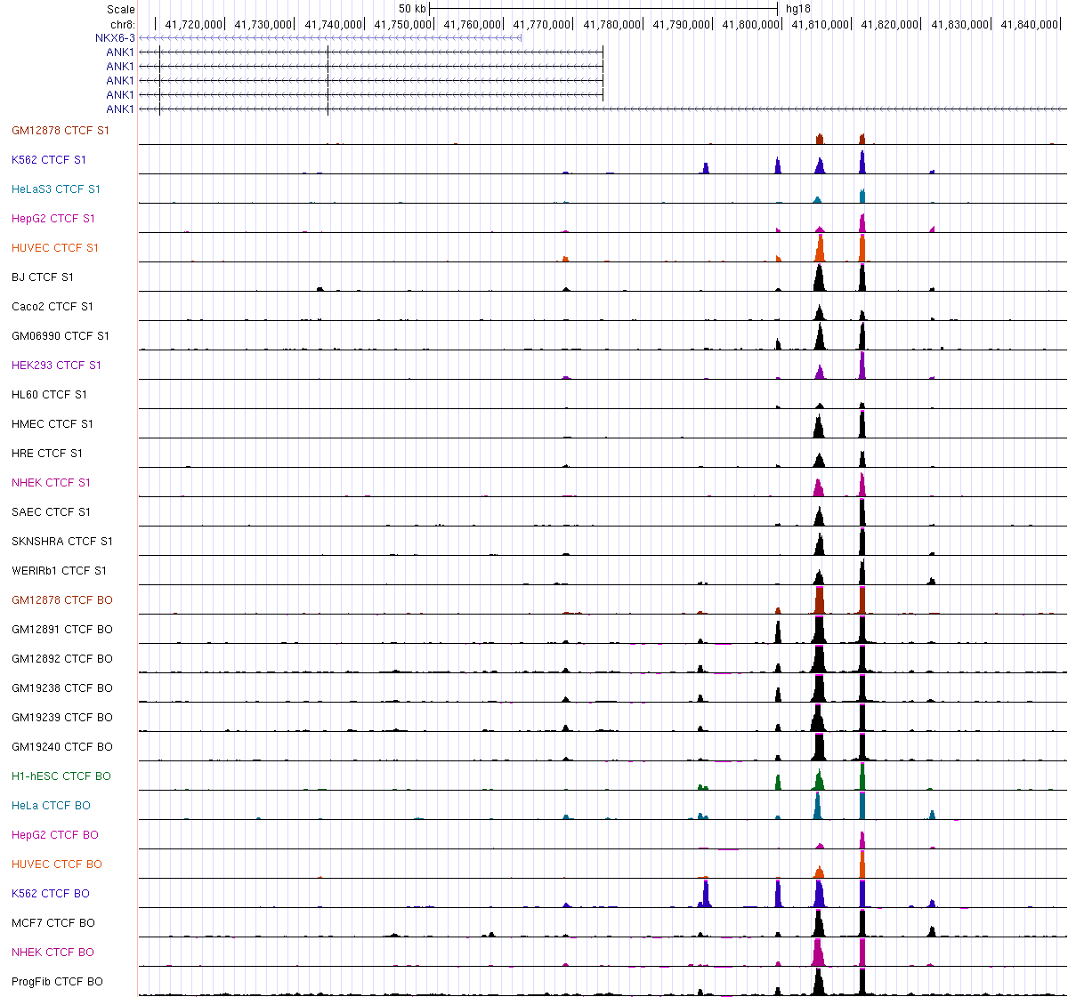
CTCF binding patterns at the human CCNB1IP1 locus
CTCF binding patterns at the human beta-globin locus
A
B
C
20kb
10kb
50kb
HBB
CCNB1IP1
PARP2
ANK1
S8 Fig. Occupancy patterns of CTCF at HBB (A), CCNB1IP1-PARP2 (B), and ANK1(C) loci in various cell lines
CTCF ChIP-seq data from the ENCODE project (https://genome.ucsc.edu/ENCODE/index.html) are shown. Red rectangles indicate the location of an insulator for each locus: 5’HS4 insulator at HBB locus, the putative CCNB1IP1-insulator, and the ANK1 insulator[18]. Whereas CTCF peaks were observed in the majority of the cell lines at the 5’HS4 insulator, no peaks were observed at CCNB1IP1 and ANK1 insulators.

