Slide 1
H₂O₂ (μM) | 0 | 200 | 0 | 200 |  | 0 | 200 | 0 | 200
Soluble / Insoluble | Sol | Sol | Insol | Insol |  | Sol | Sol | Insol | Insol
Total protein | 7.1 | 9.0 | 2.7 | 7.0 |  | 18.5 | 17.5 | 7.2 | 6.0
Insoluble adjusted by soluble protein |  |  | 0.4 | 0.8 |  | 6.5 | 4.4 | 0.4 | 0.3
% change | +107.1 |  |  |  |  | -12.7
Species | House mouse |  |  |  |  | Chinchilla
MLS (years) | 4.0 |  |  |  |  | 17.2
Supplemental Figure 1: Representative blot of detergent insoluble protein

Slide 2
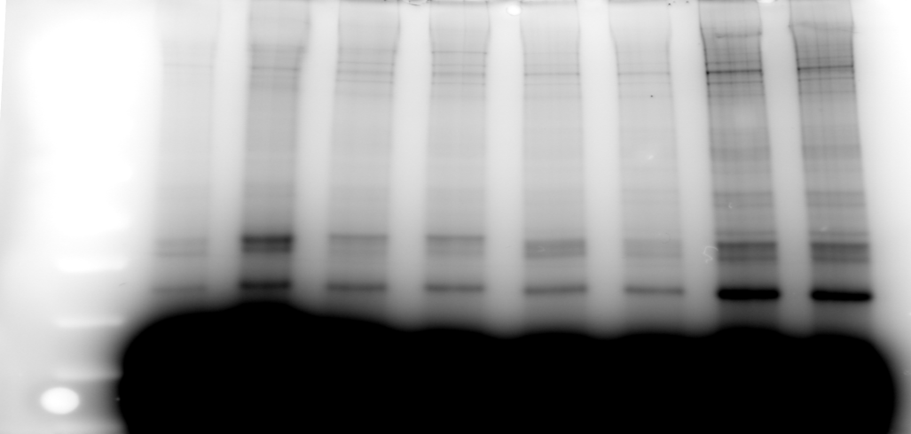
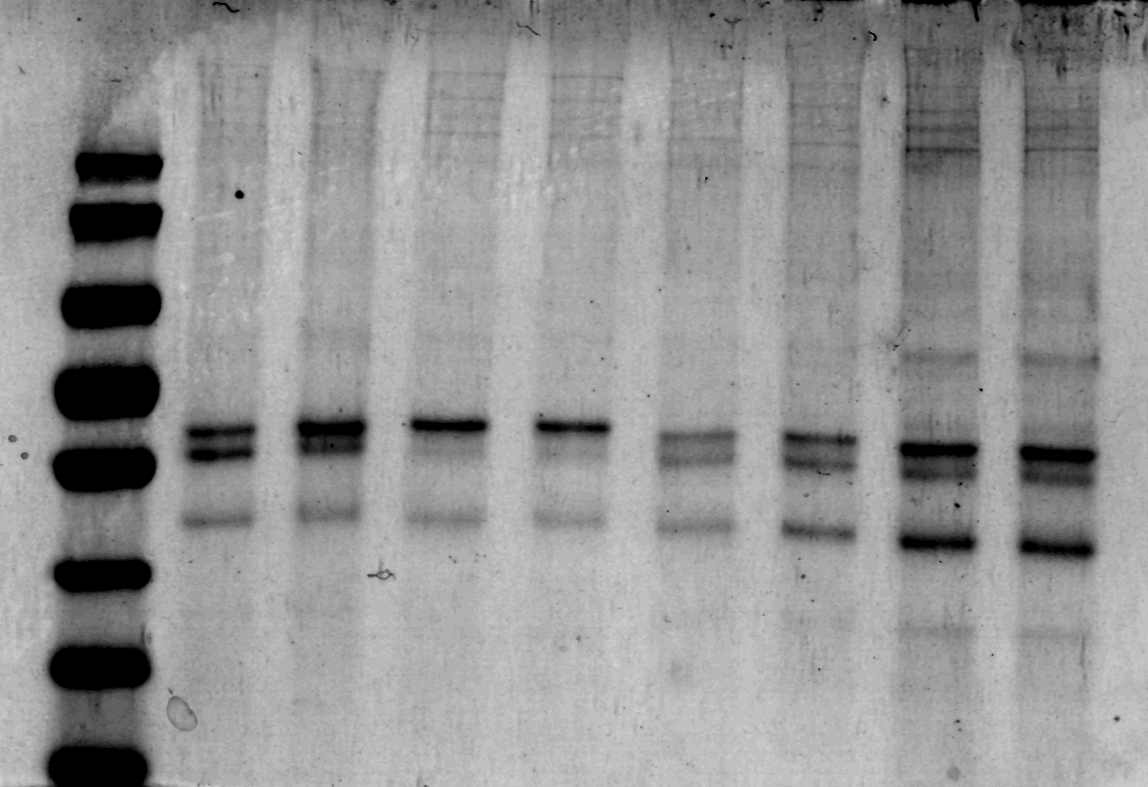
Unbound Region of
label quantification
Total protein Disulphide bonds
H₂O₂ (μM) | 0 | 100 | 0 | 100 | 0 | 100 | 0 | 100
Disulphide bonds | 9.9 | 15.5 | 12.9 | 11.6 | 11.6 | 10.0 | 17.5 | 16.1
Total protein | 2.4 | 2.5 | 1.6 | 1.2 | 1.8 | 2.3 | 5.3 | 5.0
Disulphide (adjusted to total protein) | 4.1 | 6.3 | 8.2 | 9.6 | 6.5 | 4.4 | 3.3 | 3.2
% change | +55.3 |  | +16.6 |  | -32.7 |  | -1.7
Species | Shrew |  | Gerbil |  | Fox Squirrel |  | Chinchilla
MLS (years) | 2.2 |  | 6.3 |  | 16.0 |  | 17.2
Supplemental Figure 2: Representative blot of disulphide bond formation

Slide 3
Supplemental Figure 3: (A) scatterplot of maximum lifespan against body mass (log₁₀ scale) in 52 species of mammals. (B) Scatterplot of change in protein carbonyl content following exposure to 100μM H₂O₂ body mass (log₁₀ scale) in 52 species of mammals.

Slide 4
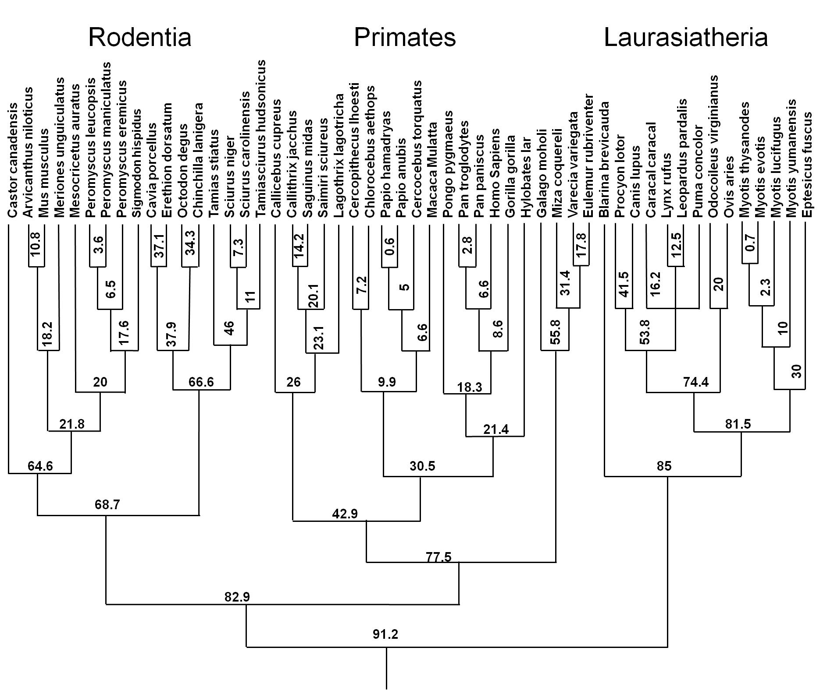
Supplemental Figure 4:
Mammalian phylogeny, values at nodes are millions of years since divergence

Slide 5
Supplemental Figure 5: Reference list for construction of phylogeny

Slide 6
A C
B
Supplemental Figure 6: Scatterplot of % change in protein carbonyl content following exposure to 5 mM paraquat. (A) Data for 16 species of rodents. (B) Data for 19 species of primates. (C) Data for 14 species of Lauriasiatheria.. Cells from humans are shown in the scatterplot (with the "H" symbol) but not used in the statistical analysis. Values are adjusted by total protein content in each sample. Error bars, if present, represent SEM of 2-3 cell lines derived from independent animals.

Slide 7
Supplemental Figure 7: Scatterplot of % change in protein carbonyl content following exposure to 5mM paraquat plotted against body mass (log₁₀ scale) in 52 species of mammals.

Slide 8
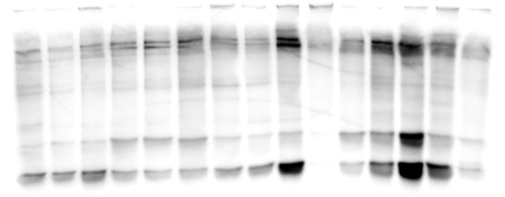
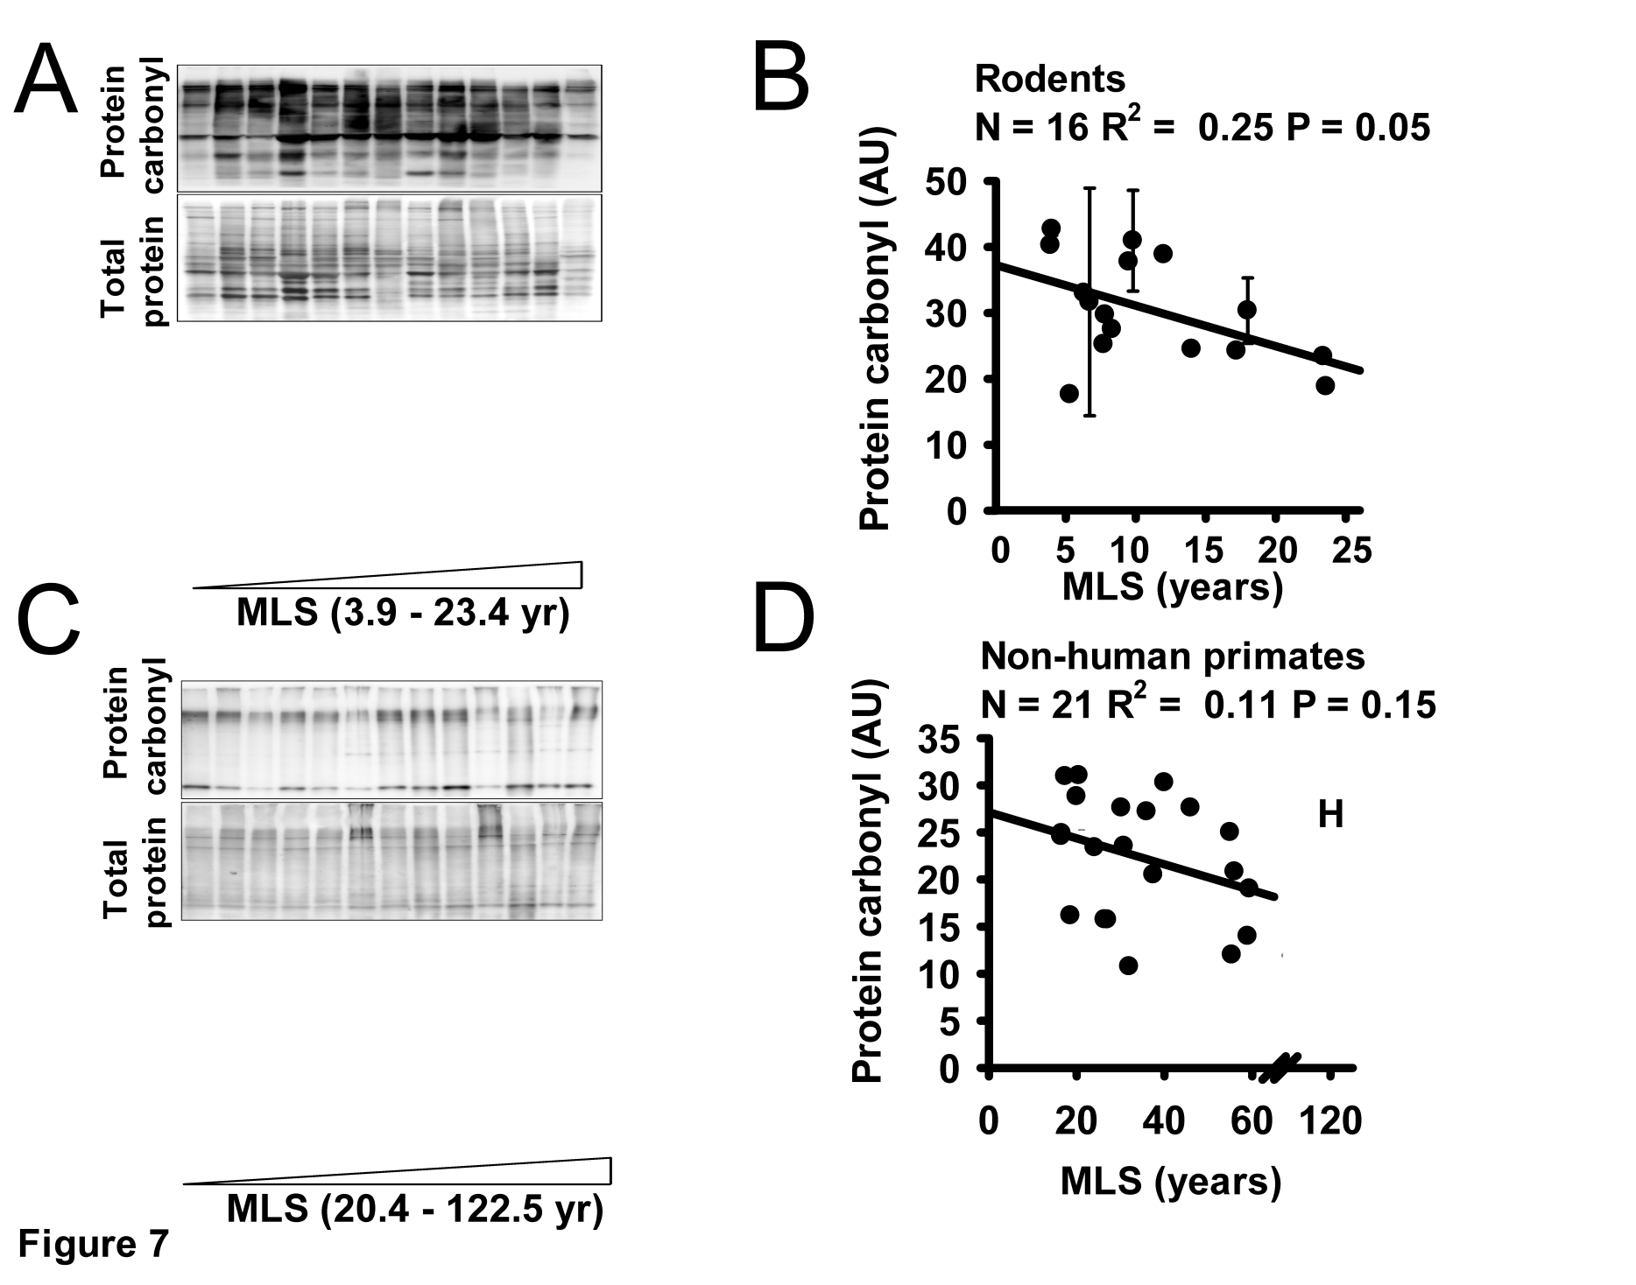
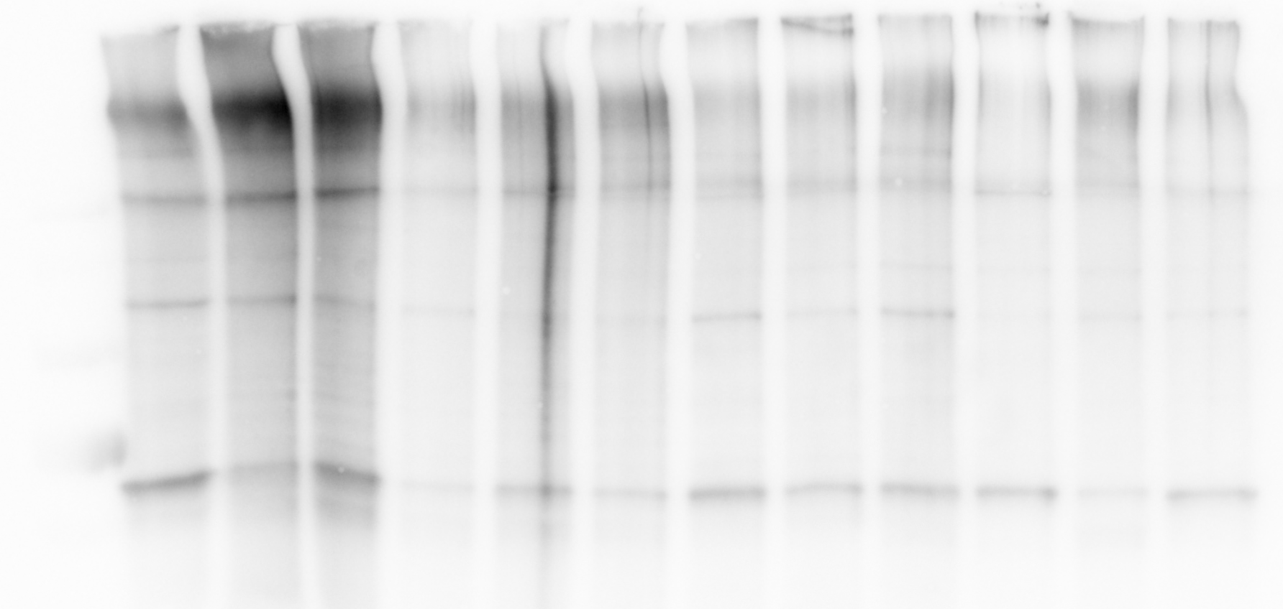
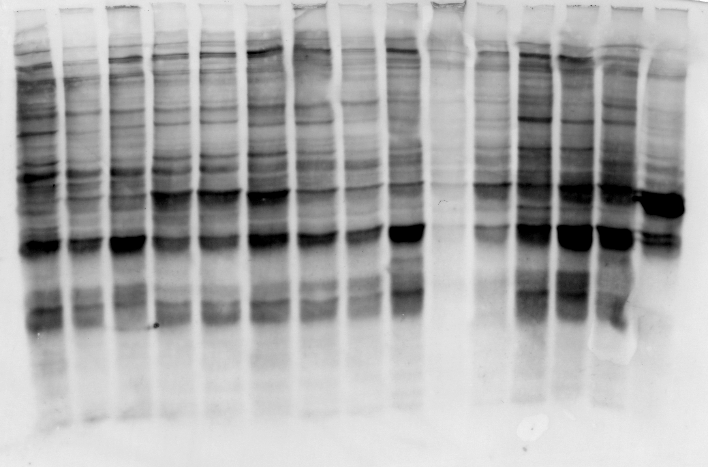
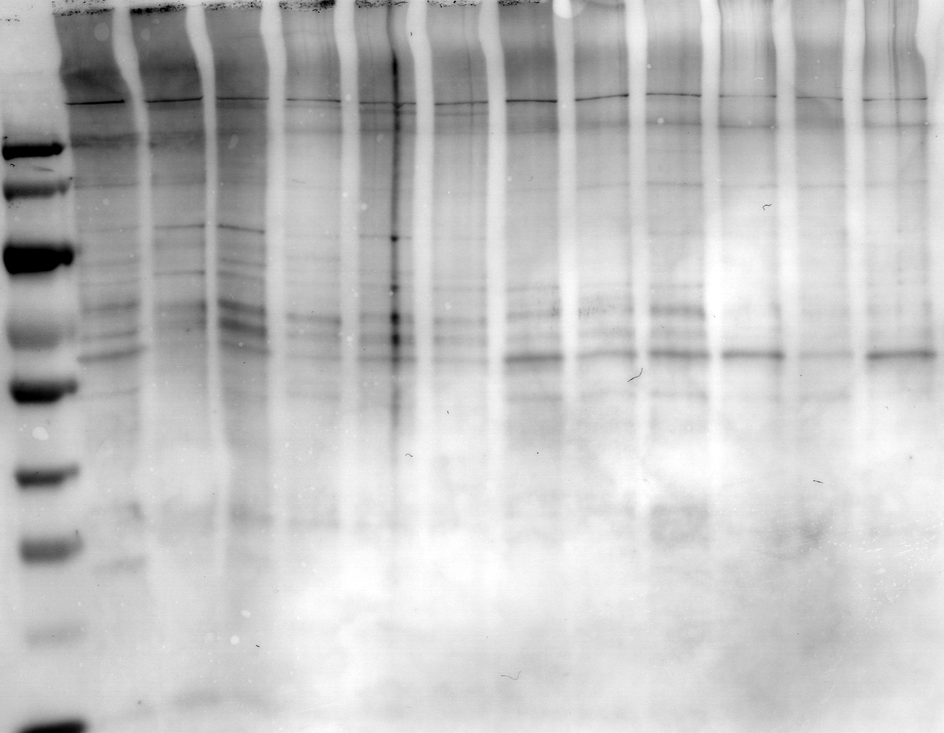
A B C
Total Protein
Protein Carbonyl
Hamster (MLS 3.9)
House mouse (MLS 4.0)
Cotton rat (MLS 5.2)
Gerbil (MLS 6.3)
Nile kusu (MLS 6.7)
Cactus mouse (MLS 7.3)
White footed mouse (MLS 7.9)
Deer mouse (MLS 8.3)
Chipmunk (MLS 9.5)
Degu (MLS 14)
Fox squirrel (MLS 16)
Chinchilla (MLS 17.2)
Porcupine (MLS 18)
Beaver (MLS 23.4)
Grey Squirrel (MLS 23.6)
Red-bellied lemur (MLS 20)
L’Hoest’s monkey (MLS 24.1)
Olive Baboon (MLS 27.5)
Squirrel monkey (MLS 30.2)
Vervet (MLS 30.8)
Woolly monkey (MLS 32)
Ruffed lemur (MLS 36)
Hamadryas (MLS 39)
Baboon (MLS 55)
Managabey (MLS 46)
Gibbon (MLS 55)
Gorilla (MLS 55.4)
Chimpanzee (MLS 59)
Human (MLS 122.5)
Shrew (MLS 2.2)
Yuma myotis (MLS 8.8)
Fringed myotis (MLS 18.3)
Big brown bat (MLS 19)
Long-eared myotis (MLS 22)
Little brown bat (MLS 34)
Wild sheep (MLS 22.8)
Deer (MLS 23)
Desert lynx (MLS 20.3)
Common raccoon (MLS 21)
Cougar (MLS 23.8)
Domestic dog (MLS 24)
Supplemental Figure 8: (A) Representative blot of baseline protein carbonyl content in (A) 15 species of rodent. (B) 14 species of primate (C) 12 species of Laurasiatheria.

Slide 9
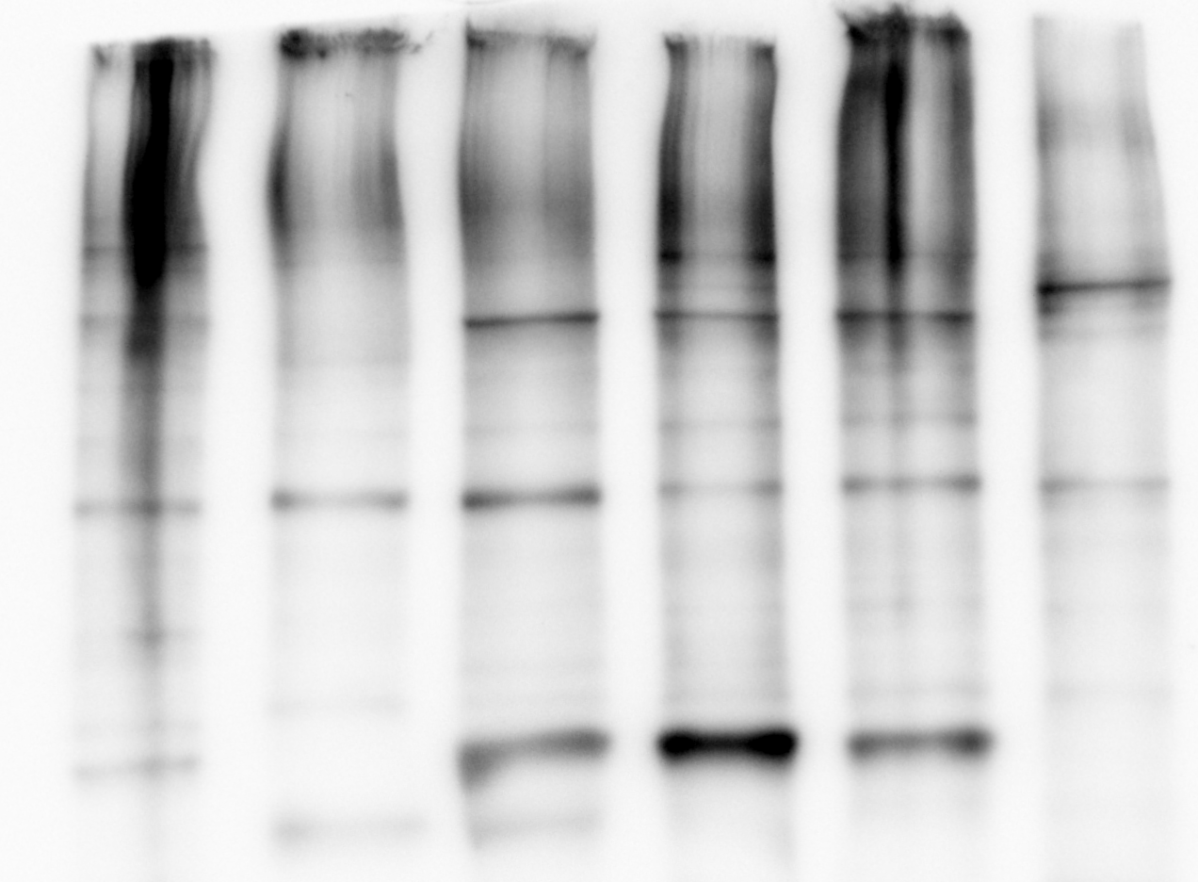
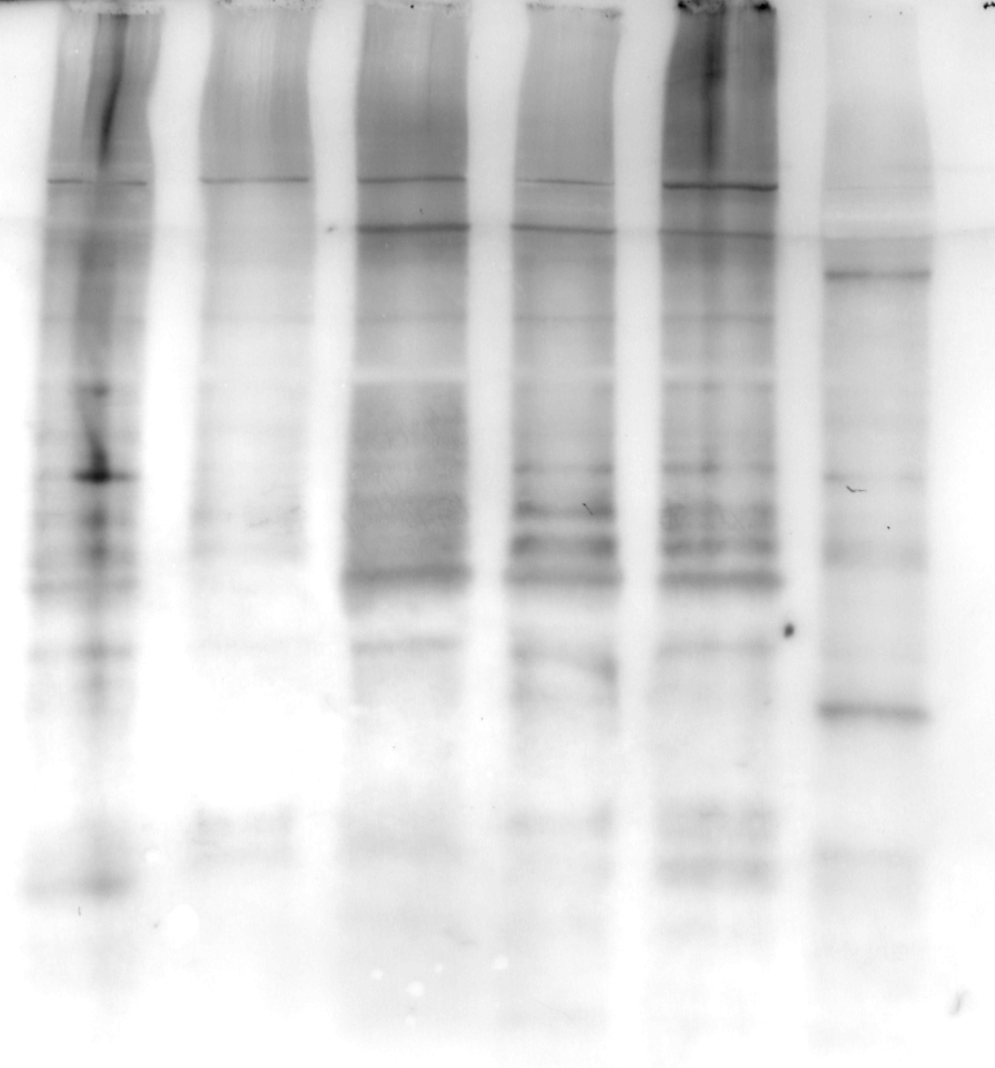
Total Protein Protein Carbonyl
Chinchilla
(mls 17.2)
Porcupine
(mls 18)
Beaver
(mls 23.4)
Lemur
(mls 20)
Titi
(mls 26.4)
Macaque
(mls 40)
Rodents Primates
Supplemental Figure 9: Representative blot of protein carbonyl content in 3 species of rodents and 3 species of primate. Protein carbonyl content is measured using an antibody against 2,4-Dinitrophenol (anti-DNP). Total protein is measured using an india ink stain.

Slide 10
Supplemental Table 1: List of rodent cell lines
Rodent species
Common Species Name | Latin Species Name | Family | MLS (yrs) | Weight (g) | Number of Donors
Golden hamster | Mesocricetus auratus | Muridae | 3.9 | 105 | 1
Wild house mouse | Mus musculus | Muridae | 4 | 20.5 | 3
Cotton rat | Sigmodon hispidus | Muridae | 5.2 | 185 | 1
Gerbil | Meriones unguiculatus | Muridae | 6.3 | 53.2 | 1
Nile kusu | Arvicanthus niloticus | Muridae | 6.7 | 110 | 3
Cactus mouse | Peromyscus eremicus | Cricetidae | 7.4 | 25 | 1
White-footed mouse | Peromyscus leucopsis | Cricetidae | 7.9 | 23 | 1
Deer mouse | Peromyscus maniculatus | Cricetidae | 8.3 | 20.5 | 1
Chipmunk | Tamias striatus | Sciuridae | 9.5 | 96 | 1
Red squirrel | Tamiasciurus hudsonicus | Sciuridae | 9.8 | 200 | 2
Guinea pig | Cavia porcellus | Caviidae | 12 | 728 | 2
Degu | Octodon degus | Octodontidae | 14 | 235 | 1
Fox squirrel | Sciurus niger | Sciuridae | 16 | 800 | 1
Chinchilla | Chinchilla lanigera | Chinchillidae | 17.2 | 642.5 | 3
North American Porcupine | Erethizon dorsatum | Erethizontidae | 18 | 8600 | 3
American Beaver | Castor canadensis | Castoridae | 23.4 | 20250 | 3
Grey squirrel | Sciurus carolinensis | Sciuridae | 25.6 | 533 | 1

Slide 11
Supplemental Table 2: List of primate cell lines
Primate species
Common Species Name | Latin Species Name | Family | MLS (yrs) | Weight (g) | Number of Donors
Common marmoset | Callithrix jacchus | Callitrichidae | 16.5 | 255 | 1
Southern lesser bushbaby | Galago moholi | Galagonidae | 16.6 | 175 | 1
Coquerel's mouse lemur | Mizra coquereli | Cheirogaleidae | 17.4 | 311 | 1
Pygmy marmoset | Callithrix pygmaea | Callitrichidae | 18.6 | 124 | 1
Red-bellied lemur | Eulemur rubriventer | Lemuridae | 20 | 1765 | 1
Red tamarin | Saguinus midas | Callitrichidae | 20.5 | 501 | 1
L'Hoest's monkey | Cercopithecus lhoesti | Cercopithecidae | 24.1 | 4700 | 1
Red titi | Callicebus cupreus | Pitheciidae | 26.4 | 1120 | 1
Olive baboon | Papio anubis | Cercopithecidae | 27.5 | 24000 | 1
Common squirrel monkey | Saimiri sciureus | Cebidae | 30.2 | 925 | 1
Vervet | Chlorocebus aethiops | Cercopithecidae | 30.8 | 5620 | 4
Common woolly monkey | Lagothrix lagotricha | Cebidae | 32 | 7650 | 1
Black & white ruffed lemur | Varecia variegata | Lemuridae | 36 | 3670 | 1
Hamadryas baboon | Papio hamadryas | Cercopithecidae | 37.5 | 18000 | 2
Rhesus macaque | Macaca mulatta | Cercopithecidae | 40 | 8235 | 2
Red-capped mangabey | Cercocebus torquatus | Cercopithecidae | 46 | 9493 | 1
Bonobo | Pan paniscus | Hominidae | 55 | 39925 | 1
Gorilla | Gorilla gorilla | Hominidae | 55.4 | 139842 | 2
White-handed gibbon | Hylobatus lar | Hylobatidae | 56 | 6810 | 1
Orangutan | Pongo pygmaeus | Hominidae | 59 | 64475 | 1
Chimpanzee | Pan troglodytes | Hominidae | 59.4 | 44984 | 2
Human | Homo sapiens | Hominidae | 122.5 | 62035 | 2

Slide 12
Supplemental Table 3: List of Laurasiatheria cell lines
Laurasiatheria species
Common Species Name | Latin Species Name | Order | MLS (yrs) | Weight (g) | Number of Donors
Northern Short-tailed Shrew | Blarina brevicauda | Soricomorpha | 2.2 | 21.6 | 3
Yuma Myotis | Myotis yumanensis | Chiroptera | 8.8 | 6.25 | 1
Fringed Myotis | Myotis thysanodes | Chiroptera | 18.3 | 6 | 1
Desert lynx | Caracal caracal | Carnivora | 20.3 | 16000 | 1
Big brown bat | Myotis lucifugus | Chiroptera | 19 | 23 | 2
Raccoon | Procyon lotor | Carnivora | 21 | 6000 | 2
Western Long-eared Myotis | Myotis evotis | Chiroptera | 22 | 7.4 | 1
Wild Sheep | Ovis aries | Artiodactyla | 22.8 | 80000 | 2
White-tailed deer | Odocoileus virginianus | Artiodactyla | 23 | 87000 | 1
Cougar | Puma concolor | Carnivora | 23.4 | 63000 | 1
Domestic dog | Canis familiaris | Carnivora | 24 | 40000 | 1
Ocelot | Leopardus pardalis | Carnivora | 28.2 | 88000 | 1
Bobcat | Lynx rufus | Carnivora | 32.3 | 94000 | 2
Little brown bat | Eptesicus fuscus | Chiroptera | 34 | 10 | 3

Slide 13
Supplemental Table 4: List of bird cell lines
Bird species
Common Species Name | Latin Species Name | Order | MLS (yrs) | Weight (g) | Number of Donors
Yellow-rump warbler | Dendroica coronata | Passeriformes | 6.9 | 12 | 1
Horned lark | Eremophila alpestris | Passeriformes | 8 | 33.5 | 1
Carolina wren | Thryothorus ludovicianus | Passeriformes | 9.2 | 17.5 | 1
Killdeer | Charadrius vociferus | Charadriiformes | 10.9 | 88 | 1
House finch | Carpodacus mexicanus | Passeriformes | 11.6 | 21.4 | 1
Barn swallow | Hirundo rustica | Passeriformes | 16 | 18.3 | 1
American robin | Turdus migratorius | Passeriformes | 17 | 75.5 | 1
Gray catbird | Dumetella carolinensis | Passeriformes | 17.9 | 34.5 | 1
Gadwall | Anas strepera | Anseriformes | 22.3 | 791 | 1
Wood duck | Aix sponsa | Anseriformes | 22.5 | 452.8 | 1
Pheasant | Phasianus colchicus | Galliformes | 27 | 1095 | 1
Mallard | Anas platyrhynchos | Anseriformes | 29.1 | 1,048 | 1
Mourning dove | Zenaida macroura | Columbiformes | 31.3 | 119 | 1
Rock dove | Columba livia | Columbiformes | 35 | 358.7 | 1
Ostrich | Struthio camelus | Struthioniformes | 50 | 111,000 | 1

Slide 14
Supplemental Table 5: List of cell lines obtained from Corriell cell repository
Common Species Name | Latin Species Name | MLS (yrs) | Corriell Cell Line Name
Southern lesser bushbaby | Galago moholi | 16.6 | PR00519
Coquerel's mouse lemur | Mizra coquereli | 17.4 | PR01044
Pygmy marmoset | Callithrix pygmaea | 18.6 | PR00839
Red-bellied lemur | Eulemur rubriventer | 20 | PR00273
Red tamarin | Saguinus midas | 20.5 | PR00550
Red titi | Callicebus cupreus | 26.4 | PR00793
Olive baboon | Papio anubis | 27.5 | PR00033
Common squirrel monkey | Saimiri sciureus | 30.2 | PR00612
Common woolly monkey | Lagothrix lagotricha | 32 | AG05356
Black & White ruffed lemur | Varecia variegata | 36 | PR00293
Red-capped mangabey | Cercocebus torquatus | 46 | PR00485
Bonobo | Pan paniscus | 55 | PR00235
Gorilla | Gorilla gorilla | 55.4 | PR00055 | PR00278
White-handed gibbon | Hylobatus lar | 56 | PR001131
Orangutan | Pongo pygmaeus | 59 | PR01107
Chimpanzee | Pan troglodytes | 59.4 | PR00175 | PR00115
Human | Homo sapiens | 122.5 | GM02937 | GM02912

