Slide 1
Revealing Glycoproteins in the Secretome from MCF-7 Human Breast Cancer Cells
Aik-Aun Tan¹, Wai-Mei Phang², Subash C.B. Gopinath⁴, Onn H. Hashim⁵, Lik-Voon Kiew⁶ and Yeng Chen^{2, 3*}
¹Institute for Research in Molecular Medicine (INFORMM), Universiti Sains Malaysia, Penang 11800, Malaysia
²Department of Oral Biology & Biomedical Sciences, Faculty of Dentistry, University of Malaya, Kuala Lumpur 50603, Malaysia
³Oral Cancer Research and Coordinating Centre, Faculty of Dentistry, University of Malaya, Kuala Lumpur 50603, Malaysia
⁴Institute of Nano Electronic Engineering (INEE) & School of Bioprocess Engineering, Universiti Malaysia Perlis, Kangar, Perlis, Malaysia
⁵Department of Molecular Medicine, Faculty of Medicine, University of Malaya, Kuala Lumpur 50603, Malaysia
⁶Department of Pharmacology, Faculty of Medicine, University of Malaya, Kuala Lumpur 50603, Malaysia

Slide 2
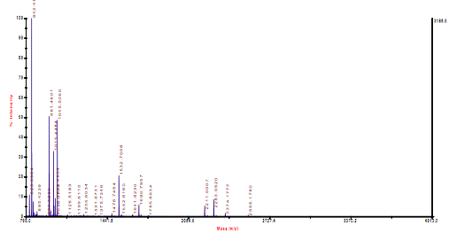
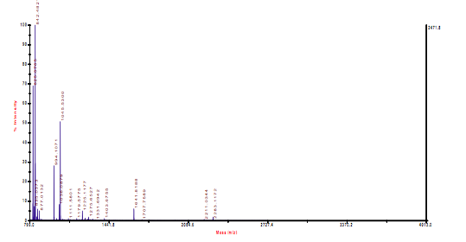
(a)
(b)
Suppl. Fig. 1

Slide 3
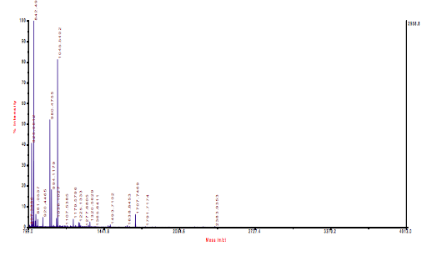
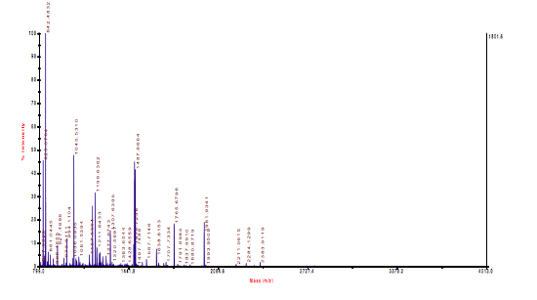
(c)
(d)
Suppl. Fig. 1

Slide 4
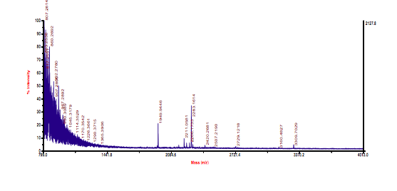
(e)
Suppl. Fig. 1

Slide 5
Supplementary figure legends
S. Figure 1
Mass spectra of tryptic peptides derived from MCF-7 growth media. Protein identity of (a) carboxypeptidase A4 (CPA4), (b) alpha-1-antitrypsin (AAT), (c) haptoglobin (HP), (d) HSC-70 (HSC70), and (e) osteonectin (ON) were confirmed by ABI 4800 Proteomics Analyzer MALDI-TOF/TOF Mass Spectrometer. Analyses were performed in reflectron mode.

