Slide 1
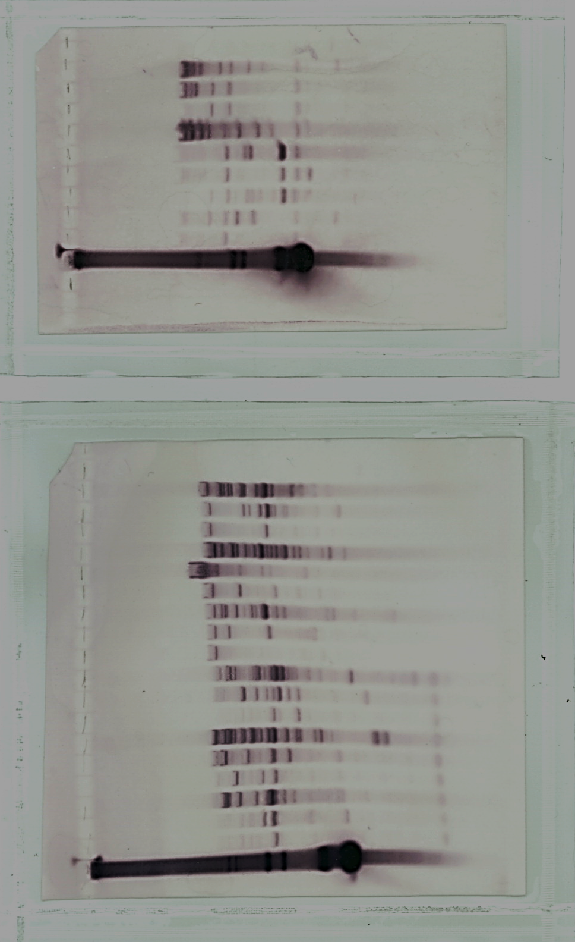
A
E
E
E
E
Xb
E
PeUMPS gene
1 kb
B
XbaI, EcoRI, HindIII
KpnI
TUBP
cPeUMPS
ACTT
pUT1
XbaI
NcoI
HindIII
KpnI
RBCSP
cPeUMPS
RBCST
pUT2
0.5 kb
C
EcoRI
XbaI
PC
1
2
3
4
5
6
7
8
9
1
2
3
4
5
6
7
8
9
19
19
7.7
7.7
6.2
6.2
4.3
4.3
3.5
3.5
2.7
2.7
1.9
1.9
1.5
1.5
0.9
M4
M4-1D
M4-1C
M4-1A
M4-1B
M4-2A
M4-2B
M4-2D
M4-2E
M4
M4-1D
M4-1C
M4-1A
M4-1B
M4-2A
M4-2B
M4-2D
M4-2E
0.9
0.4
0.4
Fig. S2

