Slide 1
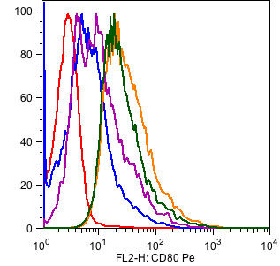
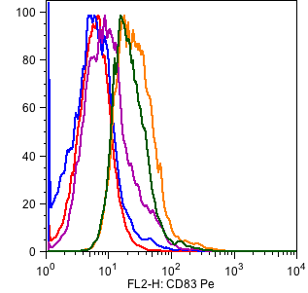
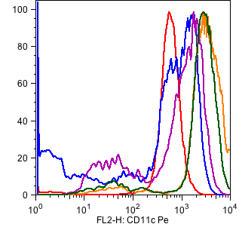
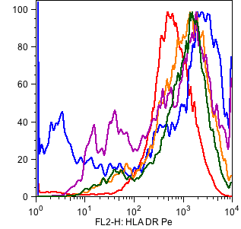
Type | Median Fluorescence
No stimulation | 2.7
K/pp65 | 5.6
K/OX40L/pp65 | 8.7
K/CD40L/pp65 | 27.9
K/CD40L/OX40L/pp65 | 22.3
Type | Median Fluorescence
No stimulation | 5.8
K/pp65 | 5.2
K/OX40L/pp65 | 8.8
K/CD40L/pp65 | 24.4
K/CD40L/OX40L/pp65 | 19.8
Type | Median Fluorescence
No stimulation | 573
K/pp65 | 594
K/OX40L/pp65 | 1104
K/CD40L/pp65 | 3162
K/CD40L/OX40L/pp65 | 2763
Type | Median Fluorescence
No stimulation | 583
K/pp65 | 890
K/OX40L/pp65 | 723
K/CD40L/pp65 | 1024
K/CD40L/OX40L/pp65 | 1155
Supplementary Figure 1. Expression of CD80, CD83, CD11c and HLA-DR by monocytes 72 hours after co-culture with irradiated K/pp65 (in blue), K/OX40L/pp65 (in violet), K/CD40L/pp65 (in orange) and K/OX40L/CD40L/pp65 (in green). The red line represents the expression of CD80, CD83, CD11c and HLA-DR before the stimulation.

Slide 2
100
K/CD40L/OX40L/pp65
100
K/CD40L/OX40L/pp65
K/CD40L/OX40L
K/CD40L/OX40L
80
K/pp65
80
K/pp65
60
60
% of specific lyses at 40:1 ratio (E:T)
% of specific lyses at 20:1 ratio (E:T)
40
40
20
20
0
0
CHLA255
Raji
Irrel
pp65
CHLA255
Raji
Irrel
pp65
100
K/CD40L/OX40L/pp65
100
K/CD40L/OX40L/pp65
K/CD40L/OX40L
80
K/CD40L/OX40L
80
K/pp65
K/pp65
60
60
% of specific lyses at 10:1 ratio (E:T)
% of specific lyses at 5:1 ratio (E:T)
40
40
20
20
0
0
CHLA255
Raji
Irrel
pp65
CHLA255
Raji
Irrel
pp65
Supplementary Figure 2. Cytotoxic activity (⁵¹Cr-release assay at 40:1, 20:1, 10:1 and 5:1 effector:target ratios) of CAR-CMV-CTLs stimulated in vitro by K/pp65 or K/CD40L/pp65 or K/CD40L/OX40L/pp65. Targets are CHLA-255 neuroblastoma cells (GD2⁺ cells) and Raji lymphoma cells (GD2⁻ cells). PHA blasts pulsed with CMV-pp65 or irrelevant pepmixes were also used as positive and negative target cells, respectively. Data summarize mean ± SD of 4 donors.

