Slide 1
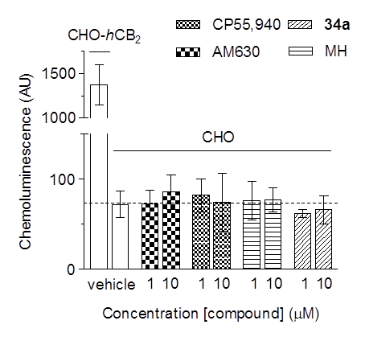
Suppementary Figure 1. [³⁵S]GTPγS binding assays performed in mock transfected CHO cells. CP55,940, AM630, MH and 34a were tested in [³⁵S]GTPγS assays using 20 µg of membranes obtained from mock-transfected CHO cells at concentrations of 1 and 10 µM. The level of basal [³⁵S]GTPγS binding in CHO-hCB₂ cells is also reported as a reference.

Slide 2
AM630
CP55,940
Supplementary Figure 2. Pharmacological behaviour of AM630 and CP55,940 in presence or absence constitutive activity of CB₂ receptors. In presence of constitutive activity, AM630 increased forskolin-induced cAMP production while this effect is abolished upon 24 h pre-treatment with 10 µM of AM630 (CB₂ receptors in the inactive state). The effects of CP55,940 on cAMP were not affected by the presence or absence of constitutively activated CB₂ receptors.

Slide 3
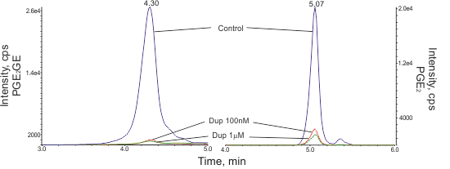
RAW264.7
A
hCOX-2
B
Cell homogenate
C
Intact cells
D
E
2-AG oxygenation
AA oxygenation
Supplementary Figure 3. The effects of DuP-697 in different cellular systems. The non-selective COX-2 inhibitor DuP-697 showed the same potency of inhibiting PGE₂ and PGE₂-GE formation in (A) purified hCOX-2, (B) RAW264.7 cell homogenate and (C) intact cells. (D) Chromatograms of PGE₂ and PGE₂-GE formation in RAW264.7 intact cells. (E) DuP-697 retained the non selective inhibition of COX-2 activity also in RAW264.7 cells stimulated to endogenously produce 2-AG.

Slide 4
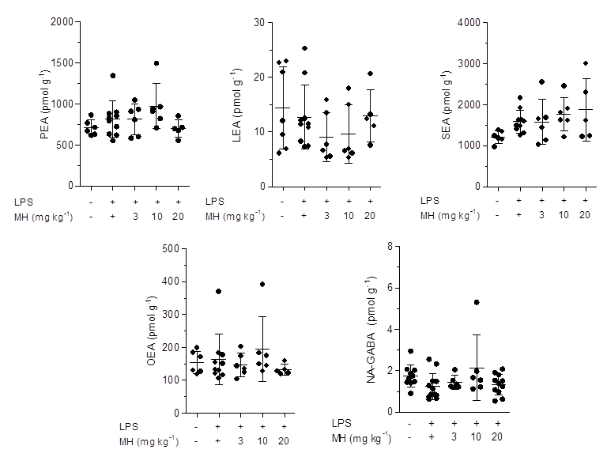
Supplementary Figure 4. LC-MS/MS quantification of N-acetylethanolamines in mouse brain. Palmitoyl-, linoleoyl-, stearoyl-, oleoyl ethanolamides and NA-GABA were quantified in brains from mice challenged for 6 h with LPS (i.p., 2.5 mg kg⁻¹, or saline), after 1 h of pre-treatment with MH (i.p., 3, 10 and 20 mg kg⁻¹) or vehicle.

Slide 5
Supplementary Figure 5. [³H]AEA uptake into U937 cell-derived macrophages. Different concentrations of MH and 32 were pre-incubated for 15 min with U937 cell-derived macrophages and then cells were incubated for 5 min with 100 nM of [³H]AEA. UCM707 was used as positve control. The radioactivity associated with the liphophilic fraction extracted from cells was expressd in % of vehicle-treated cells.

Slide 6
A
B
Supplementary Figure 6. Screening of several MHK, honokiol and magnolol derivaitves for SSI of COX-2 activity. (A) Screening of the library at 2 µM using 2-AG (10 µM) as hCOX-2 substrate. (B) hCOX-2 was added to 10 µM of AA or 2-AG after 30 min pre-treatment with 2 µM of the hit compounds, vehicle or the positive control (DuP-697). *p<0.05, **p<0.01 2-AG substrate vs. AA substrate

