Slide 1
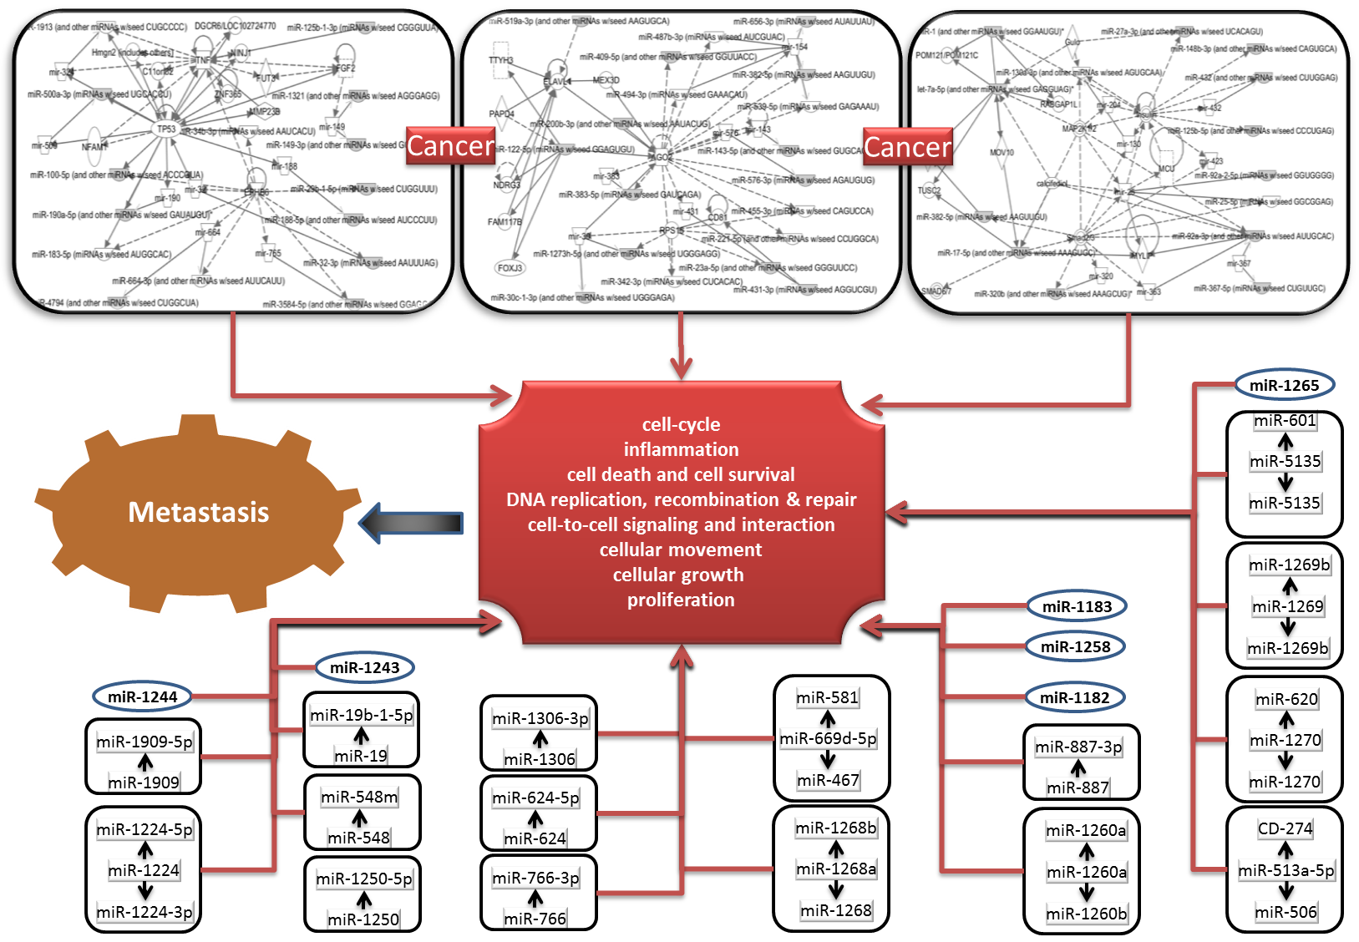
Supplementary Figure 1. Ingenuity interaction networks for the miRNAs reorganized in aggressive high-risk metastatic neuroblastoma. All networks identified by IPA converge at biological functions that endorses metastatsis and, thereby signify their role as metastamiRs

