Slide 1
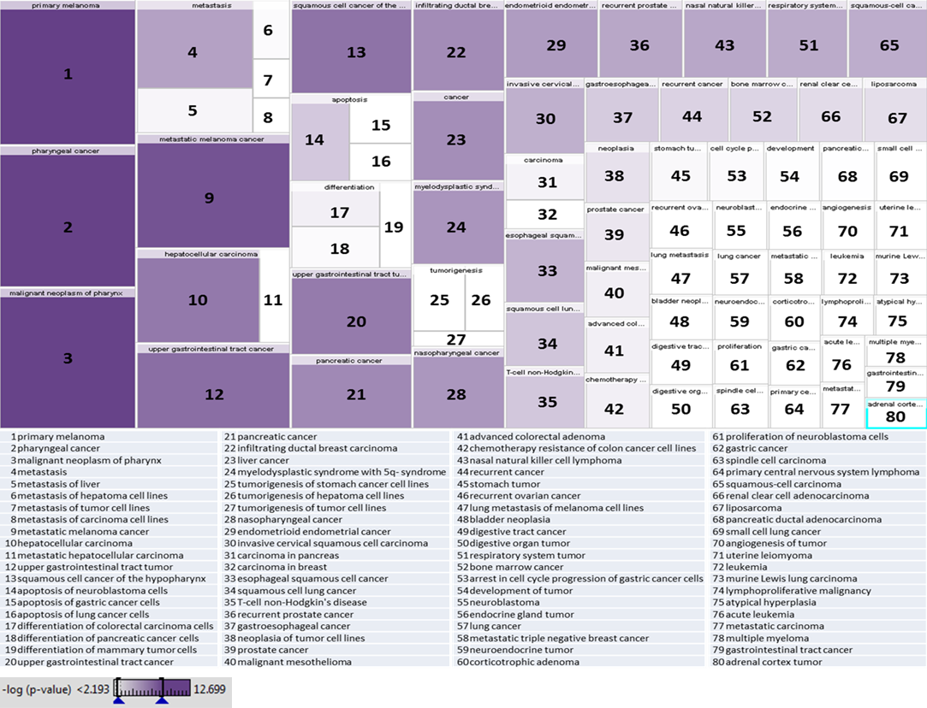
Supplementary Figure 2. Ingenuity pathway analysis: Heat map showing the association of the identified metastamiRs in multiple tumor systems. Box sizes correspond to the number of focus molecules and the color intensity is the –log(p-value). Numerical labels in the boxes corresponds to the tumor type.

