Slide 1
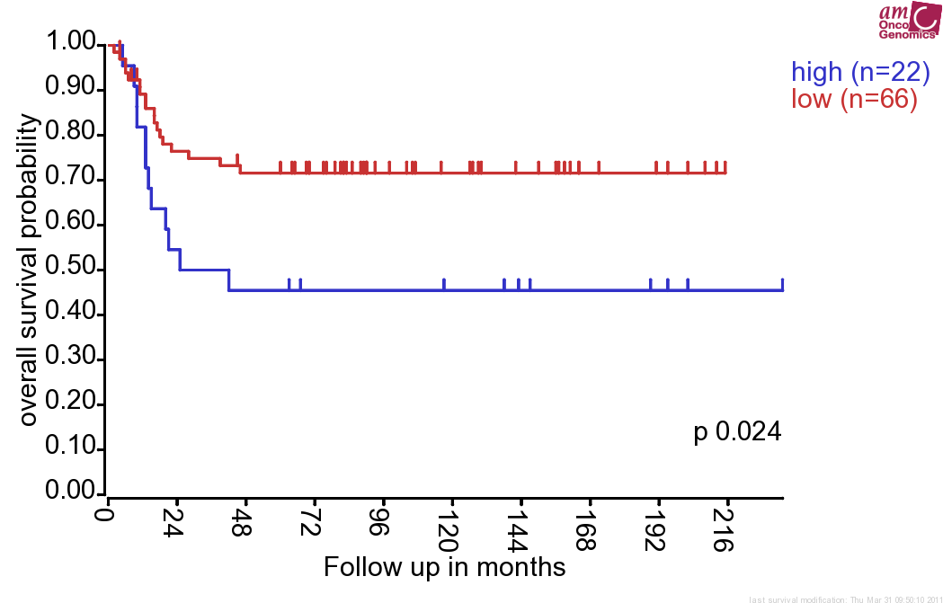
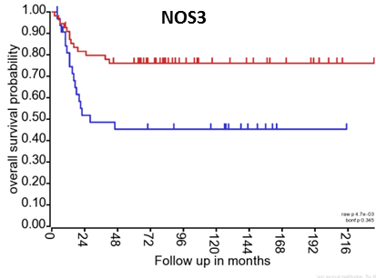
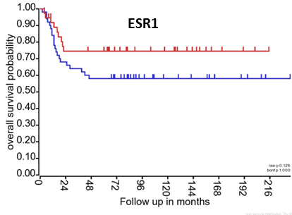
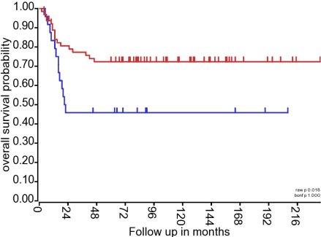
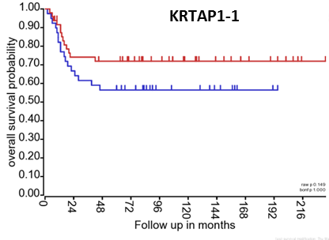
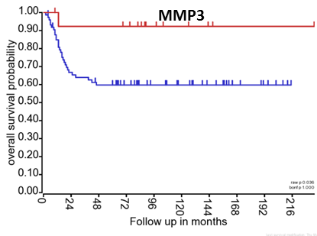
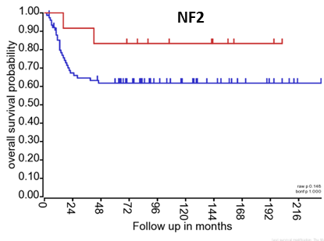
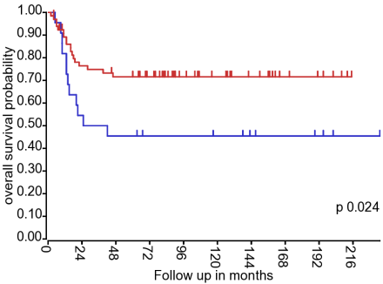
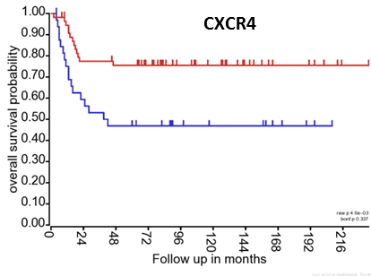
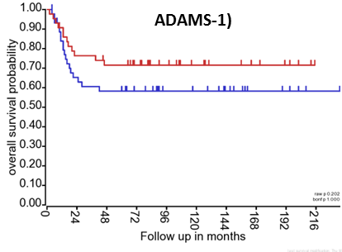
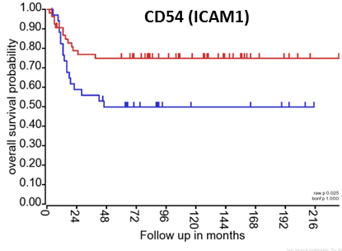
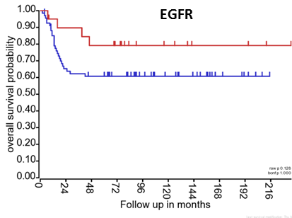
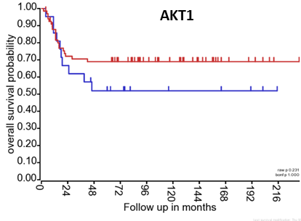
Supplementary Figure 4. Kaplan Meier plots showing clinical outcomes in a cohort of 88 neuroblastoma patients in association with the expression pattern of metastamiRs’ targets NOS3, ESR1, SELE, KRTAP1-1, MMP3, NF2, ELK-1, CXCR4, ADAMTS-1, ICAM-1, EGFR and ATK-1. All these targets showed induced expression levels in MSDACs (compared to parental SH-SY5Y) and manifold of metastatic tumors (compared with non-metastatic xenograft) as examined with immunoblotting.
MMP9
VEGF

