Slide 1
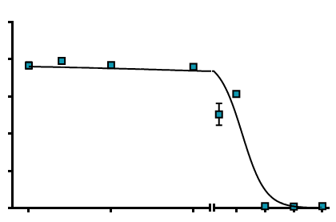
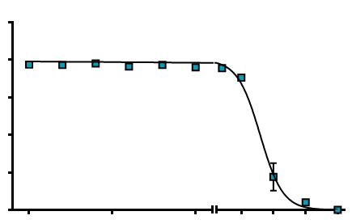
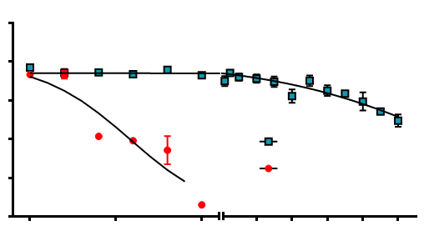
Supplementary Figure 2
A
125
SUM190
B
125
rSUM190
100
100
75
75
% Cell Viability
% Cell Viability
50
50
25
25
0
0
DSF (µM)
DSF (µM)
0
0.25
0.5
2.5
5
7.5
10
0
0.25
0.5
2.5
5
7.5
10
C
125
MDA-IBC-3
100
75
% Cell Viability
50
DSF
25
DSF-Cu
0
DSF (µM)
0
0.25
0.5
10
20
30
40
50

