Slide 1
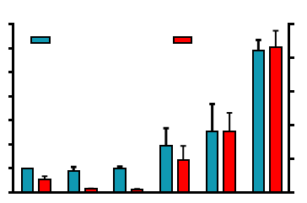






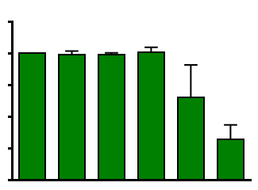
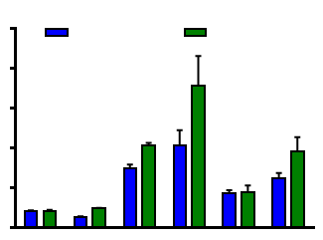
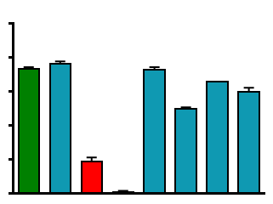







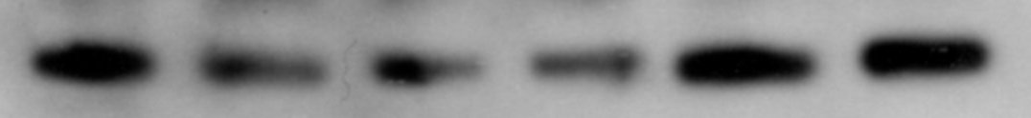

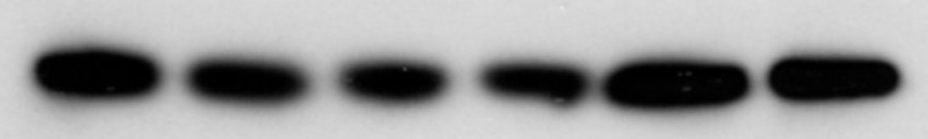





Figure 2
A
rSUM149
B
7
**
50
DSF
DSF-Cu
6
MitoSOX Red
DHE
**
U
Cu
300
100
200
300
5
40
SOD1
Fold increase in
mitochondrial superoxides
30
SOD2
4
% Cells with high
cytoplasmic superoxides
3
20
SUM149
GAPDH
2
10
SOD1
1
SOD2
0
-
-
0
DSF (nM)
Cu
300
100
200
300
GAPDH
-
-
+
+
+
+
rSUM149
C
D
1.25
12.5
SUM149
*
rSUM149
1.00
10.0
0.75
7.5
Reduced glutathione
content
Fold induction of
Nrf2 activity
*
*
0.50
*
5.0
**
**
*
**
0.25
2.5
*
0
0
DSF (nM)
Cu
-
300
-
100
200
300
DSF (µM)
Cu
-
0.15
-
0.15
10
20
-
-
+
+
+
+
-
-
+
+
-
-
E
F
DSF
DSF-Cu
DSF
DSF-Cu
rSUM149
U
Cu
300
100
200
300
U
Cu
300
100
200
300
125
p-NF-κB
100
**
**
NF-κB
75
**
**
GAPDH
% Cell Viability
p-p38
50
p38
25
GAPDH
0
p-ERK1/2
DSF-Cu
SOD Mimic
- - 200 300 200 300 200 300
- 200 - 100 200
ERK1/2
GAPDH
SUM149
rSUM149

