Slide 1
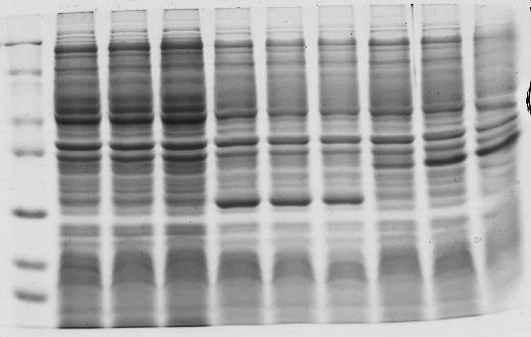
BL21 + pET28a
+ SbASR-1
BL21
BL21 + pET28a
M 2hr 4hr 6hr 2hr 4hr 6hr 2hr 4hr 6hr
kDa
116.0
68.0
45.0
35.0
25.0
18.0
14.4
Figure S4: SDS-PAGE analysis of the 6-Histidine tagged SbASR-1 recombinant protein expressed in E.coli BL21 (DE3) cells. Lane 1, protein standard marker; lane 2-4, BL21 (DE3); lane 5-7, BL21 containing pET28a; lane 8-10, BL21 harboring pET28a:SbASR-1 after induction with 1mM IPTG.

