Slide 1
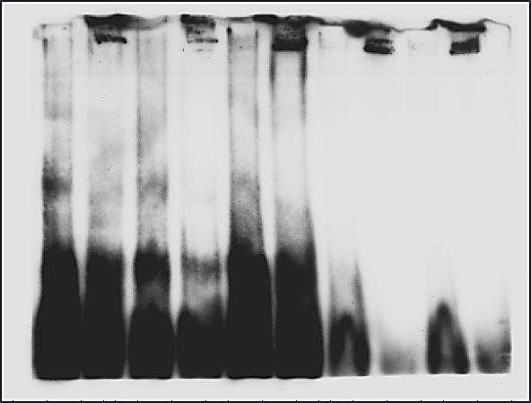
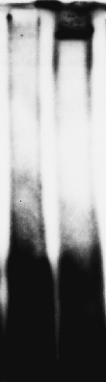
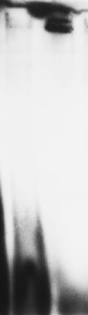
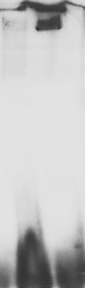
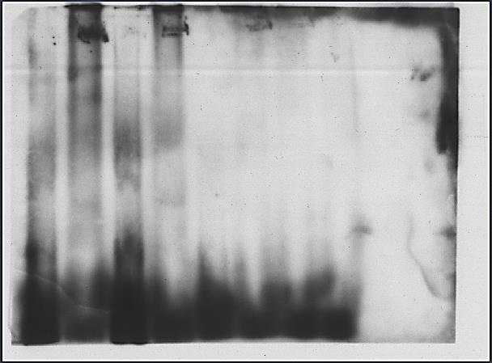
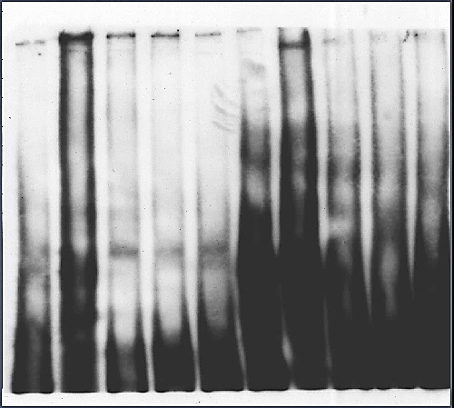
ARBS-1
ARBS-2
ARBS-3
ARBS-4
ARBS-5
ARBS-6
ARBS-7
ARBS-8
Probe
Probe + Protein
Probe
Probe + Protein
Probe
Probe + Protein
Probe
Probe + Protein
Probe
Probe + Protein
Probe
Probe + Protein
Probe
Probe + Protein
Probe
Probe + Protein
Figure S6: Screening of all eight probes for determining the exact binding site for SbASR-1 protein. All probes ARSB-1 and ARBS-8 showed clear shifting of band (denoted with blue arrow) which was absent in the lane containing only probe.

