Slide 1
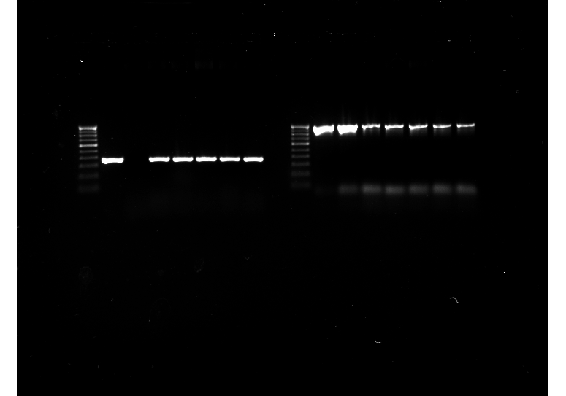
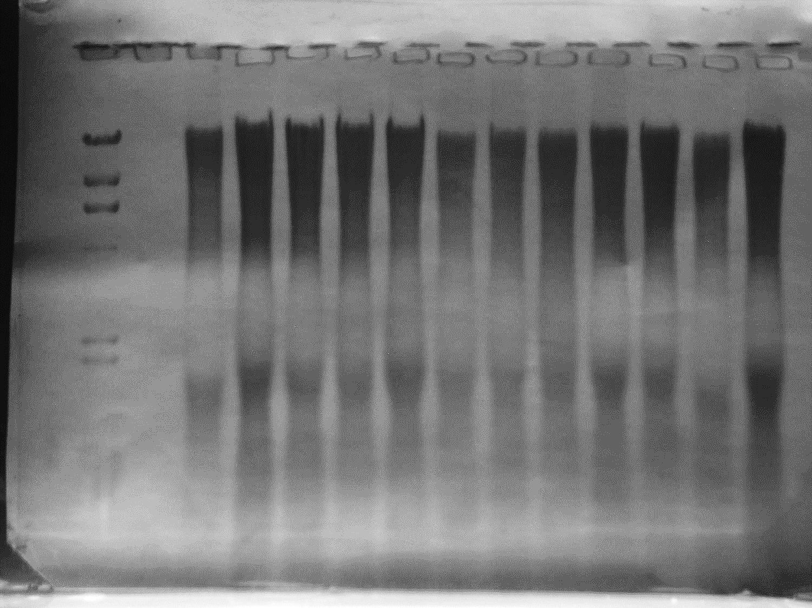
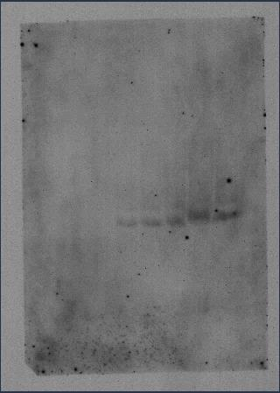
M PC Wt A1 A2 A3 A4 A5
368 bp
PCR
Kb M Wt A1 A2 A3 A4 A5
23.130
9.416
6.557
4.361
2.322
Southern hybridization
Figure S7: Molecular confirmation of putative transgenic lines. Amplification of SbASR-1 gene and Southern hybridization of Wt and different transgenic lines with SbASR-1 specific probe. Lane M: molecular marker, PC: positive control, Wt: wild type plant (non-transformed) and A1-A5: transgenic lines.

