Slide 1
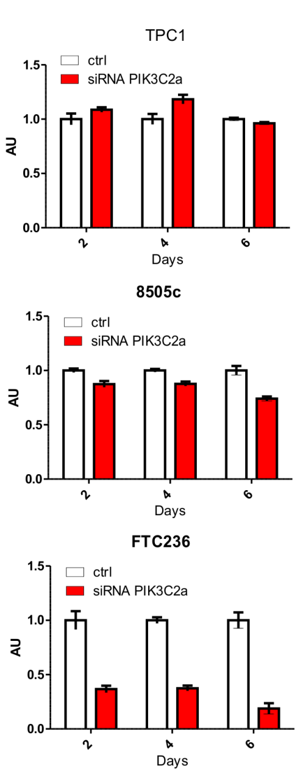







Suppl. Fig. S6 Chew et al
A
C
FTC133
TPC1
8505C
FTC236
PI3KC2α
Tubulin
B
siRNA
no transfection
TGX 100mM
scramble
PI3KC2α
PI3KC2α
1.5 0.2 1 1.4
p-AKT2
(S474)
AKT2
2.3 0.5 1 0.9
p-AKT1
(S473)
AKT1

